Slide 1
Coarse-graining Markov state models with PCCA

Slide 2
Coarse-graining Markov state models
Coarse-graining Markov state models here means
finding a smaller transition matrix that does a similar job as the large original transition matrix.

Slide 3
Coarse-graining Markov state models
Coarse-graining Markov state models here means
finding a smaller transition matrix that does a similar job as the large original transition matrix.
We have already seen eigendecomposition as a way of reducing the dimension of a transition matrix. Let’s take this as our starting point…

Slide 4

The truncated eigendecomposition
The eigendecomposition of $P(τ)$ reads
$$P(τ)=RΛ\left(τ\right)L$$
We have seen that for sufficiently large lag times $τ$, the majority of eigenvalues become almost zero.
We can therefore truncate the matrix $Λ(τ)$.
$$\left(\begin{matrix}1 & 0 & 0 & ⋯ & 0 & 0 \\ 0 & 0.99 & 0 & ⋯ & 0 & 0 \\ 0 & 0 & ⋱ & ⋱ & 0 & 0 \\ ⋮ & ⋮ & ⋱ & ⋱ & 0 & 0 \\ 0 & 0 & 0 & 0 & 0 & 0 \\ 0 & 0 & 0 & 0 & 0 & 0\end{matrix}\right)$$
Delete this and call the reduced matrix $\tilde{Λ}$. We can also ignore the corresponding eigenvectors in $R$, $L$ and call the reduced matrix$\tilde{R}$, $\tilde{L}$.

Slide 5

The truncated eigendecomposition
The eigendecomposition of $P(τ)$ reads
$$P(τ)=RΛ\left(τ\right)L$$
We have seen that for sufficiently large lag times $τ$, the majority of eigenvalues become almost zero.
We can therefore truncate the matrix $Λ(τ)$.
$$\left(\begin{matrix}1 & 0 & 0 & ⋯ & 0 & 0 \\ 0 & 0.99 & 0 & ⋯ & 0 & 0 \\ 0 & 0 & ⋱ & ⋱ & 0 & 0 \\ ⋮ & ⋮ & ⋱ & ⋱ & 0 & 0 \\ 0 & 0 & 0 & 0 & 0 & 0 \\ 0 & 0 & 0 & 0 & 0 & 0\end{matrix}\right)$$
Delete this and call the reduced matrix $\tilde{Λ}$. We can also ignore the corresponding eigenvectors in $R$, $L$ and call the reduced matrix$\tilde{R}$, $\tilde{L}$.

Slide 6
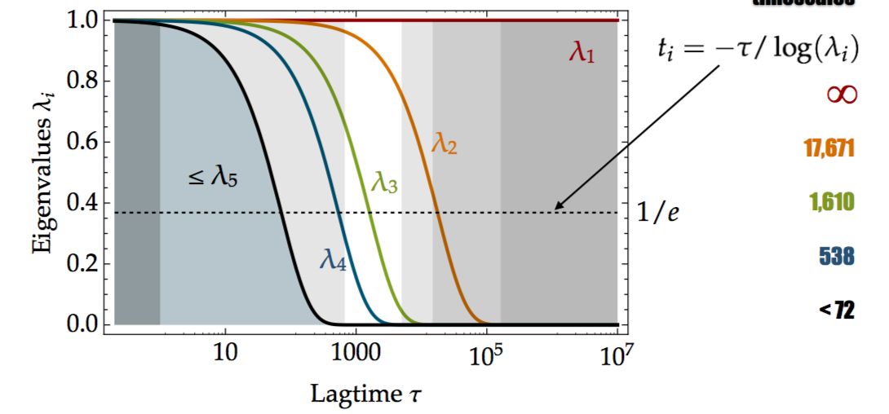
The truncated eigendecomposition
The eigendecomposition of $P(τ)$ reads
$$P(τ)=RΛ\left(τ\right)L$$
We have seen that for sufficiently large lag times $τ$, the majority of eigenvalues become almost zero.
We can therefore truncate the matrix $Λ(τ)$.
$$\left(\begin{matrix}1 & 0 & 0 & ⋯ & 0 & 0 \\ 0 & 0.99 & 0 & ⋯ & 0 & 0 \\ 0 & 0 & ⋱ & ⋱ & 0 & 0 \\ ⋮ & ⋮ & ⋱ & ⋱ & 0 & 0 \\ 0 & 0 & 0 & 0 & 0 & 0 \\ 0 & 0 & 0 & 0 & 0 & 0\end{matrix}\right)$$
Delete this and call the reduced matrix $\tilde{Λ}$. We can also ignore the corresponding eigenvectors in $R$, $L$ and call the reduced matrix$\tilde{R}$, $\tilde{L}$.

Slide 7
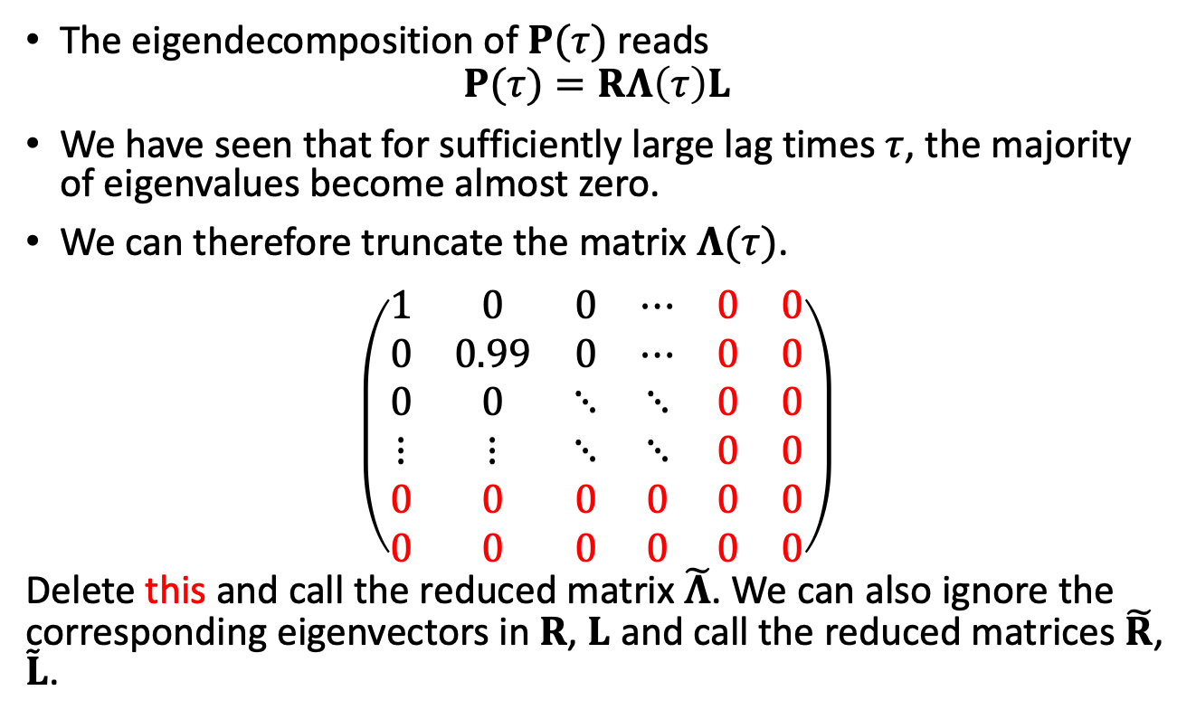
The truncated eigendecomposition
The eigendecomposition of $P(τ)$ reads
$$P(τ)=RΛ\left(τ\right)L$$
We have seen that for sufficiently large lag times $τ$, the majority of eigenvalues become almost zero.
We can therefore truncate the matrix $Λ(τ)$.
$$\left(\begin{matrix}1 & 0 & 0 & ⋯ & 0 & 0 \\ 0 & 0.99 & 0 & ⋯ & 0 & 0 \\ 0 & 0 & ⋱ & ⋱ & 0 & 0 \\ ⋮ & ⋮ & ⋱ & ⋱ & 0 & 0 \\ 0 & 0 & 0 & 0 & 0 & 0 \\ 0 & 0 & 0 & 0 & 0 & 0\end{matrix}\right)$$
Delete this and call the reduced matrix $\tilde{Λ}$. We can also ignore the corresponding eigenvectors in $R$, $L$ and call the reduced matrices$\tilde{R}$, $\tilde{L}$.

Slide 8

The truncated eigendecomposition
We now have $P\left(τ\right)≈\tilde{R}\tilde{Λ}(τ)\tilde{L}$.
And also $P{\left(τ\right)}^{N}≈\tilde{R}{\tilde{Λ}}^{N}(τ)\tilde{L}$ since $\tilde{L}\tilde{R}=Id$.
So did we find what we wanted?
  $\tilde{Λ}(τ)$ replaces $P$ for large $τ$ ✓
  $\tilde{Λ}(τ)$ is a small matrix ✓
  But $\tilde{Λ}(τ)$ is not a transition matrix.
  e.g. $\tilde{Λ}1≠1$
Can we correct the last point?

Slide 9

The truncated eigendecomposition
We now have $P\left(τ\right)≈\tilde{R}\tilde{Λ}(τ)\tilde{L}$.
And also $P{\left(τ\right)}^{N}≈\tilde{R}{\tilde{Λ}}^{N}(τ)\tilde{L}$ since $\tilde{L}\tilde{R}=Id$.
So did we find what we wanted?
  $\tilde{Λ}(τ)$ replaces $P$ for large $τ$ ✓
  $\tilde{Λ}(τ)$ is a small matrix ✓
  But $\tilde{Λ}(τ)$ is not a transition matrix.
  e.g. $\tilde{Λ}1≠1$
Can we correct the last point?

Slide 10
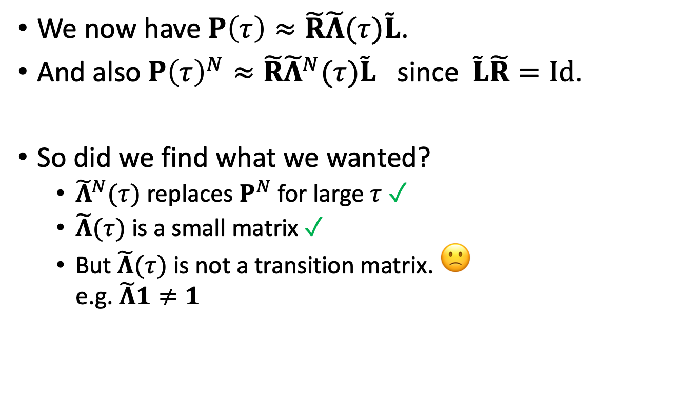
The truncated eigendecomposition
We now have $P\left(τ\right)≈\tilde{R}\tilde{Λ}(τ)\tilde{L}$.
And also $P{\left(τ\right)}^{N}≈\tilde{R}{\tilde{Λ}}^{N}(τ)\tilde{L}$ since $\tilde{L}\tilde{R}=Id$.
So did we find what we wanted?
  ${\tilde{Λ}}^{N}(τ)$ replaces $P^{N}$ for large $τ$ ✓
  $\tilde{Λ}(τ)$ is a small matrix ✓
  But $\tilde{Λ}(τ)$ is not a transition matrix. 🙁
  e.g. $\tilde{Λ}1≠1$
Can we correct the last point?

Slide 11
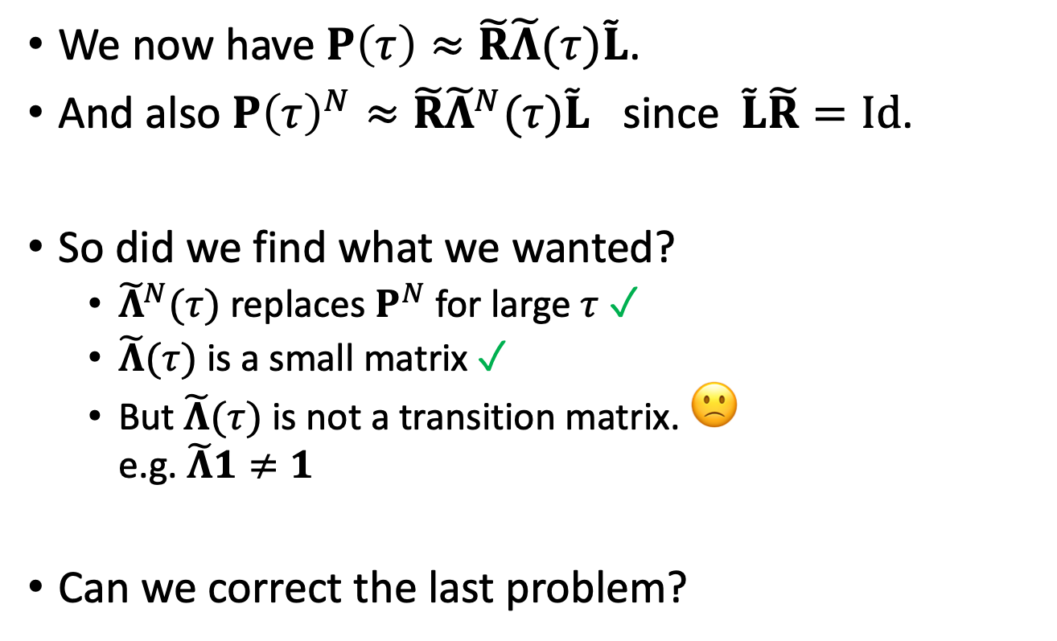
The truncated eigendecomposition
We now have $P\left(τ\right)≈\tilde{R}\tilde{Λ}(τ)\tilde{L}$.
And also $P{\left(τ\right)}^{N}≈\tilde{R}{\tilde{Λ}}^{N}(τ)\tilde{L}$ since $\tilde{L}\tilde{R}=Id$.
So did we find what we wanted?
  ${\tilde{Λ}}^{N}(τ)$ replaces $P^{N}$ for large $τ$ ✓
  $\tilde{Λ}(τ)$ is a small matrix ✓
  But $\tilde{Λ}(τ)$ is not a transition matrix. 🙁
  e.g. $\tilde{Λ}1≠1$
Can we correct the last problem?

Slide 12
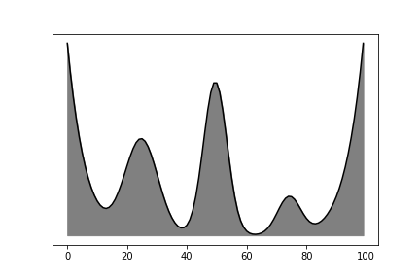
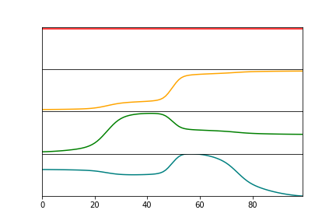

A closer look at the eigenvectors $\tilde{R}$

Slide 13
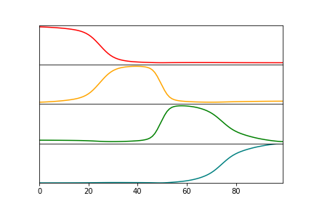

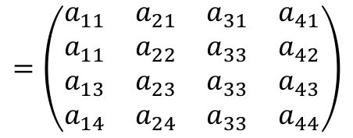
A closer look at the eigenvectors $\tilde{R}$
The dominant eigenvectors can be linearly transformed into indicator functions for the metastable states.
These indicators are called metastable memberships.
$$=\left(\begin{matrix}a_{11} & a_{21} & a_{31} & a_{41} \\ a_{11} & a_{22} & a_{33} & a_{42} \\ a_{13} & a_{23} & a_{33} & a_{43} \\ a_{14} & a_{24} & a_{33} & a_{44}\end{matrix}\right)$$
$χ^{T}$ $=$ $A^{T}$ ${\tilde{R}}^{T}$

Slide 14

Coarse-graining with PCCA
Use eigendecomposition and insert ${AA}^{−1}$:
$$P=\tilde{R}Λ\left(τ\right)\tilde{L}=\tilde{R}A A^{−1}Λ\left(τ\right)A A^{−1}\tilde{L}$$
We have $P^{N}=\tilde{R}AP_{C}^{N}A^{−1}\tilde{L}$
Are we done now?
  $P_{C}$ replaces $P$ for large $τ$ ✓ Same eigenvalue as $P$ ✓
  $P_{C}$ is a small matrix ✓
  $P_{C}1=1$ (without proof) ✓
  $P_{C}$ can be interpreted as the transition matrix between the metastable states. ✓
  $P_{C}$ is a Koopman matrix. (without proof) ✓
  $P_{C}≱0$

Slide 15

Coarse-graining with PCCA
Use eigendecomposition and insert ${AA}^{−1}$:
$$P=\tilde{R}Λ\left(τ\right)\tilde{L}=\tilde{R}A A^{−1}Λ\left(τ\right)A A^{−1}\tilde{L}$$
We have $P^{N}=\tilde{R}AP_{C}^{N}A^{−1}\tilde{L}$
Are we done now?
  $P_{C}$ replaces $P$ for large $τ$ ✓ Same eigenvalue as $P$ ✓
  $P_{C}$ is a small matrix ✓
  $P_{C}1=1$ (without proof) ✓
  $P_{C}$ can be interpreted as the transition matrix between the metastable states. ✓
  $P_{C}$ is a Koopman matrix. (without proof) ✓
  $P_{C}≱0$

Slide 16

Coarse-graining with PCCA
Use eigendecomposition and insert ${AA}^{−1}$:
$$P=\tilde{R}Λ\left(τ\right)\tilde{L}=\tilde{R}A A^{−1}Λ\left(τ\right)A A^{−1}\tilde{L}$$
We have $P^{N}=\tilde{R}AP_{C}^{N}A^{−1}\tilde{L}$
Are we done now?
  $P_{C}$ replaces $P$ for large $τ$ ✓ Same eigenvalue as $P$ ✓
  $P_{C}$ is a small matrix ✓
  $P_{C}1=1$ (without proof) ✓
  $P_{C}$ can be interpreted as the transition matrix between the metastable states. ✓
  $P_{C}$ is a Koopman matrix. (without proof) ✓
  $P_{C}≱0$
$$P_{C}$$

Slide 17

Coarse-graining with PCCA
Use eigendecomposition and insert ${AA}^{−1}$:
$$P=\tilde{R}Λ\left(τ\right)\tilde{L}=\tilde{R}A A^{−1}Λ\left(τ\right)A A^{−1}\tilde{L}$$
We have $P^{N}=\tilde{R}AP_{C}^{N}A^{−1}\tilde{L}$
Are we done now?
  $P_{C}$ replaces $P$ for large $τ$ ✓ Same eigenvalue as $P$ ✓
  $P_{C}$ is a small matrix ✓
  $P_{C}1=1$ (without proof) ✓
  $P_{C}$ can be interpreted as the transition matrix between the metastable states. ✓
  $P_{C}$ is a Koopman matrix. (without proof) ✓
  $P_{C}≱0$
$$P_{C}$$

Slide 18
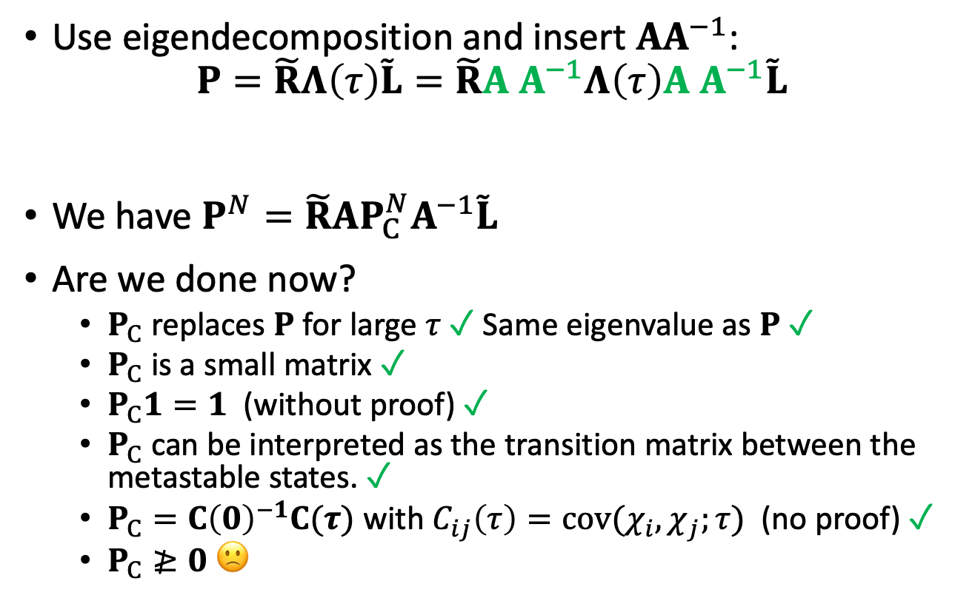
Coarse-graining with PCCA
Use eigendecomposition and insert ${AA}^{−1}$:
$$P=\tilde{R}Λ\left(τ\right)\tilde{L}=\tilde{R}A A^{−1}Λ\left(τ\right)A A^{−1}\tilde{L}$$
We have $P^{N}=\tilde{R}AP_{C}^{N}A^{−1}\tilde{L}$
Are we done now?
  $P_{C}$ replaces $P$ for large $τ$ ✓ Same eigenvalue as $P$ ✓
  $P_{C}$ is a small matrix ✓
  $P_{C}1=1$ (without proof) ✓
  $P_{C}$ can be interpreted as the transition matrix between the metastable states. ✓
  $P_{C}=C{\left(0\right)}^{−1}C(τ)$ with $C_{ij}\left(τ\right)=cov(χ_{i},χ_{j};τ)$ (no proof) ✓
  $P_{C}≱0$ 🙁
$$P_{C}$$

Slide 19
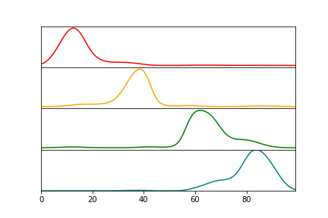
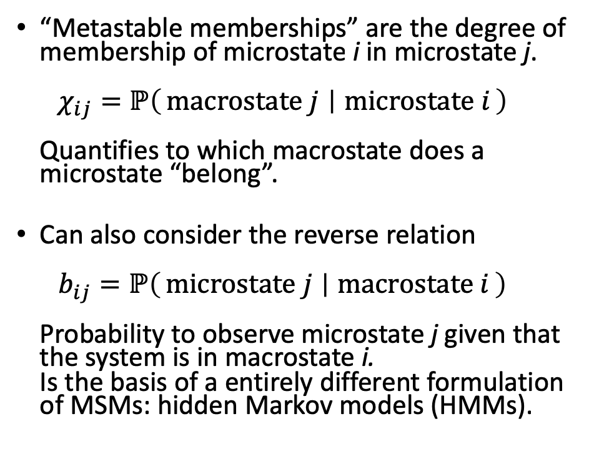
Connection to HMMs (Simon‘s talk)
metastable_memberships
“Metastable memberships” are the degree of membership of microstate i in microstate j.
$χ_{ij}=ℙ\left(macrostate j ∣ microstate i\right)$
Quantifies to which macrostate does a microstate “belong”.
Can also consider the reverse relation
$b_{ij}=ℙ\left(microstate j ∣ macrostate i\right)$
Probability to observe microstate j given that the system is in macrostate i.
Is the basis of a entirely different formulation of MSMs: hidden Markov models (HMMs).
metastable_distributions

Slide 20
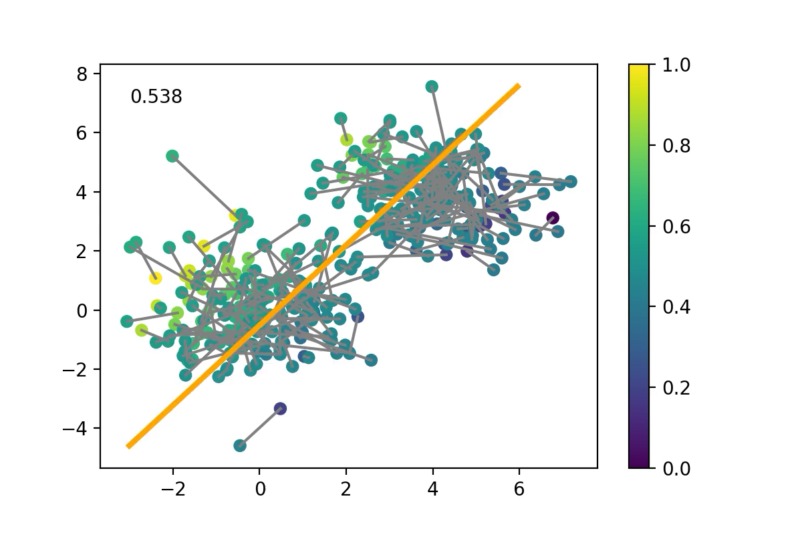
Connection to VAMPnets
Soft-max VAMPnets fit indicator functions directly to the transition pairs.
The indicator functions are modelled as sigmoids.

Slide 21
Finding the metastable memberships

Slide 22
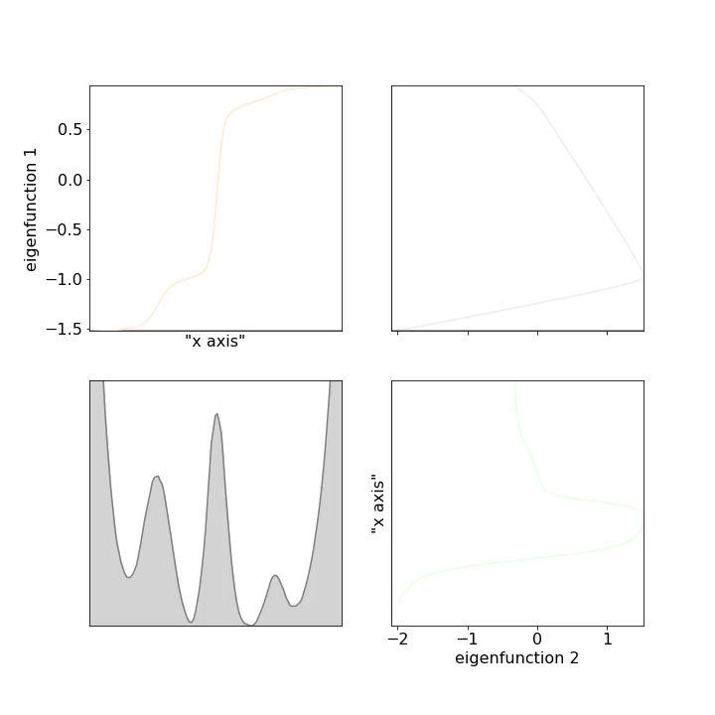
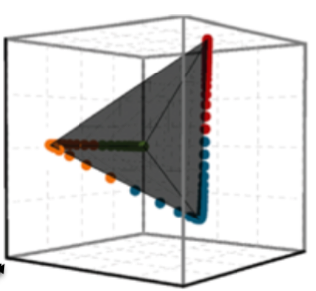
Finding the metastable memberships

Slide 23
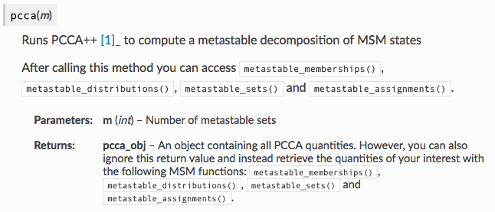
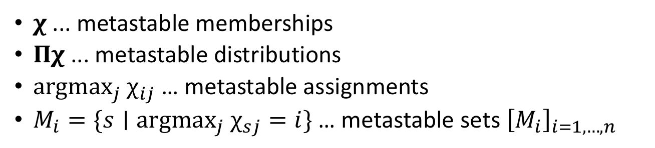
PCCA in PyEmma
$χ$ ... metastable memberships
$Πχ$ ... metastable distributions
$argmax_{j} χ_{ij}$ … metastable assignments
$M_{i}=\{s∣argmax_{j} χ_{sj}=i\}$ … metastable sets ${\left[M_{i}\right]}_{i=1,…,n}$

Slide 24
Further reading
Susanna Röblitz, Marcus Weber, “Fuzzy spectral clustering by PCCA+: application to Markov state models and data classification”, Advances in Data Analysis and Classification, 7, 147 (2013)
Marcus Weber, Konstantin Fackeldey, "G-PCCA: Spectral Clustering for Non-reversible Markov Chains", Konrad-Zuse-Zentrum für Informationstechnik Berlin, ZIB-Report 15-35 (2015)

Slide 25
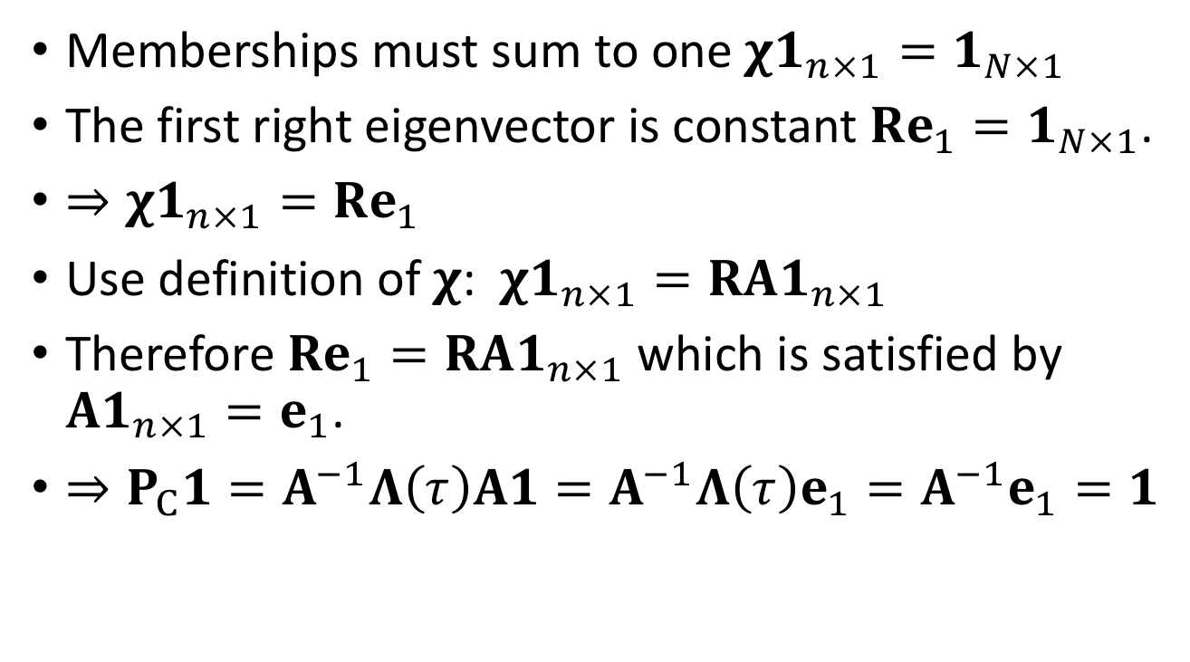

Appendix: Proof that $P_{C}1=1$
Memberships must sum to one $χ1_{n×1}=1_{N×1}$
The first right eigenvector is constant $Re_{1}=1_{N×1}$.
$⇒χ1_{n×1}=Re_{1}$
Use definition of $χ$: $χ1_{n×1}=RA1_{n×1}$
Therefore $Re_{1}=RA1_{n×1}$ which is satisfied by $A1_{n×1}=e_{1}$.
$⇒P_{C}1=A^{−1}Λ\left(τ\right)A1=A^{−1}Λ\left(τ\right)e_{1}=A^{−1}e_{1}=1$

Slide 26
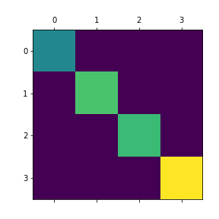
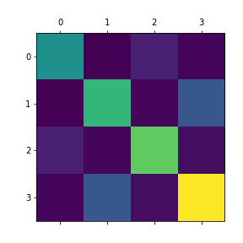


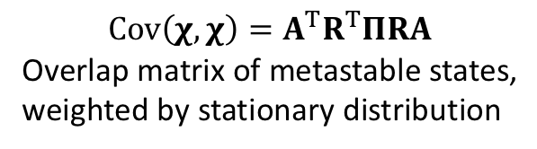

Appendix: Computing A
$$Π_{C}=diag(A^{T}R^{T}π)$$
Stationary weight of the metastable states
Inserted into the diagonal of a matrix.
$$Cov\left(χ,χ\right)=A^{T}R^{T}ΠRA$$
Overlap matrix of metastable states,
weighted by stationary distribution
$$≈$$
$tr(Π_{C}^{−1}A^{T}R^{T}ΠRA)→$ min

Slide 27
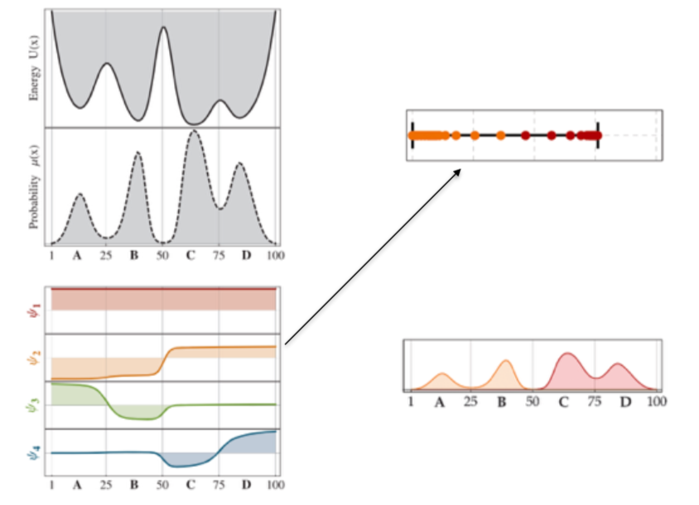

Slide 28
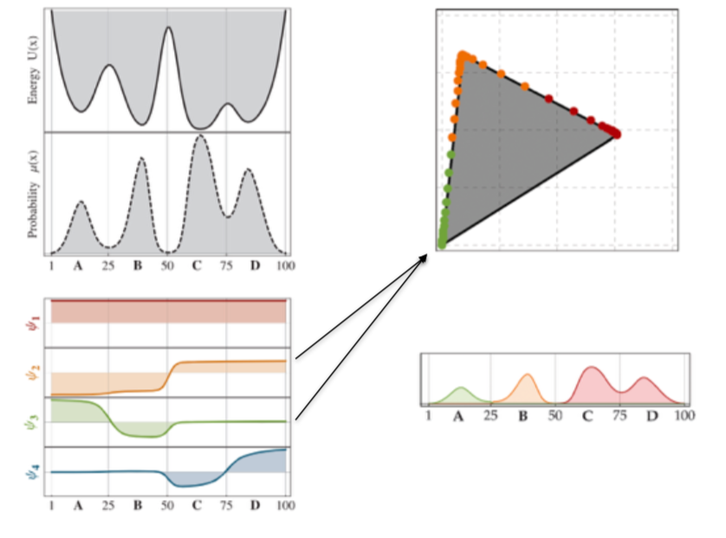

Slide 29
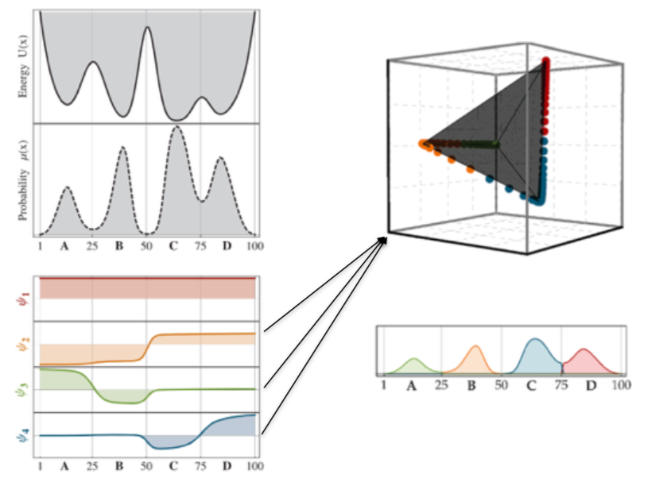

Slide 30
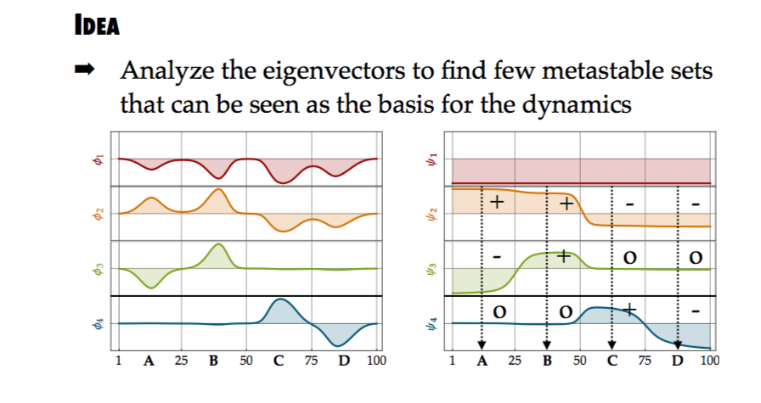

Slide 31
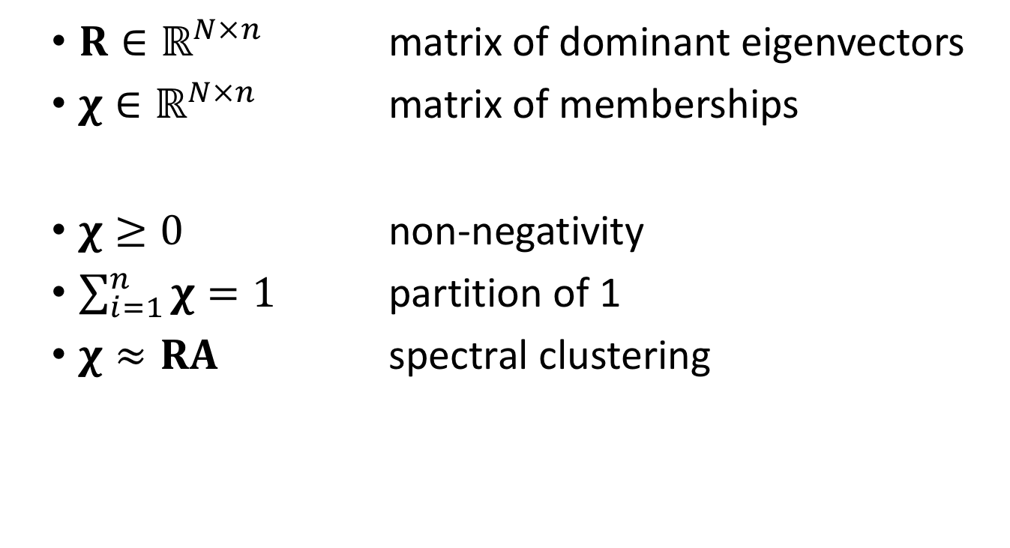
$R∈ℝ^{N×n}$ matrix of dominant eigenvectors
$χ∈ℝ^{N×n}$ matrix of memberships
$χ≥0$ non-negativity
$\sum_{i=1}^{n}{χ}=1$ partition of 1
$χ≈RA$ spectral clustering

