Slide 1
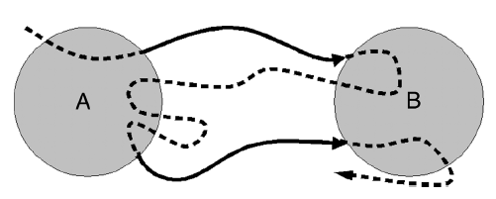
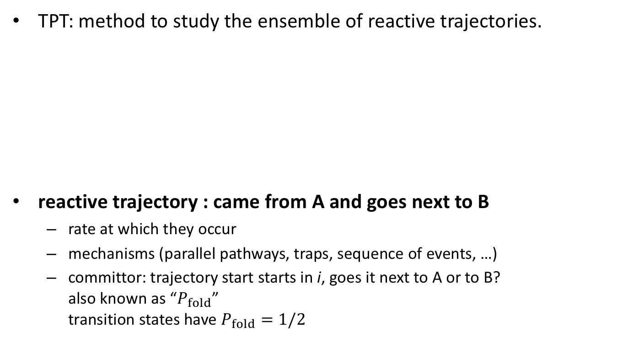
Transition Path Theory
TPT: method to study the ensemble of reactive trajectories.
reactive trajectory : came from A and goes next to B
  rate at which they occur
  mechanisms (parallel pathways, traps, sequence of events, …)
  committor: trajectory start starts in i, goes it next to A or to B?
  also known as “$P_{fold}$”
  transition states have $P_{fold}=1/2$
Notes:
Ganz witchtig: ensemble von Reaktiven Pfaden

Slide 2
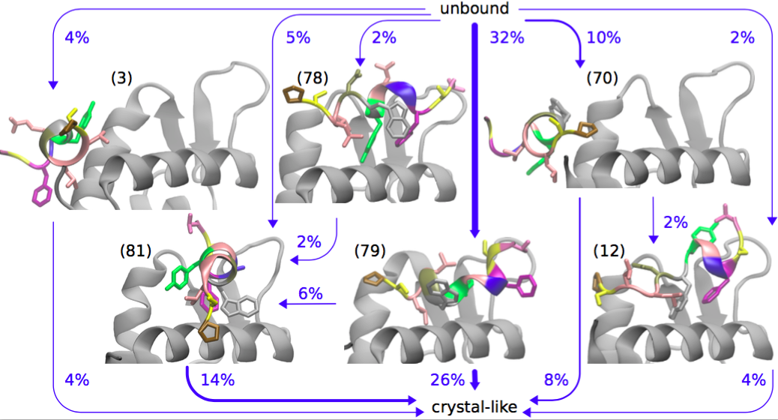
Transition Path Theory: application
Paul et al., Nat. Commun. 8, 1095 (2017)

Slide 3
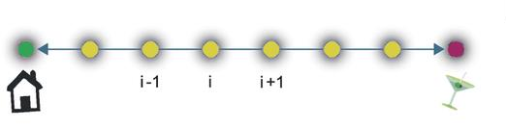
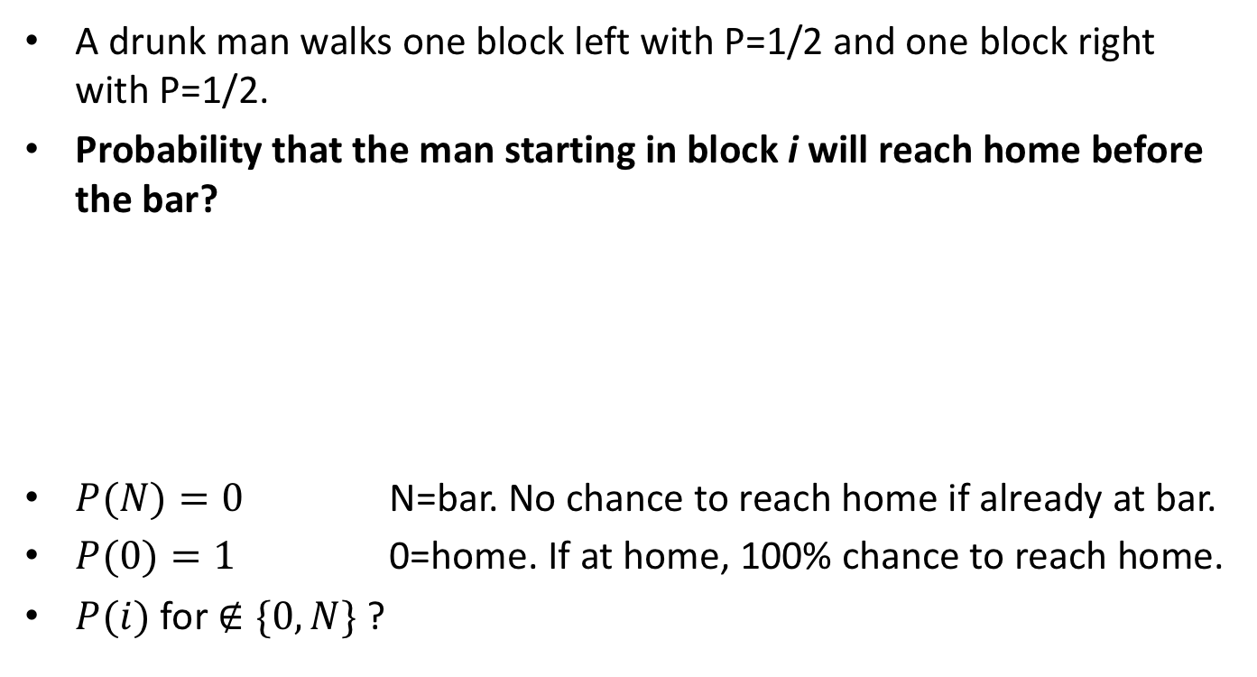
The committor
A drunk man walks one block left with P=1/2 and one block right with P=1/2.
Probability that the man starting in block i will reach home before the bar?
$P(N)=0$ N=bar. No chance to reach home if already at bar.
$P(0)=1$ 0=home. If at home, 100% chance to reach home.
$P(i)$ for $∉\{0,N\}$ ?
0 i-1 i i+1 N
Doyle, Snell, Random Walks and Electric Networks, Carus (1984)
Image: Valleriani, Nat. Scientific Reports 5, 17986 (2015).

Slide 4

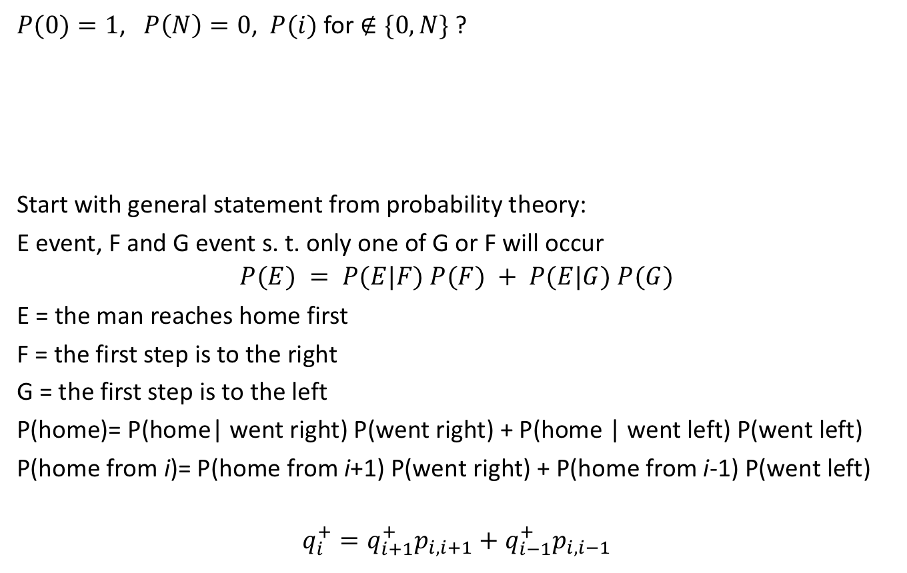
The committor $q_{i}^{+}$
$P(0)=1$, $P\left(N\right)=0$, $P(i)$ for $∉\{0,N\}$ ?
Start with general statement from probability theory:
E event, F and G event s. t. only one of G or F will occur
$$P(E) = P(E|F) P(F) + P(E|G) P(G)$$
E = the man reaches home first
F = the first step is to the right
G = the first step is to the left
P(home)= P(home| went right) P(went right) + P(home | went left) P(went left)
P(home from i)= P(home from i+1) P(went right) + P(home from i-1) P(went left)
$$q_{i}^{+}=q_{i+1}^{+}p_{i,i+1}+q_{i−1}^{+}p_{i,i−1}$$
0 i-1 i i+1 N

Slide 5
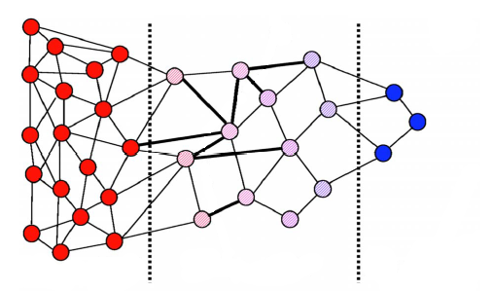
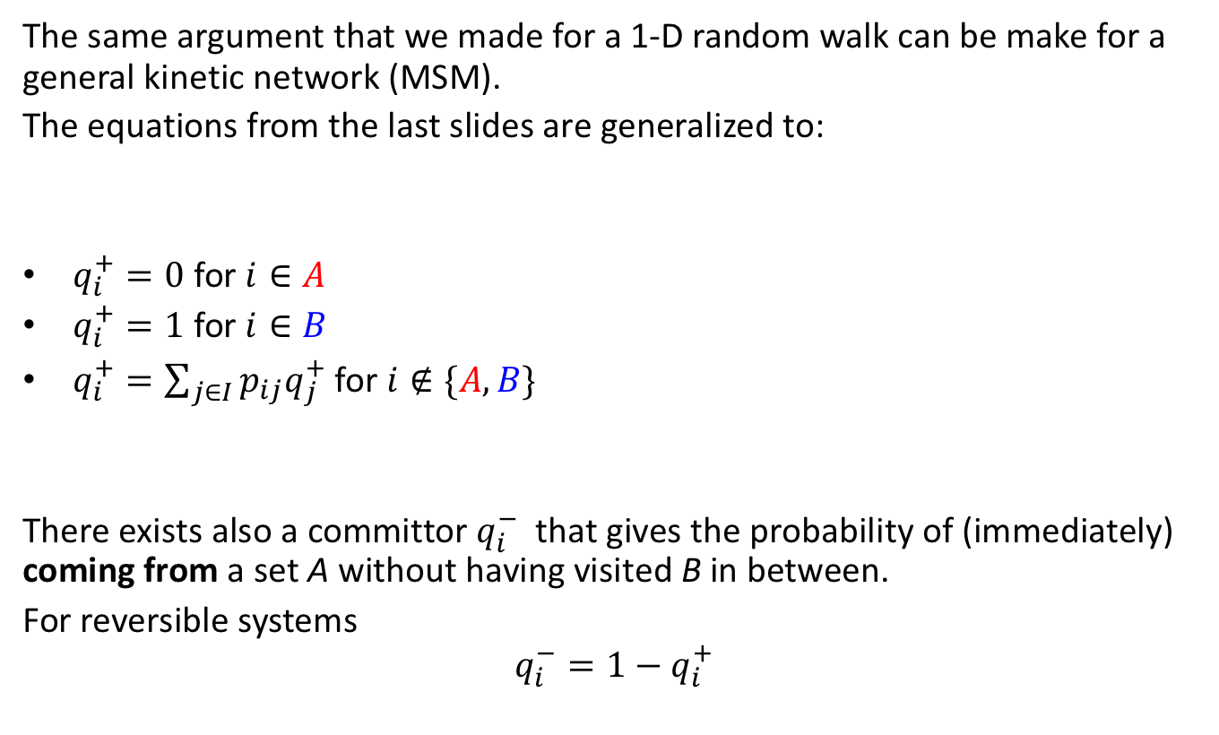



The committor $q_{i}^{+}$
The same argument that we made for a 1-D random walk can be make for a general kinetic network (MSM).
The equations from the last slides are generalized to:
$q_{i}^{+}=0$ for $i∈A$
$q_{i}^{+}=1$ for $i∈B$
$q_{i}^{+}=\sum_{j∈I}{p_{ij}q_{j}^{+}}$ for $i∉\{A,B\}$
There exists also a committor $q_{i}^{−}$ that gives the probability of (immediately) coming from a set A without having visited B in between.
For reversible systems
$$q_{i}^{−}=1−q_{i}^{+}$$
$$q^{+}=0$$
$$0<q^{+}<1$$
$$q^{+}=1$$

Slide 6
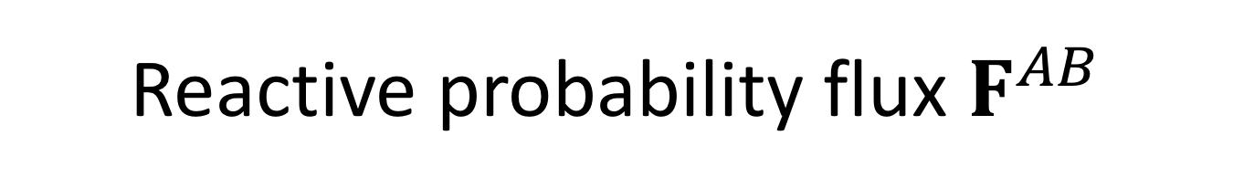
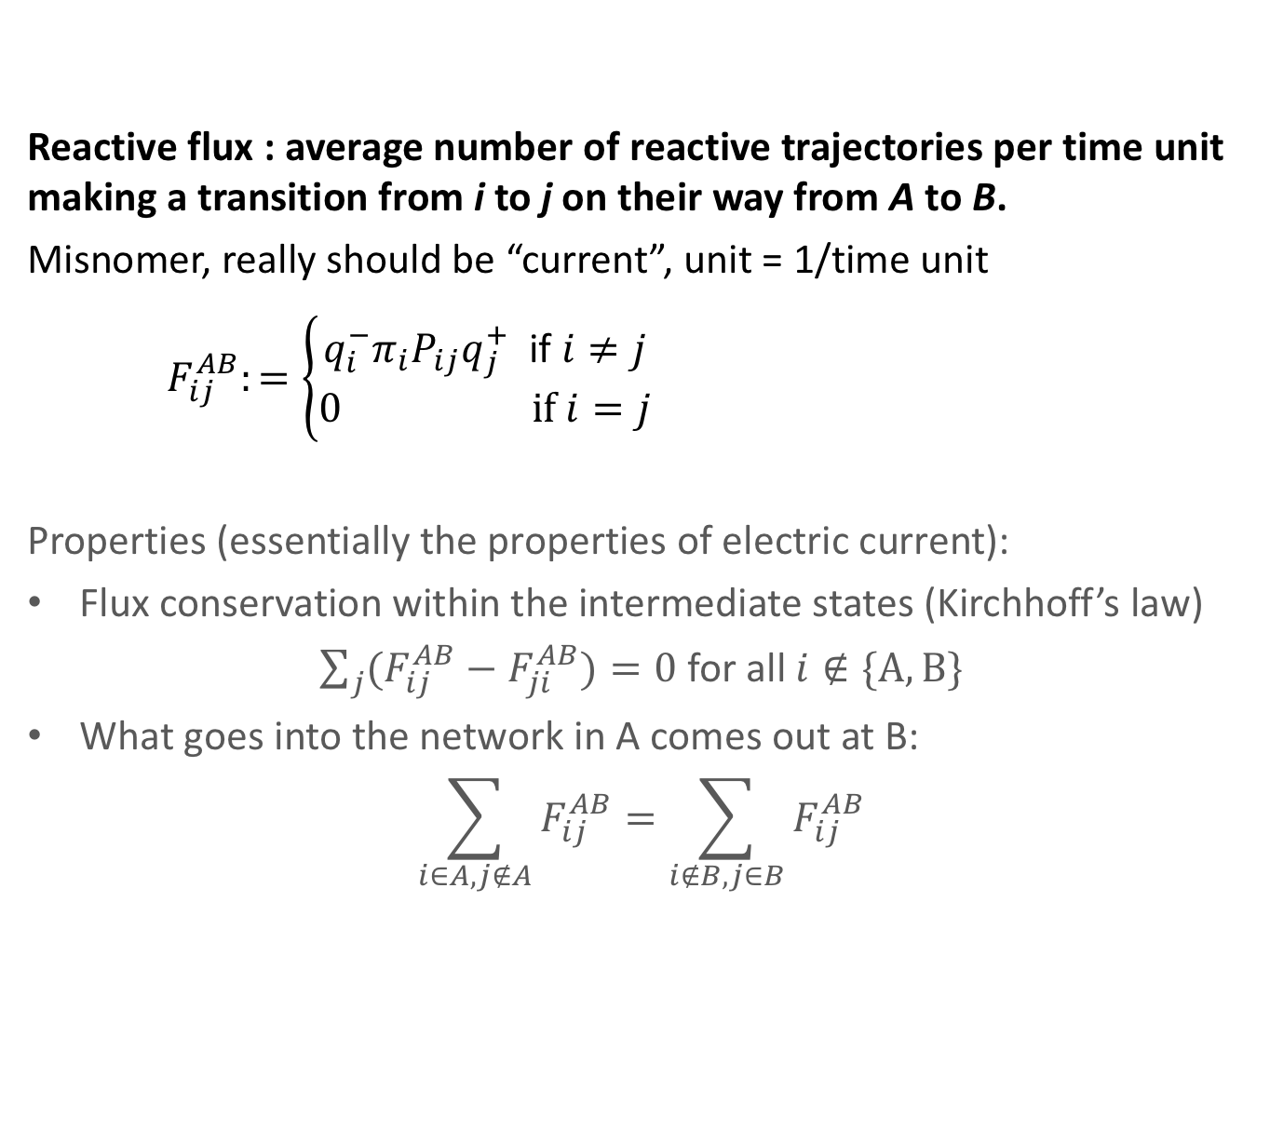
Reactive probability flux $F^{AB}$
Reactive flux : average number of reactive trajectories per time unit making a transition from i to j on their way from A to B.
Misnomer, really should be “current”, unit = 1/time unit
$F_{ij}^{AB}:=\left\{\begin{aligned}{q_{i}^{−}π}_{i}P_{ij}q_{j}^{+} \text{if} i≠j \\ 0 if i=j\end{aligned}\right.$
Properties (essentially the properties of electric current):
Flux conservation within the intermediate states (Kirchhoff’s law)
$\sum_{j}{(F_{ij}^{AB}−F_{ji}^{AB})}=0$ for all $i∉\{A,B\}$
What goes into the network in A comes out at B:
$\sum_{i∈A,j∉A}{F_{ij}^{AB}}=\sum_{i∉B,j∈B}{F_{ij}^{AB}}$
i
j

Slide 7
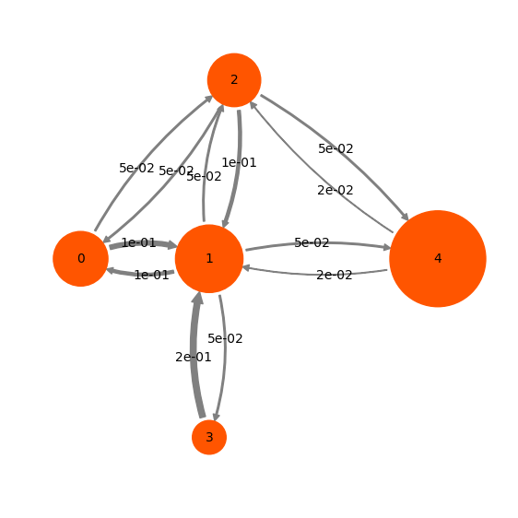
Example
transition probabilities:

Slide 8
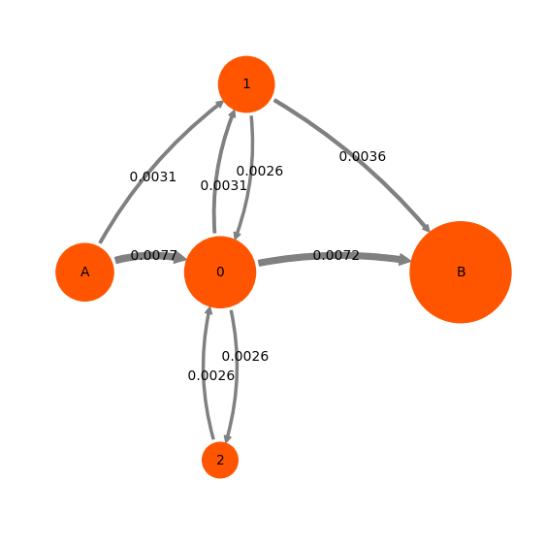
Example
reactive gross flux:
0.0031 + 0.0077 = 0.0108 = 0.0036 + 0.0072

Slide 9
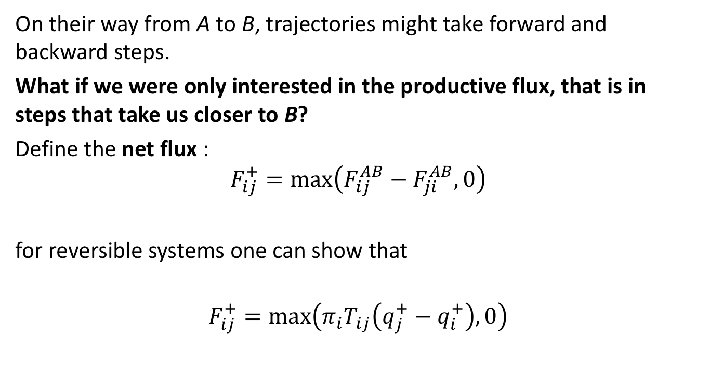
Gross flux vs. Net flux
On their way from A to B, trajectories might take forward and backward steps.
What if we were only interested in the productive flux, that is in steps that take us closer to B?
Define the net flux :
$$F_{ij}^{+}=\max\left(F_{ij}^{AB}−F_{ji}^{AB},0\right)$$
for reversible systems one can show that
$$F_{ij}^{+}=\max\left(π_{i}T_{ij}\left(q_{j}^{+}−q_{i}^{+}\right),0\right)$$
Notes:
Net flux corresponds to electrical current. Ohm‘s law applies to the net flux
only \neq 0, if target state i has a higher probability to commit than

Slide 10
Example
reactive gross flux:

Slide 11
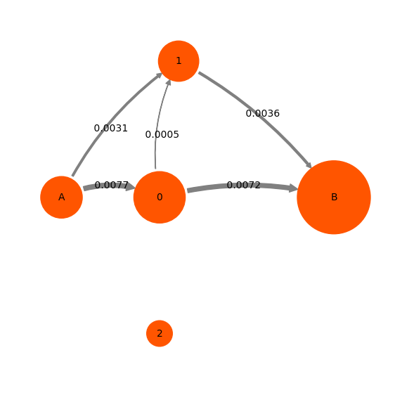
Example
reactive net flux:

Slide 12
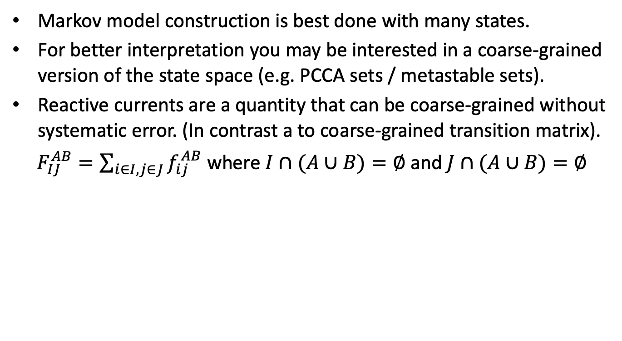
Coarse-graining of fluxes
Markov model construction is best done with many states.
For better interpretation you may be interested in a coarse-grained version of the state space (e.g. PCCA sets / metastable sets).
Reactive currents are a quantity that can be coarse-grained without systematic error. (In contrast a to coarse-grained transition matrix).
$F_{IJ}^{AB}=\sum_{i∈I,j∈J}{f_{ij}^{AB}}$ where $I∩(A∪B)=∅$ and $J∩(A∪B)=∅$
+
+

Slide 13

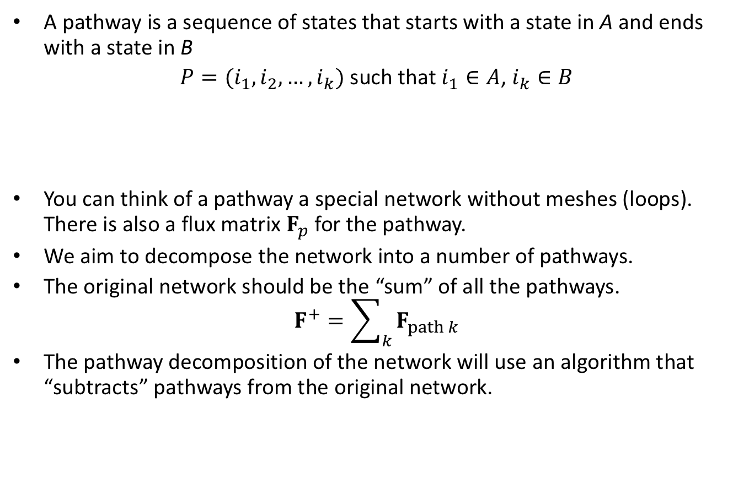
Pathway decomposition
A pathway is a sequence of states that starts with a state in A and ends with a state in B
$P=(i_{1},i_{2},…, i_{k})$ such that $i_{1}∈A$, $i_{k}∈B$
You can think of a pathway a special network without meshes (loops). There is also a flux matrix $F_{p}$ for the pathway.
We aim to decompose the network into a number of pathways.
The original network should be the “sum” of all the pathways.
$F^{+}=\sum_{k}{F_{path k}}$
The pathway decomposition of the network will use an algorithm that “subtracts” pathways from the original network.

Slide 14
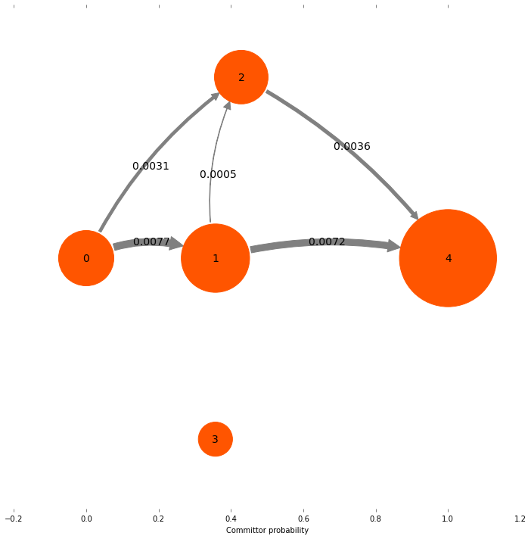
Example

Slide 15
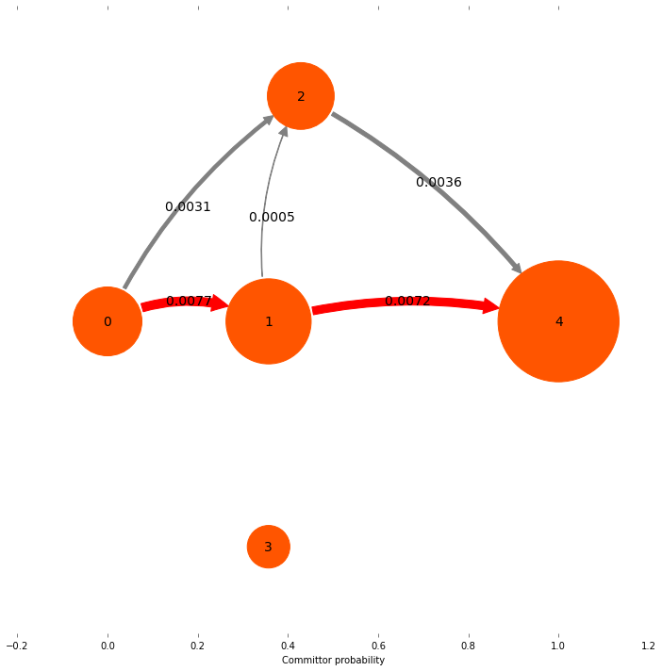
Example

Slide 16
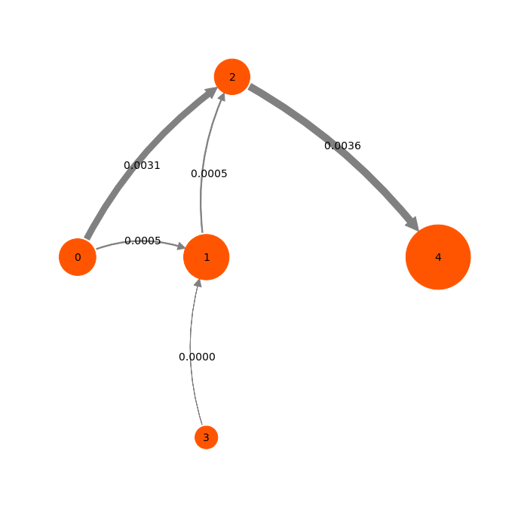
Example

Slide 17
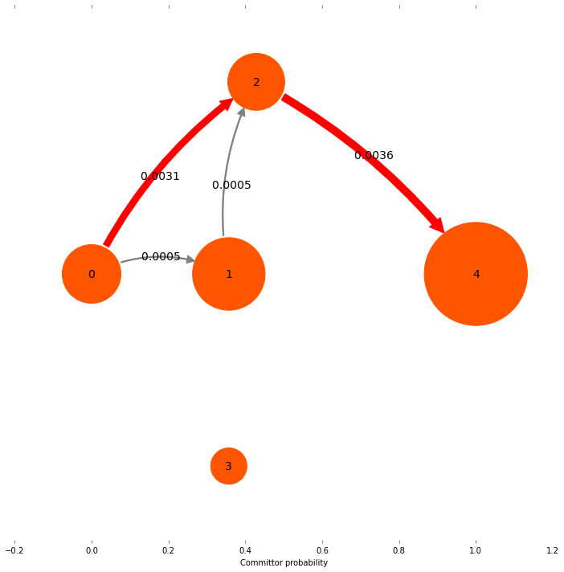
Example

Slide 18
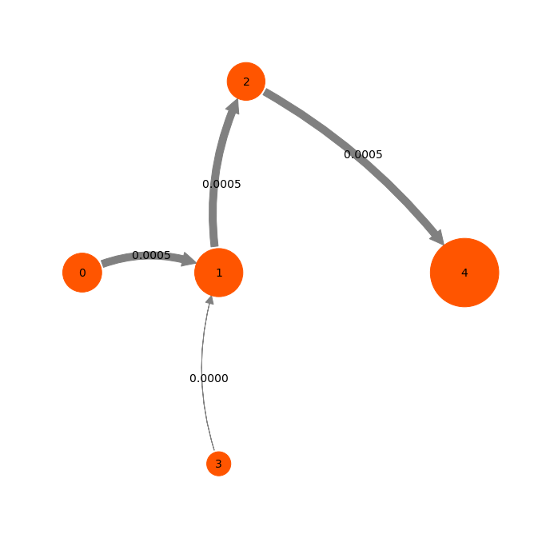
Example

Slide 19
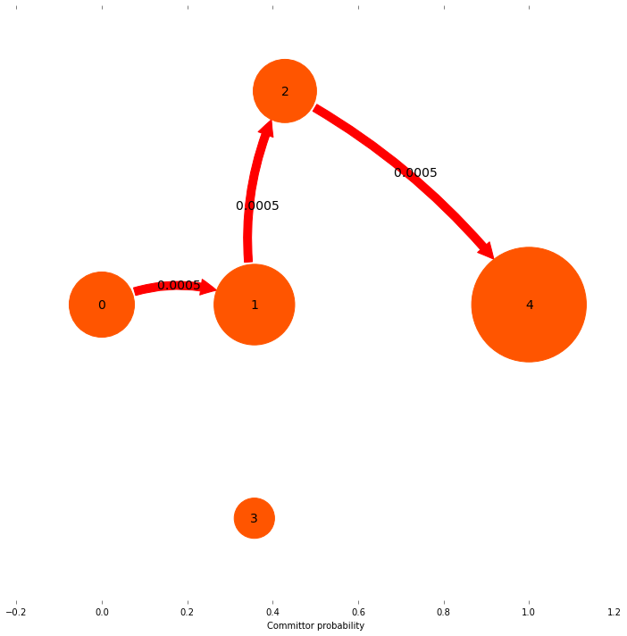
Example

Slide 20
Further reading
F. Noé, C. Schütte, E. Vanden-Eijnden, L. Reich, T. Weikl: “Constructing the Full Ensemble of Folding Pathways from Short Off-Equilibrium Simulations”.
P. Metzner, C. Schütte, and E. Vanden-Eijnden: “Transition Path Theory for Markov Jump Processes”. Mult. Mod. Sim. (2007)

Slide 21
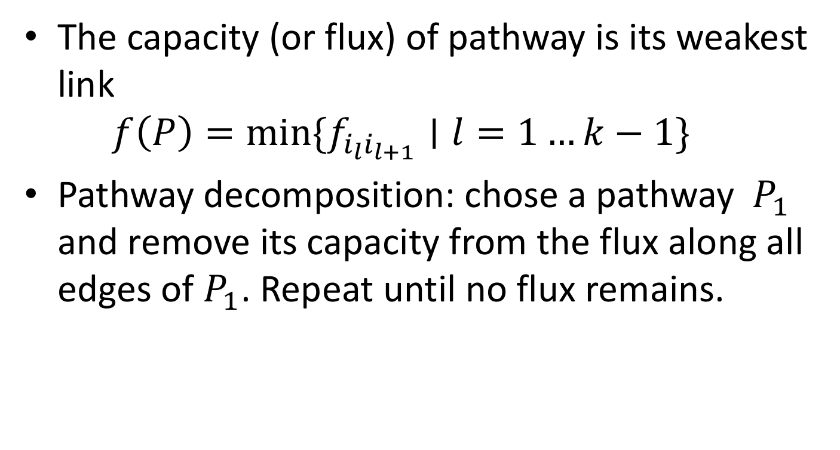
The capacity (or flux) of pathway is its weakest link
$f\left(P\right)=\min{\{f_{i_{l}i_{l+1}}∣l=1…k−1\}}$
Pathway decomposition: chose a pathway $P_{1}$ and remove its capacity from the flux along all edges of $P_{1}$. Repeat until no flux remains.

Slide 22
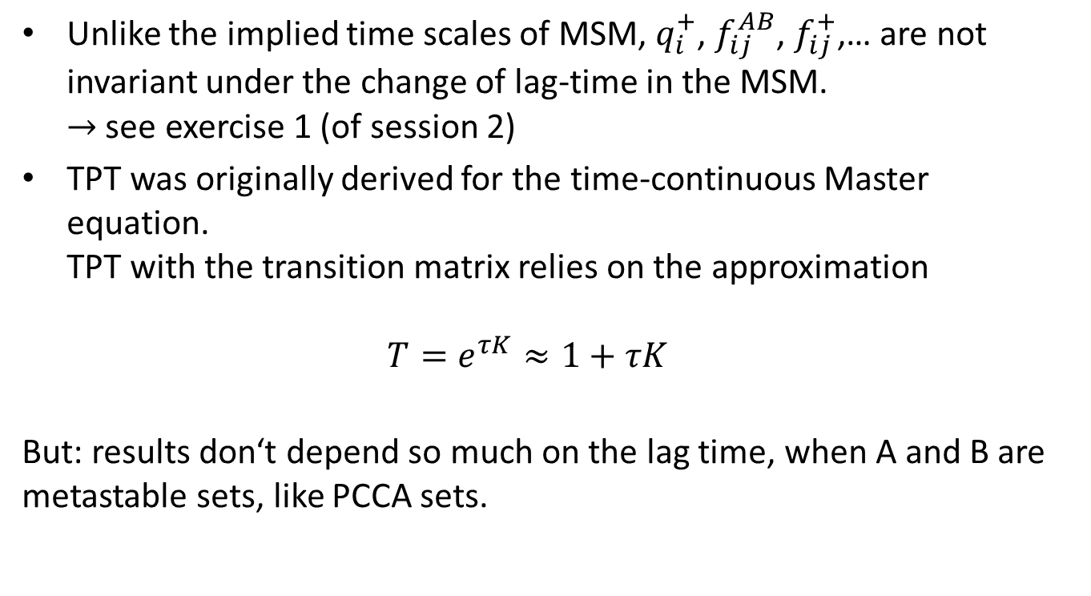
Words of caution
Unlike the implied time scales of MSM, $q_{i}^{+}$, $f_{ij}^{AB}$, $f_{ij}^{+}$,… are not invariant under the change of lag-time in the MSM.
$→$ see exercise 1 (of session 2)
TPT was originally derived for the time-continuous Master equation.
TPT with the transition matrix relies on the approximation
$T=e^{τK}≈1+τK$
But: results don‘t depend so much on the lag time, when A and B are metastable sets, like PCCA sets.

Slide 23







example
$T=\left(\begin{matrix}0.5 & 0.5 & 0 \\ 0.1 & 0 & 0.9 \\ 0 & 0.5 & 0.5\end{matrix}\right)$ $q^{+}=\left(\begin{matrix}0 \\ 0.9 \\ 1.0\end{matrix}\right)$
$T=\left(\begin{matrix}0.5 & 0.5 & 0 \\ 0.5 & 0 & 0.5 \\ 0 & 0.5 & 0.5\end{matrix}\right)$ $q^{+}=\left(\begin{matrix}0 \\ 0.5 \\ 1.0\end{matrix}\right)$
$$0.5$$
0.9
0
1
2
$$0.1$$
$$0.5$$
$q^{+}=0$ $q^{+}=0.9$ $q^{+}=1.0$
$$0.5$$
0.5
0
1
2
$$0.5$$
$$0.5$$
$q^{+}=0$ $q^{+}=0.5$ $q^{+}=1.0$

Slide 24
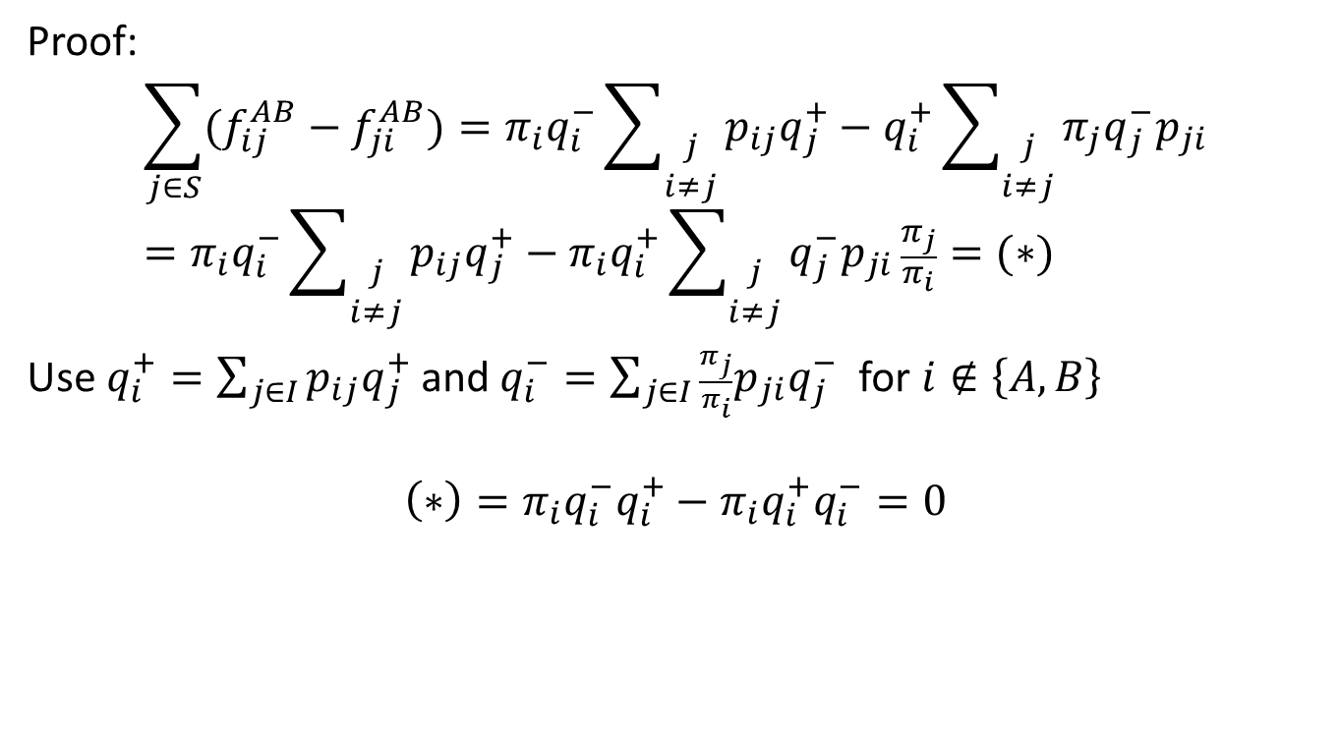
Properties of reactive flux
Proof:
$$\sum_{j∈S}{(f_{ij}^{AB}−f_{ji}^{AB})}=π_{i}q_{i}^{−}\sum_{\begin{matrix}j \\ i≠j\end{matrix}}{p_{ij}q_{j}^{+}}−q_{i}^{+}\sum_{\begin{matrix}j \\ i≠j\end{matrix}}{π_{j}q_{j}^{−}p_{ji}} \\ =π_{i}q_{i}^{−}\sum_{\begin{matrix}j \\ i≠j\end{matrix}}{p_{ij}q_{j}^{+}}−π_{i}q_{i}^{+}\sum_{\begin{matrix}j \\ i≠j\end{matrix}}{q_{j}^{−}p_{ji}}\frac{π_{j}}{π_{i}}=(∗)$$
Use $q_{i}^{+}=\sum_{j∈I}{p_{ij}q_{j}^{+}}$ and $q_{i}^{−}=\sum_{j∈I}{\frac{π_{j}}{π_{i}}p_{ji}q_{j}^{−}}$ for $i∉\left\{A,B\right\}$
$$\left(∗\right)=π_{i}q_{i}^{−}q_{i}^{+}−π_{i}q_{i}^{+}q_{i}^{−}=0$$

Slide 25
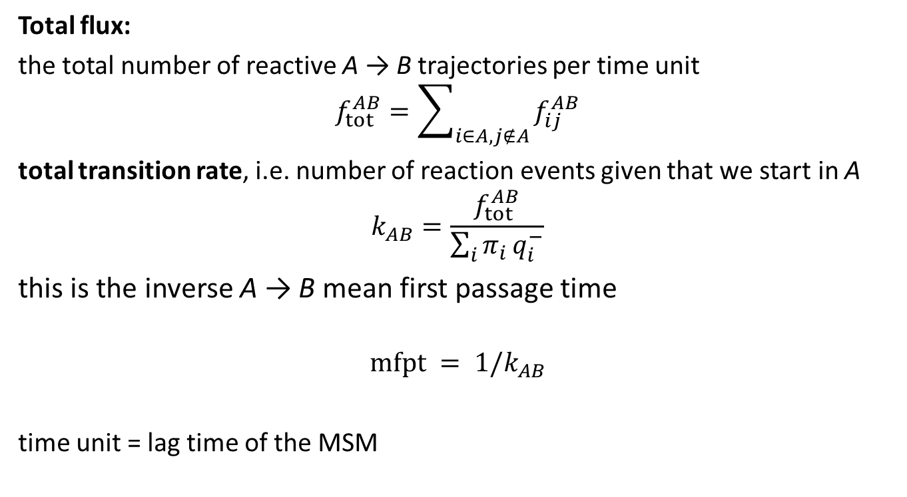
Total flux and MFPT
Total flux:
the total number of reactive A → B trajectories per time unit
$$f_{tot}^{AB}=\sum_{i∈A,j∉A}{f_{ij}^{AB}}$$
total transition rate, i.e. number of reaction events given that we start in A
$$k_{AB}=\frac{f_{tot}^{AB}}{\sum_{i}{π_{i}}q_{i}^{−}}$$
this is the inverse A → B mean first passage time
$$mfpt = 1/k_{AB}$$
time unit = lag time of the MSM
Notes:
Flux of red arrows

Slide 26
outline
Committor
Reactive flux
Gross flux vs. Net flux
Pathway decomposition
A word of caution

Slide 27
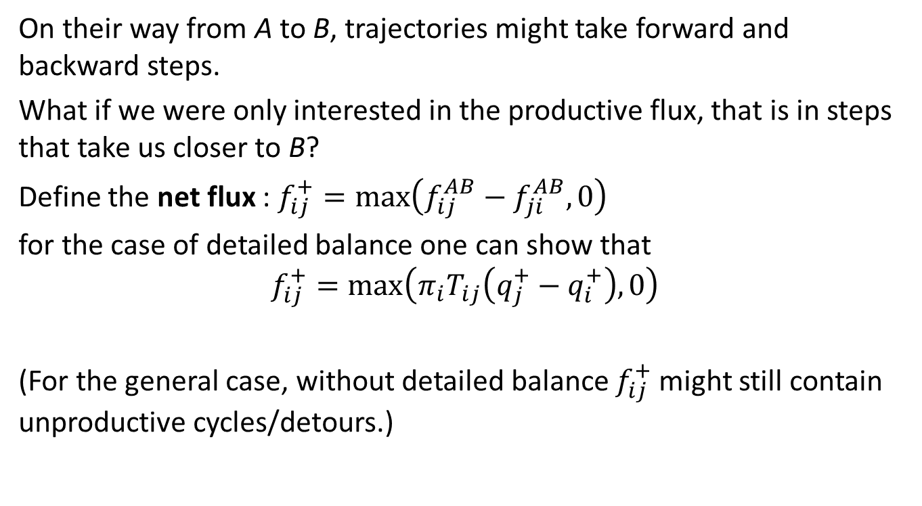
Gross flux vs. Net flux
On their way from A to B, trajectories might take forward and backward steps.
What if we were only interested in the productive flux, that is in steps that take us closer to B?
Define the net flux : $f_{ij}^{+}=\max\left(f_{ij}^{AB}−f_{ji}^{AB},0\right)$
for the case of detailed balance one can show that
$$f_{ij}^{+}=\max\left(π_{i}T_{ij}\left(q_{j}^{+}−q_{i}^{+}\right),0\right)$$
(For the general case, without detailed balance $f_{ij}^{+}$might still contain unproductive cycles/detours.)
Notes:
Net flux corresponds to electrical current. Ohm‘s law applies to the net flux.

Slide 28
Transition Path Theory
Computer tutorial in Markov modeling (PyEMMA)
20.2.2018
Fabian Paul
Notes:
250ns
time step orig 250 ps
subs 2.5 ns
length 100k frames
400k

Slide 29
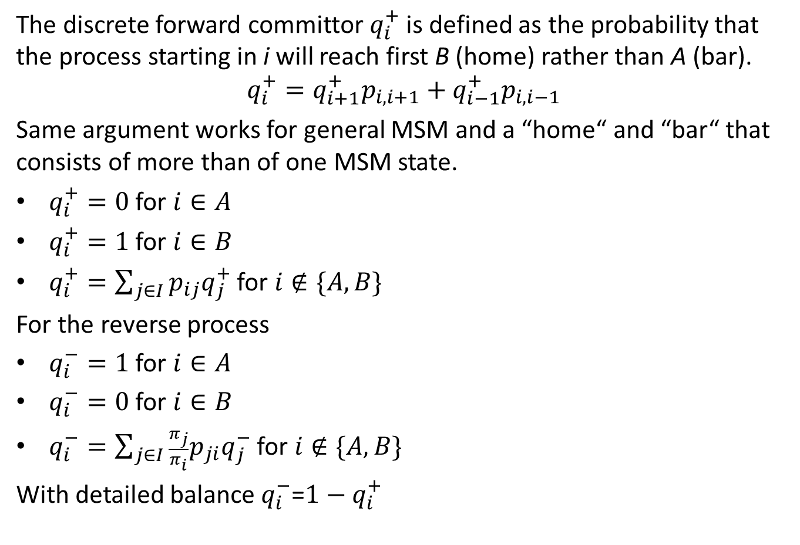



The committor
The discrete forward committor $q_{i}^{+}$ is defined as the probability that the process starting in i will reach first B (home) rather than A (bar).
$$q_{i}^{+}=q_{i+1}^{+}p_{i,i+1}+q_{i−1}^{+}p_{i,i−1}$$
Same argument works for general MSM and a “home“ and “bar“ that consists of more than of one MSM state.
$q_{i}^{+}=0$ for $i∈A$
$q_{i}^{+}=1$ for $i∈B$
$q_{i}^{+}=\sum_{j∈I}{p_{ij}q_{j}^{+}}$ for $i∉\{A,B\}$
For the reverse process
$q_{i}^{−}=1$ for $i∈A$
$q_{i}^{−}=0$ for $i∈B$
$q_{i}^{−}=\sum_{j∈I}{\frac{π_{j}}{π_{i}}p_{ji}q_{j}^{−}}$ for $i∉\{A,B\}$
With detailed balance $q_{i}^{−}$=$1−q_{i}^{+}$
$$q^{+}=0$$
$$0<q^{+}<1$$
$$q^{+}=1$$

Slide 30
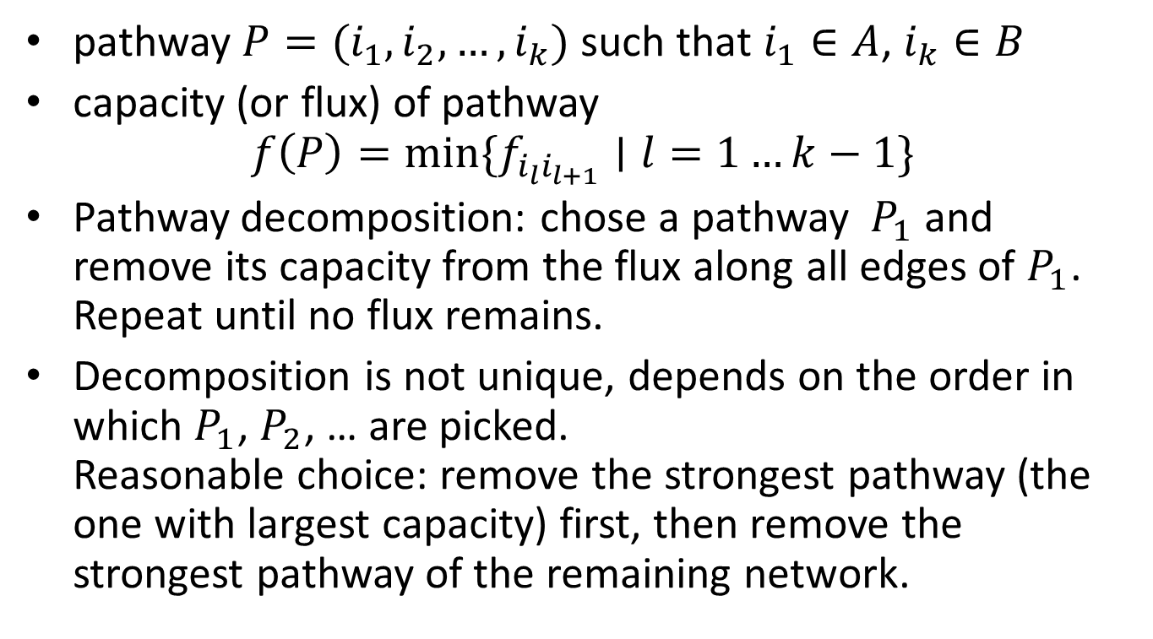
Pathway decomposition
pathway $P=(i_{1},i_{2},…, i_{k})$ such that $i_{1}∈A$, $i_{k}∈B$
capacity (or flux) of pathway
$f\left(P\right)=\min{\{f_{i_{l}i_{l+1}}∣l=1…k−1\}}$
Pathway decomposition: chose a pathway $P_{1}$ and remove its capacity from the flux along all edges of $P_{1}$. Repeat until no flux remains.
Decomposition is not unique, depends on the order in which $P_{1}$, $P_{2}$, … are picked.
Reasonable choice: remove the strongest pathway (the one with largest capacity) first, then remove the strongest pathway of the remaining network.

Slide 31
example: comittor
2
1
4
3

