Slide 1
Variational Approach to Markov Processes (VAMP) Identification of molecular order parameters and states from nonreversible MD simulations
Fabian Paul
Computer Tutorial in Markov Modeling
18-FEB-2020

Slide 2
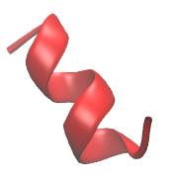
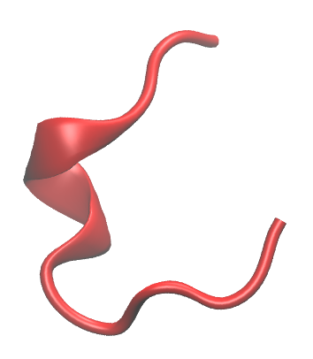
Recap: the spectral theory of MSMs
A Markov state model consists of:
a set of states ${\left\{s_{i}\right\}}_{i=1,…N}$
(conditional) transition probabilities between these states $T_{ij}=ℙ(s\left(t+τ\right)=j∣s(t)=i)$
…

Slide 3
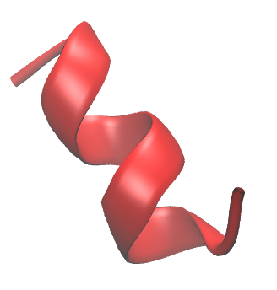
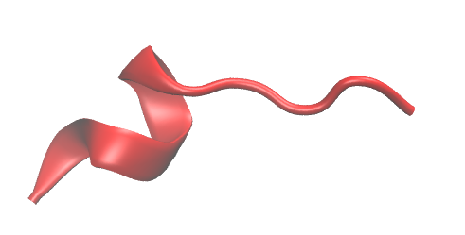
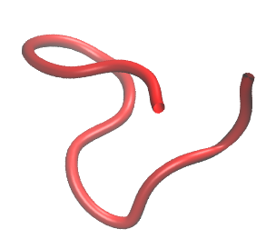
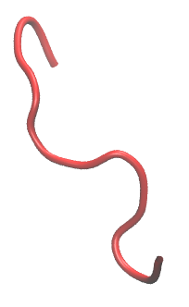
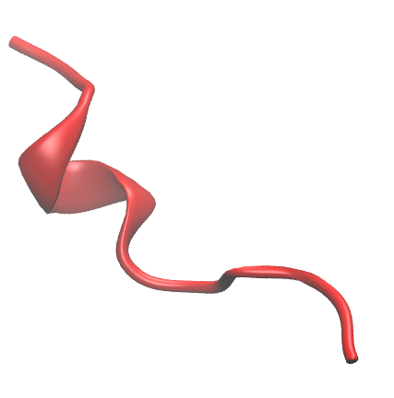
Markov state models: estimation
Markov model estimation starts with: grouping of geometrically^{[1]} or kinetically^{[2]} related conformations into clusters or microstates
1
2
microstates
3
[1] Prinz et al., J. Chem. Phys. 134, 174105 (2011)
[2] Pérez-Hernández, Paul, et al., J. Chem. Phys. 139, 015102 (2013)

Slide 4
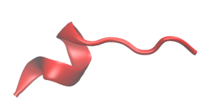
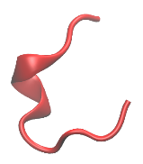
Markov state models: estimation
We then assign every conformation in a MD trajectory to a microstate.
time $t$
τ
2τ
3τ
4τ
5τ
6τ
7τ
trajectory
microstate $s$
1
1
2
3
3
2
3
We count transitions between microstates and tabulate them in a count matrix $C$ e. g. $C_{11}=1$, $C_{12}=1$, $C_{23}=2$, …
We estimate the transition probabilities $T_{ij}$ from $C$.
Naïve estimator: ${\hat{T}}_{ij}=C_{ij}/\sum_{k}{C_{ik}}$
Maximum-likelihood estimator [1]
[1] Prinz et al., J. Chem. Phys. 134, 174105 (2011)
[2] Pérez-Hernández, Paul, et al., J. Chem. Phys. 139, 015102 (2013)

Slide 5
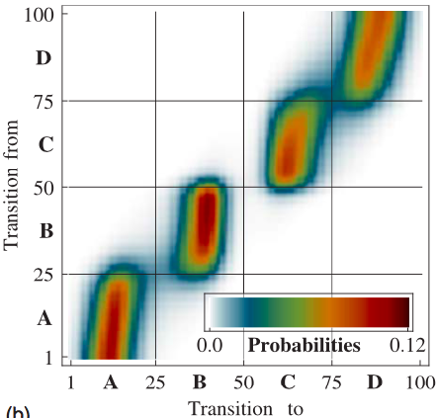
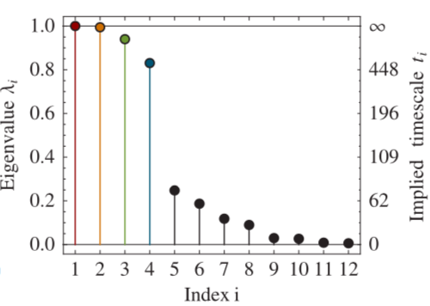
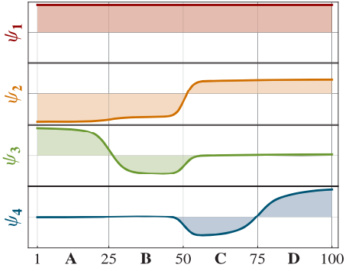
The spectrum of a reversible T matrix
Energy U(i)
The large eigenvalues of the transition matrix and their corresponding eigenvectors encode the information about the slow molecular processes.
Flat regions of the eigenvectors allow to identify the metastable states.
Prinz et al., J. Chem. Phys. 134, 174105 (2011)
Notes:
TODO: add IST equation!

Slide 6
Both MSMs and TICA make use of the same spectral method
The spectral method (working with eigenvalue and eigenvector) is not limited to Markov state models.
Estimation of MSMs
$$T(τ)=\frac{C_{ij}(τ)}{C_{i}}$$
In matrix notation $T\left(τ\right)=C{\left(0\right)}^{−1}C(τ)$
Eigenvalue problem: $T\left(τ\right)v=λv$ $⇔$ $C{\left(0\right)}^{−1}C\left(τ\right)v=λv$ $⇔$ $C\left(τ\right)v=λC(0)v$
The last equation is known as the TICA problem. All equations generalize to the case where $C(0)$ and $C\left(τ\right)$ are not count matrices, but correlation matrices.
The indices $i,j$ don’t longer refer to states but to features.
Schwantes, Pande, J. Chem. Theory Comput. 9 2000 (2013)
Pérez-Hernández et al ,J. Chem. Phys., 139 015102 (2013)

Slide 7
VAC and VAMP

Slide 8
Variational approach to conformational dynamics VAC (Rayleigh-Ritz for classical dynamics)
Any autocorrelation is bounded by the system-specific number $\hat{λ}$, that is related to the system-specific autocorrelation time $\hat{t}$by $\hat{λ}=e^{−τ/\hat{t}}.$
$$acf\left(ψ;τ\right):=\frac{\sum_{t}^{T−τ}{ψ\left(x\left(t\right)\right)ψ\left(x(t+τ)\right)}}{\sum_{t}^{T−τ}{ψ\left(x\left(t\right)\right)ψ\left(x(t)\right)}}=\frac{{\left\langle ψ,Tψ\right\rangle }_{π}}{{\left\langle ψ, ψ\right\rangle }_{π}}≤\hat{λ}$$
The maximum is achieved if $ψ$ is an eigenfunction of $T$.
Proof:
Expand $ψ$ in an (orthonormal) eigen-basis of $T$: $ψ\left(x\right)=\sum_{i}{c_{i}}φ_{i}\left(x\right)$, ${\left\langle ψ, ψ\right\rangle }_{π}=\sum_{i}{c_{i}^{2}}>0$
$${\left\langle ψ,Tψ\right\rangle }_{π}−\hat{λ}{\left\langle ψ, ψ\right\rangle }_{π}=\sum_{i}{c_{i}^{2}}λ_{i}−\sum_{i}{c_{i}^{2}}\hat{λ}=\sum_{i}{c_{i}^{2}}\left(λ_{i}−\hat{λ}\right)≤0$$
If $\hat{λ}$ is $\max_{i} λ_{i}$the largest of T’s eigenvalues, the inequality holds.
Result can only be zero if $c_{i}=0$ for $i≠j$and $λ_{j}=\max_{i} λ_{i}⇒ψ\left(x\right)∝φ_{max}\left(x\right)$
Remark: the variational approach generalizes to the optimization of multiple eigenfunctions. $\hat{λ}$ is replaced by the sum of the eigenvalues $R_{k}=\sum_{i=1}^{k}{λ_{i}}$
Noé, Nüske, SIAM Multiscale Model. Simul. 11, 635 (2013)

Slide 9
Interpretation of variational principle
good test function bad test function
Pick some test function $χ_{test}\left(x\right)$ and pick some test conformations $x_{i,inital}$ distributed according to equilibrium distribution $π$
Propagate $x_{i,inital}$ with the the MD integrator. Call result $x_{i,final}$.
Correlate $χ_{test}\left(x_{inital}\right)$ with $χ_{test}\left(x_{final}\right)$.
score=$\frac{\sum_{i=1}^{N}{\left(χ\left(x_{i,inital}\right)−\overline{χ}\right)⋅\left(χ\left(x_{i,final}\right)−\overline{χ}\right)}}{\sum_{i=1}^{N}{\left(χ\left(x_{i,inital}\right)−\overline{χ}\right)⋅\left(χ\left(x_{i,inital}\right)−\overline{χ}\right) }}$
$$Ω$$

Slide 10
Gradient-based optimization of function parameters
Parameters $p$ of $χ_{test}\left(x;p\right)$ can be optimized with gradient-based techniques. Make use of the gradient of the VAC or VAMP score, the gradient of the test function and off-the-shelf optimizers such as ADAM or BFGS.

Slide 11
Reversible dynamics
In equilibrium, every trajectory is as probable as its time-reversed copy
$$ℙ\left(s\left(t+τ\right)=j and s\left(t\right)=i\right)=ℙ\left(s\left(t+τ\right)=i and s\left(t\right)=j\right)$$
$$ℙ\left(s\left(t+τ\right)=j∣ s\left(t\right)=i\right)ℙ_{eq}(s\left(t\right)=i)=ℙ\left(s\left(t+τ\right)=i∣ s\left(t\right)=j\right)ℙ_{eq}(s\left(t\right)=j)$$
$$π_{i}T_{ij}=π_{j}T_{ji}$$
In mathematician’s notation ${\left\langle e_{i},Te_{j}\right\rangle }_{π}={\left\langle e_{j},Te_{i}\right\rangle }_{π}$ where ${\left\langle x,y\right\rangle }_{π}=\sum_{i}{x_{i}y_{i}π_{i}}$
$T$ is a symmetric matrix w.r.t. to a non-standard scalar product.
$T$ has real eigenvalues and eigenvectors (linear algebra I).
Prinz et al., J. Chem. Phys. 134, 174105 (2011)

Slide 12
The problem with nonreversible systems
$R_{k}=\sum_{i=1}^{k}{λ_{i}}$ where $λ_{i}$ are the true eigenvalues.
For nonreversible dynamics ${\left\langle e_{i},Te_{j}\right\rangle }_{π}≠{\left\langle e_{j},Te_{i}\right\rangle }_{π}$
There might not even be a well-defined $π$.
Eigenvalues and eigenvectors will be complex.
Variational principle doesn’t work. $acf(ψ)≤\hat{λ}∈ℂ$ makes no sense. One can’t order complex numbers on a line.
Optimization of models not possible
Feature selection not possible
Is there any way to fix this? Can we maybe find some other operator that is related to dynamics and that is symmetric?

Slide 13
A possible solution: VAMP Variational approach to Markov processes
Introduce the “backward” transition matrix $T_{b} :=C{\left(N\right)}^{−1}C\left(−τ\right)=C{\left(N\right)}^{−1} C^{⊤}\left(τ\right)$ i.e. estimate MSM/TICA from time-reversed data, where $C_{ij}\left(−τ\right):=\sum_{t=τ}^{N}{f_{i}\left(x\left(t−τ\right)\right)f_{j}\left(x(t)\right)}$ $C_{ij}\left(N\right):=\sum_{t=τ}^{N}{f_{i}\left(x(t)\right)f_{j}(x(t))}$
Introduce the forward-backward transition matrix $T_{fb}≔TT_{b}$and $T_{bf}:=T_{b}T$
Can show that $T_{fb}$ and $T_{bf}$ are symmetric without any reference to a stationary vector (symmetry is built into the matrices).
Eigenvalues and eigenvectors of $T_{fb}$ and $T_{bf}$ are real.
They fulfill a variational principle $\left\|C^{−1/2}\left(0\right)C\left(τ\right)C{\left(N\right)}^{−1/2}\right\|≤R$
Wu, Noé, J. Nonlinear Sci. 30, 23 (2020) Klus, S. et al, J. Nonlinear Sci., 28, 1 (2018)

Slide 14
Cross-validation
The model parameters (in this example parameters of the line and steepness of the transition) were optimized for a particular realization of the dynamics.
Didn’t we say that the eigenfunctions and eigenvalues were an intrinsic property of the molecular system?
So the eigenfunctions should be the same if we repeat the analysis with a second simulation of the same system.

Slide 15
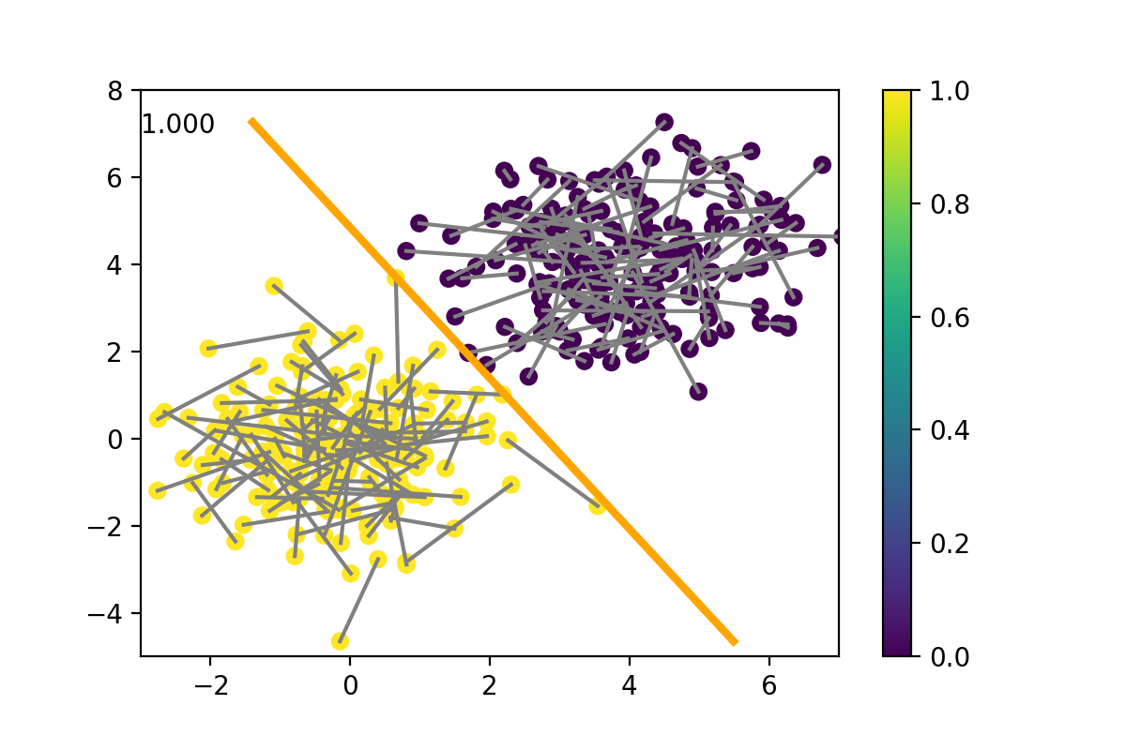
Cross-validation
The model parameters (in this example parameters of the line and steepness of the transition) were optimized for a particular realization of the dynamics.
Didn’t we say that the eigenfunctions and eigenvalues were an intrinsic property of the molecular system?
So the eigenfunctions should be the same if we repeat the analysis with a second simulation of the same system.

Slide 16
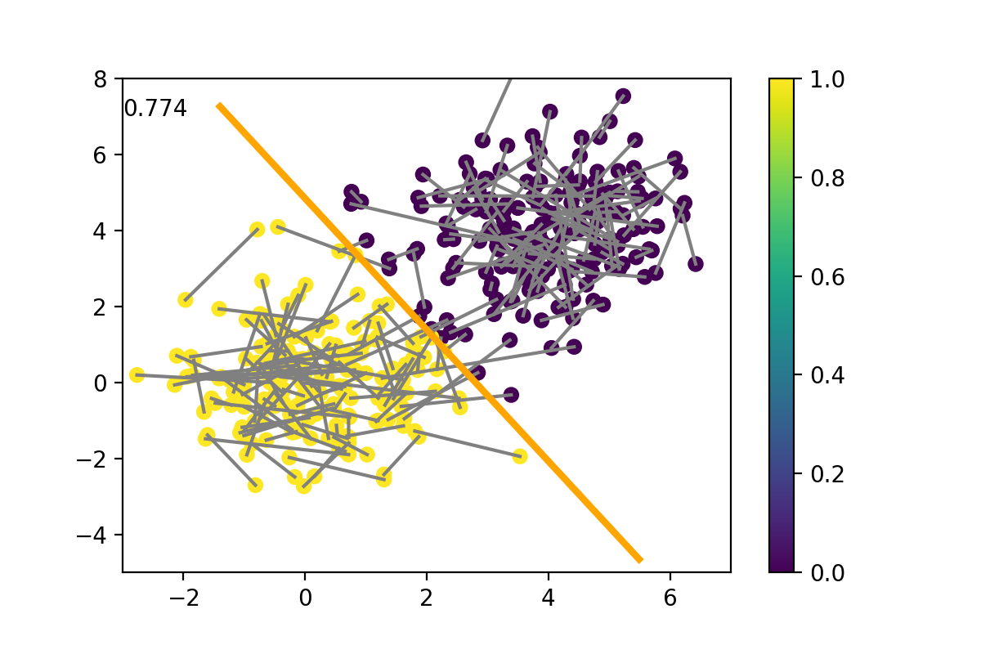
Cross-validation
Ideally, we want to tell if the solution is robust at a single glance by measuring the robustness with one number.
The VAMP score or VAC score (also called GRMQ¹) lends itself to this task.
Keep all the trained model parameters fixed (here the line parameters and the steepness of the transition), plug in new data and recompute the test autocorrelation.
The test autocorrelation will be lower in general, which means that the original model was fit to noise (overfit).
[1] McGibbon, Pande, J Chem Phys., 142 124105 (2015)

Slide 17
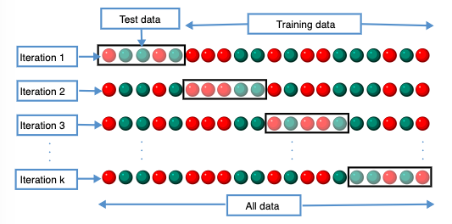
Cross-validation
Reporting a test-score that was computed from independent realizations is the gold standard.
Independent realizations can be expensive to sample.
Do the approximate k-fold (hold-out) cross-validation.
Split all data into training set and test sets.
Optimize the model parameters with the training set and test the parameters with test sets.
Repeat for k different divisions of the data.
k-fold cross-validation can be tricky with highly autocorrelated time series data!

Slide 18
Applications

Slide 19
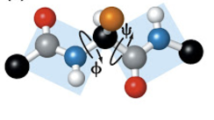
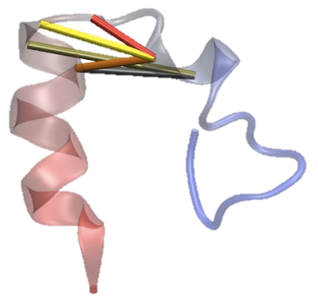
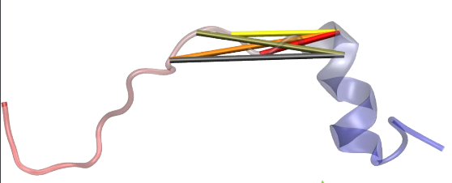
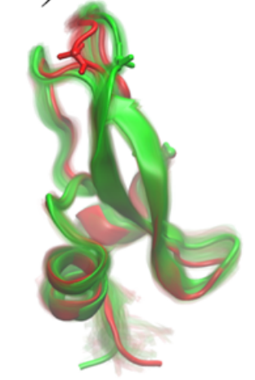
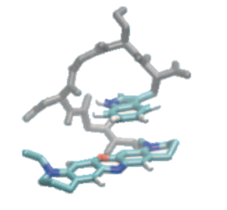
Application: feature selection
variational principle: the higher the score the better
Compare test scores for different selections of molecular features. Which selection gives best score?
dihedrals?
distances?
contacts?
chemical intuition?
rigid body approximation?
side chain flips?

Slide 20
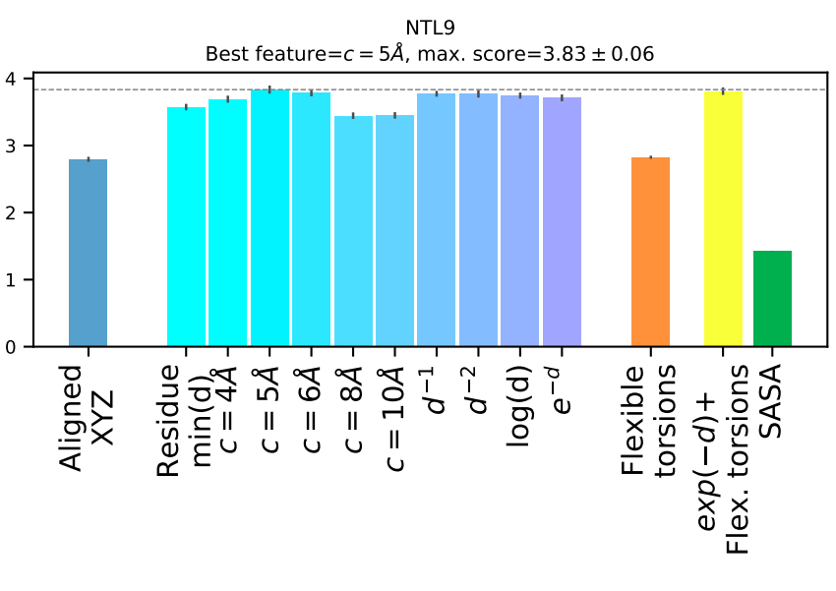
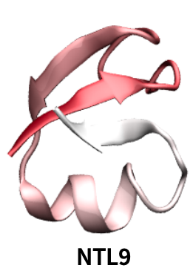
Application: feature selection
Scherer et al J. Chem. Phys. 150, 194108 (2019)

Slide 21
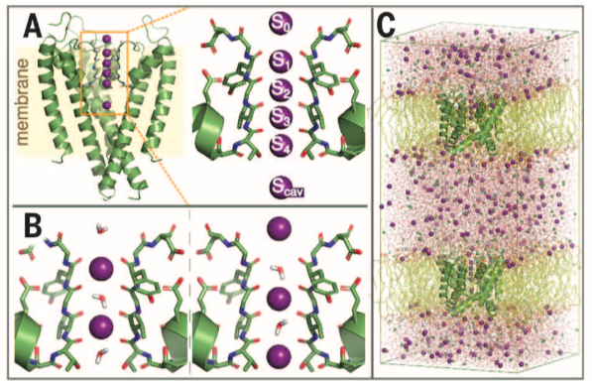
Application: ion channel non-equilibrium MD
Analysis of MD simulation data of the "controversial” direct-knock-on conduction mechanism in the KcsA potassium channel.
Ions a constantly inserted at one side of the membrane and deleted at the other side.
Paul et al, J. Chem. Phys. MMMK, 164120 (2019).
Fig1 and data: Köpfer et al., Science, 346, 352 (2014).

Slide 22
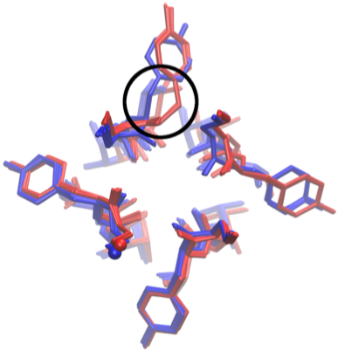
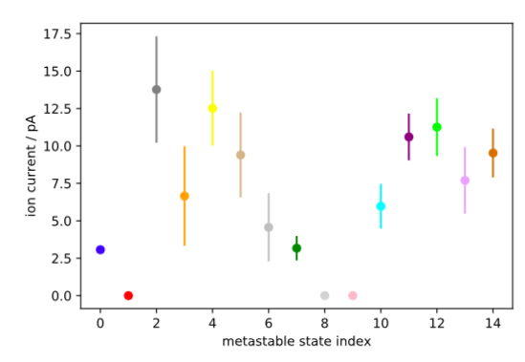
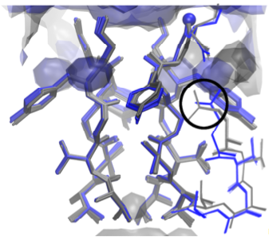
Application: ion channel non-equilibrium MD
By clustering in the VAMP space, we identified 15 different states that differ structurally near the selectivity filter and differ in their conductivity.

Slide 23
Summary and conclusion
VAC and VAMP are two variational principles that allow to approximate the true eigenfunctions of the dynamical system (VAC) or its restricted singular functions (VAMP) by using optimization.
VAMP even works in non-equilibrium settings, if the dynamics is driven by external forces or if the sampling is so limited, that transitions in both the forward and backward directions are not available.
VAMP can be used for feature selection and to model the slow reaction coordinates with enormously complicated functions (see talk tomorrow).

Slide 24
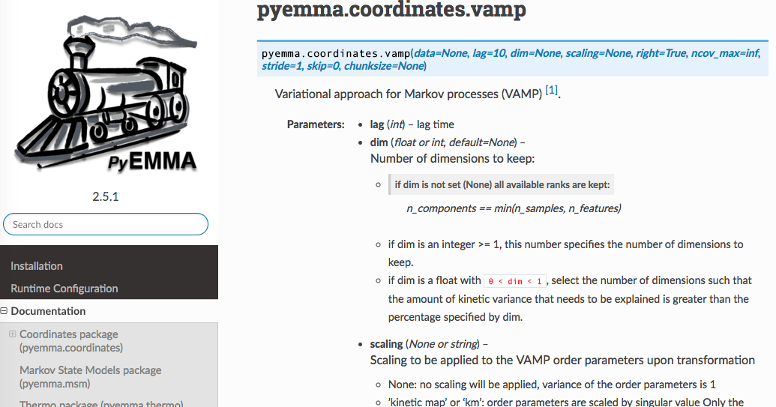
Chapman-Kolmogorov test

Slide 25
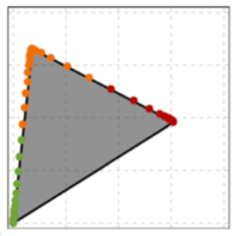
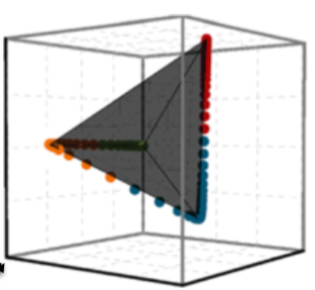
From order parameters to states to MSMs
PCCA = Perron-cluster cluster analysis
Motivating observation: the set of all MD data projected onto the dominant eigenvectors $\left\{v\left(x\right) ∣ x∈data\right\}$ form a simplex
In 2-D simplex=triangle In 3-D simplex=tetrahedron ...
Deuflhard, Weber. Linear Algebra Appl., 398 161, (2005).
Weber, Galliat. Tech. Rep. 02-12, KZZ (2002).

Slide 26
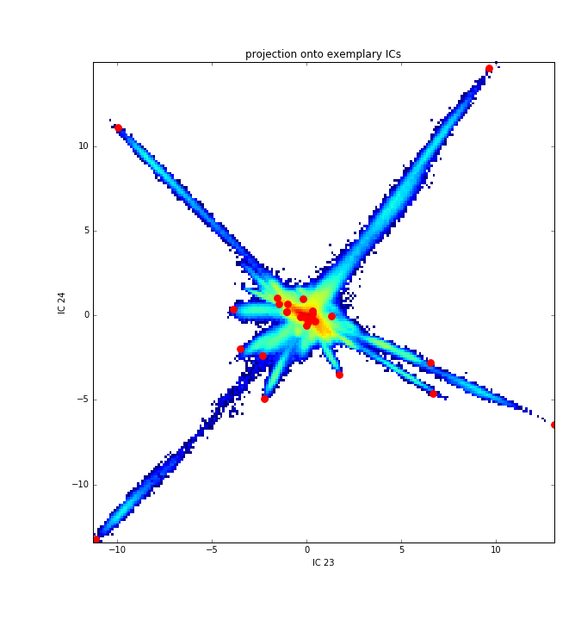
From order parameters to states to MSMs
I: PCCA only needs the eigenvectors
II: TICA (and VAMP) provide eigenvectors
I&II → We can do PCCA in TICA or VAMP space.
Steps of the PCCA algorithm:
Find the N-1 most distant points (the vertices) in the N-dimensional eigenspace.
Compute barycentric coordinates of every MD frame with respect to the N-1 vertices.
Weber, Galliat, Tech. Rep. 02-12, KZZ (2002).

Slide 27
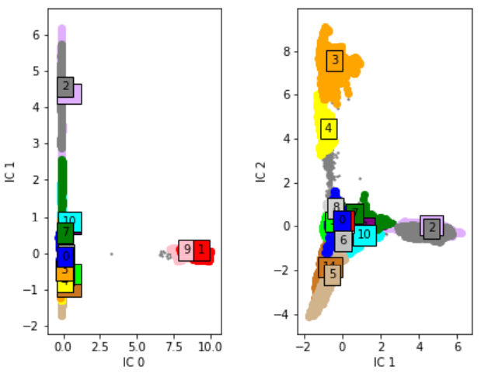
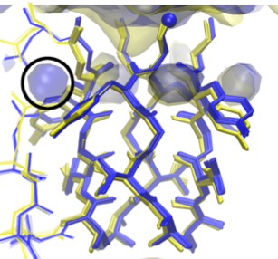
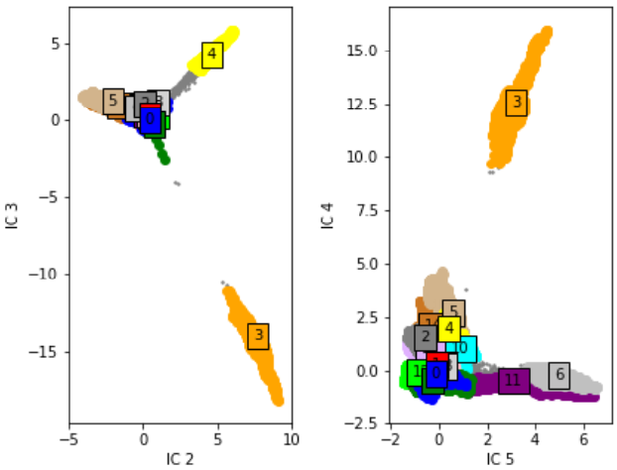
Projections to VAMP space, colored by state
Ensembles of conformations
Transition network
Notes:
Transition network

Slide 28
$T$ time steps
$n$
features
Separate into:
last $T−τ$ time steps
Y
first $T−τ$ time steps
X
K
$$≈$$
$K = {\left(X^{T}X\right)}^{−1}X^{T} Y = C{\left(0\right)}^{−1} C(τ)$
$$K v = λ v ⇔ C(τ) v =λ C(0) v$$
Do a dimensionality reduction by keeping only the dominant eigenmodes.
Notes:
TODO: correct the transposes

Slide 29
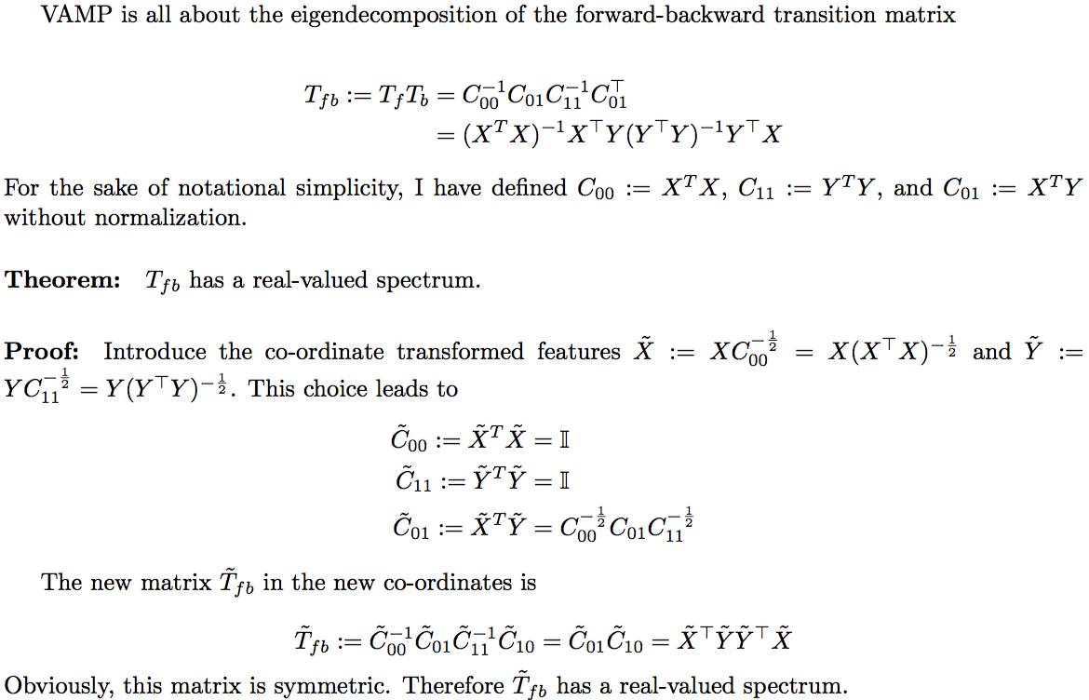

Slide 30
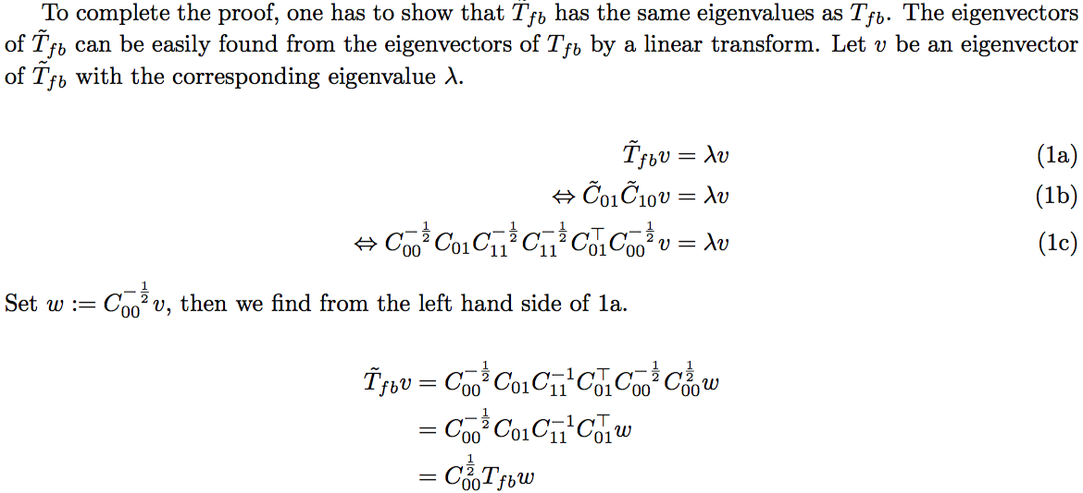

Slide 31
Markov state models

Slide 32
MSM theory : propagator and generator
Langevin equation
$$\ddot{x}=F\left(x\right)/m−γ\dot{x}+\sqrt{2k_{B}Tγ/m} η_{i}\left(t\right)$$
Fokker-Planck equation
$$\frac{∂p(t,p,x)}{∂t}=\underbrace{\left(−\frac{p}{m}⋅∇_{x}+∇_{p}⋅\left(γp−F\left(x\right)\right)+γk_{B}TmΔ_{p}\right)}p(t,p,x)$$
Propagator (operator) define $X=\left(p,x\right)$
$$𝒫_{τ}\left[p\left(t,.\right)\right](X)=\exp\left[τA\right]p\left(t,.\right)=p(t+τ,X)$$
$$=\int{p\left(t,Y\right)p\left(Y→X;τ\right)dY}$$
Transfer operator define $p\left(t,X\right)=u(t,X)p_{B}(X)$
$$𝒯\left[u_{t};τ\right](X):=\frac{1}{p_{B}(X)}\int{u_{t}\left(Y\right)p_{B}\left(Y\right)p\left(Y→X;τ\right)dY}$$
$$A$$

Slide 33
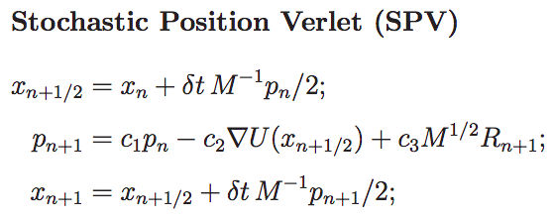
Integration of the equations of motion
cited from: Leimkuhler, Matthews, Applied Mathematics Research eXpress, 2013, 34 (2013)
Notes:
Essentially found from velocity verlet, by replacing the force with F-m*gamma*v and adding noise in every update of the momenta.

Slide 34
MSM theory : transfer operator
$$𝒯\left[u_{t};τ\right](X):=\frac{1}{p_{B}(X)}\int{u_{t}\left(Y\right)p_{B}\left(Y\right)p\left(Y→X;τ\right)dy}$$
$$u_{t+τ}\left(X\right)=𝒯_{slow}\left[u_{t};τ\right](X)+𝒯_{fast}\left[u_{t};τ\right](X)$$
$$𝒯_{slow}\left[u_{t};τ\right]\left(X\right)=\sum_{i}{λ_{i}\left(τ\right)ψ_{i}(X)\int{ψ_{i}\left(Y\right)p_{B}\left(Y\right)u_{t}\left(Y\right)dy}}=\sum_{i}{λ_{i}\left(τ\right)ψ_{i}\left(X\right){\left\langle ψ_{i},u_{t}\right\rangle }_{p_{B}}}$$
$$T_{ij}=\frac{{\left\langle χ_{j},𝒯[χ_{i}]\right\rangle }_{p_{B}}}{{\left\langle χ_{j},χ_{i}\right\rangle }_{p_{B}}}=\frac{\iint{χ_{i}\left(x\right)p_{B}\left(Y\right)p\left(Y→X;τ\right)χ_{j}\left(X\right)dxdy}}{\int{χ_{j}\left(X\right)χ_{i}\left(X\right)p_{B}\left(X\right)dy}}=\frac{cov(χ_{j},χ_{i};τ)}{cov(χ_{i},χ_{i};0)}$$
Prinz et al. J. Chem. Phys. 134, 174105 (2011)
Sarich et al SIAM Multiscale Model. Simul. 8, 1154 (2010).

Slide 35
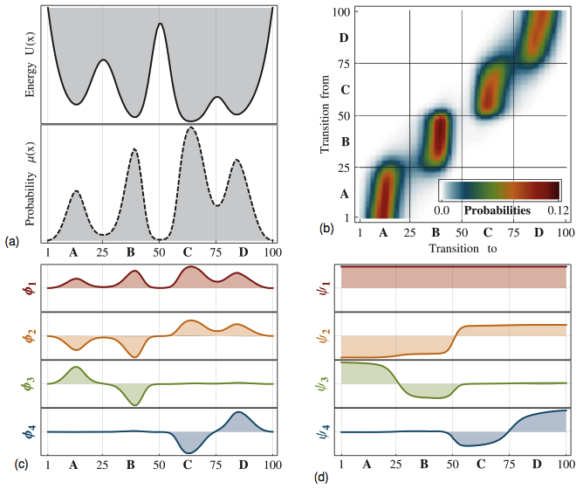
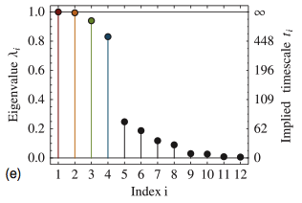
MSM: spectral properties
time scales: processes:
$$𝒯_{slow}\left[u_{t};τ\right]\left(X\right)=\sum_{i}{λ_{i}\left(τ\right)ψ_{i}\left(X\right){\left\langle ψ_{i},u_{t}\right\rangle }_{p_{B}}}$$
$$\underset{n times}{\underbrace{𝒯_{s}∘…∘𝒯_{s}}u_{t}}=\sum_{i}{λ_{i}^{n}\left(τ\right)ψ_{i}{\left\langle ψ_{i},u_{t}\right\rangle }_{p_{B}}}$$
for MSM: $$p^{T}\left(nτ\right)=\sum_{i}{λ_{i}^{n}φ_{i} [ψ_{i}⋅p\left(0\right)]}$$
$φ_{i}$(left) $ψ_{i}$ (right)
Prinz et al., J. Chem. Phys. 134, 174105 (2011)
Sarich et al., SIAM Multiscale Model. Simul. 8, 1154 (2010).
Notes:
TODO: rewrite with transfer operator

