Slide 1
Multi-Ensemble Markov Models and 🚋 TRAM 🚋
Fabian Paul
19-Feb-2020

Slide 2
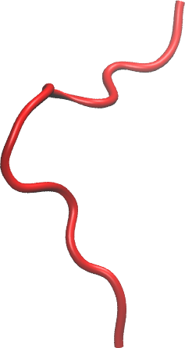
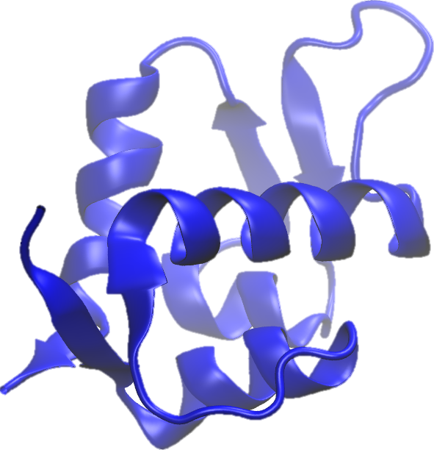
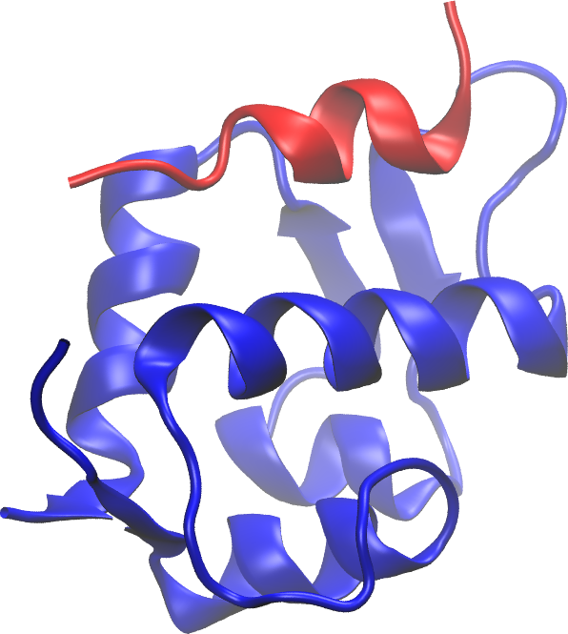




Main challenges in molecular dynamics simulation
Molecular dynamics simulation of biomolecules is difficult because:
molecular systems are high-dimensional
their dynamics are stochastic + biologically interesting events are rare
rare event
(free) energy
$$x_{N}$$
$$x_{3}$$
$$x_{2}$$
$$x_{1}$$

Slide 3
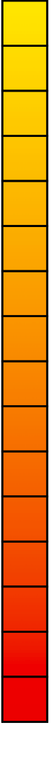
Reachable time scales in MD simulation
protein
unbinding
1s
protein
folding
aggregated length in multiple trajectories
10⁻³s
larger
domain
motion
length of a single trajectory
10⁻⁶s
MD
formation
of helices,
loop
motions
10⁻⁹s
side-chain
rotamers
10⁻¹²s
10⁻¹⁵s
bond
vibration
MD integration time step (4fs)
Notes:
Why to we need 4fs: stiff pontentials, larger time step would lead to steric clashes

Slide 4
Reachable time scales in MD simulation
important biological processes
protein
unbinding
1s
protein
folding
aggregated length in multiple trajectories
10⁻³s
MD
+
Markov
state
models
larger
domain
motion
length of a single trajectory
10⁻⁶s
MD
formation
of helices,
loop
motions
10⁻⁹s
side-chain
rotamers
10⁻¹²s
10⁻¹⁵s
bond
vibration
Notes:
Why to we need 4fs: stiff pontentials, larger time step would lead to steric clashes

Slide 5
Reachable time scales in MD simulation
important biological processes
protein
unbinding
MD
+
Markov
state
models
+
new
method:
TRAM
1s
protein
folding
aggregated length in multiple trajectories
10⁻³s
MD
+
Markov
state
models
larger
domain
motion
length of a single trajectory
10⁻⁶s
MD
formation
of helices,
loop
motions
10⁻⁹s
side-chain
rotamers
10⁻¹²s
10⁻¹⁵s
bond
vibration
Notes:
Why to we need 4fs: stiff pontentials, larger time step would lead to steric clashes

Slide 6
Outline
Importance sampling
Simulation types
  Boltzmann reweighting
  Umbrella sampling
  multi-temperature simulation
  accelerated MD
Analysis methods
  Weighted Histogram Analysis method + its problems
  Multi Ensemble Markov Models and discrete TRAM

Slide 7
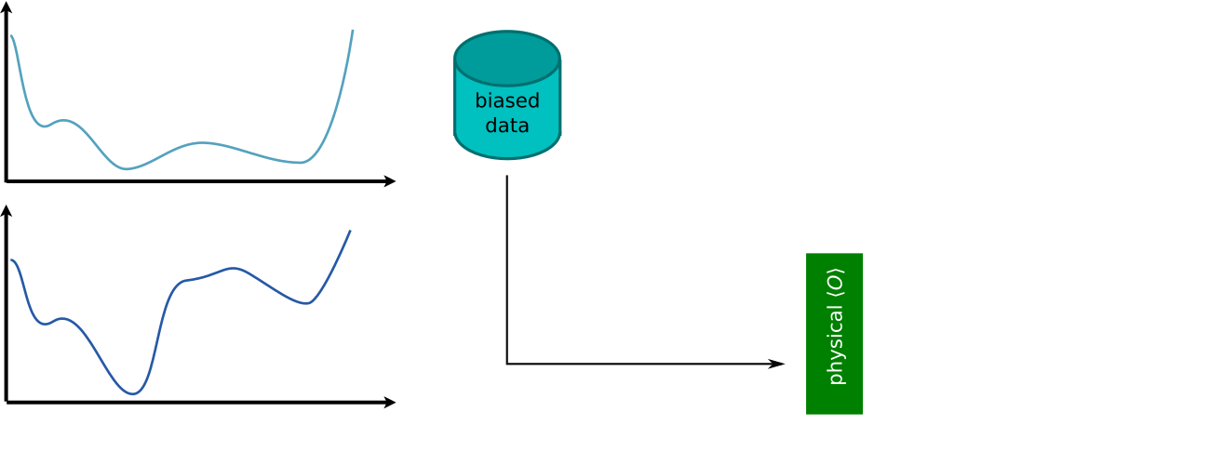
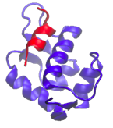
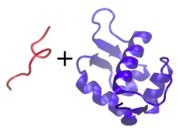


Importance sampling^{[1]} (Boltzmann reweighting)
is a method for systems that are “hard” to simulate.
$$U^{(0)}$$
$$x$$
[1] Kahn, Marshall, J. Oper. Res. Soc. Am. 1, 263 (1953) (or earlier by others)

Slide 8

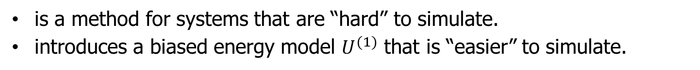
Importance sampling^{[1]} (Boltzmann reweighting)
is a method for systems that are “hard” to simulate.
introduces a biased energy model $U^{(1)}$ that is “easier” to simulate.
$$U^{(1)}$$
biased
$$U^{(0)}$$
physical
$$x$$
[1] Kahn, Marshall, J. Oper. Res. Soc. Am. 1, 263 (1953) (or earlier by others)

Slide 9
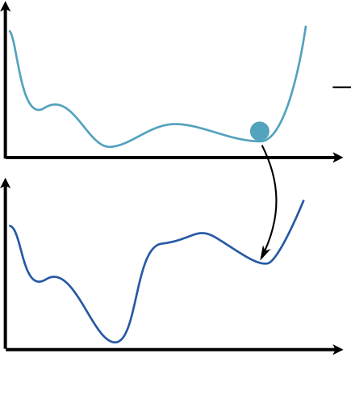
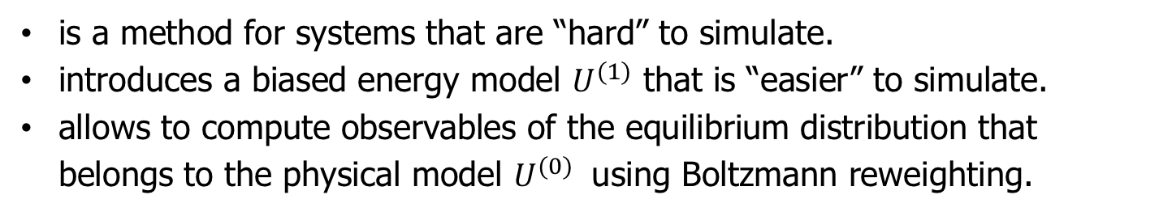
Importance sampling^{[1]} (Boltzmann reweighting)
is a method for systems that are “hard” to simulate.
introduces a biased energy model $U^{(1)}$ that is “easier” to simulate.
allows to compute observables of the equilibrium distribution that belongs to the physical model $U^{(0)}$ using Boltzmann reweighting.
$$U^{(1)}$$
biased
← simulate using this model…
$$U^{(0)}$$
physical
← … but calculate observables for this model.
$$x$$
[1] Kahn, Marshall, J. Oper. Res. Soc. Am. 1, 263 (1953) (or earlier by others)

Slide 10


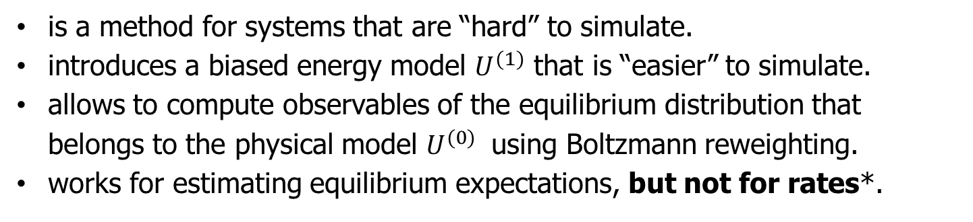
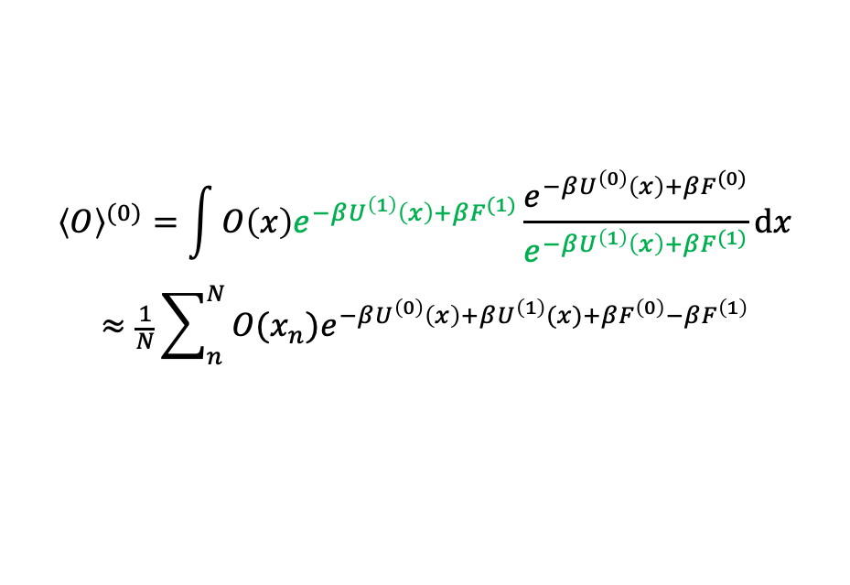
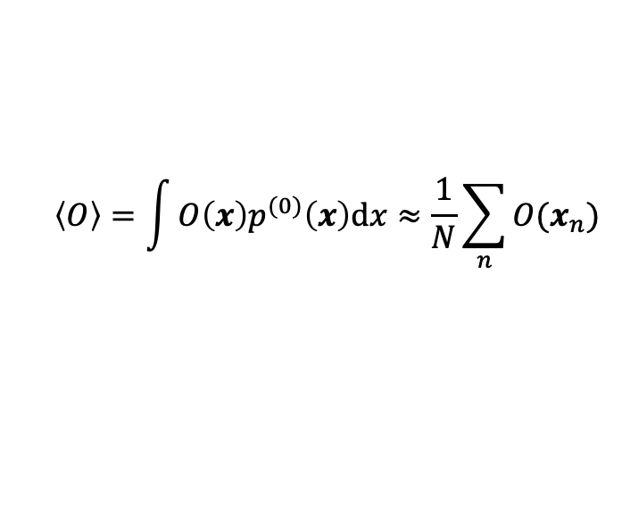
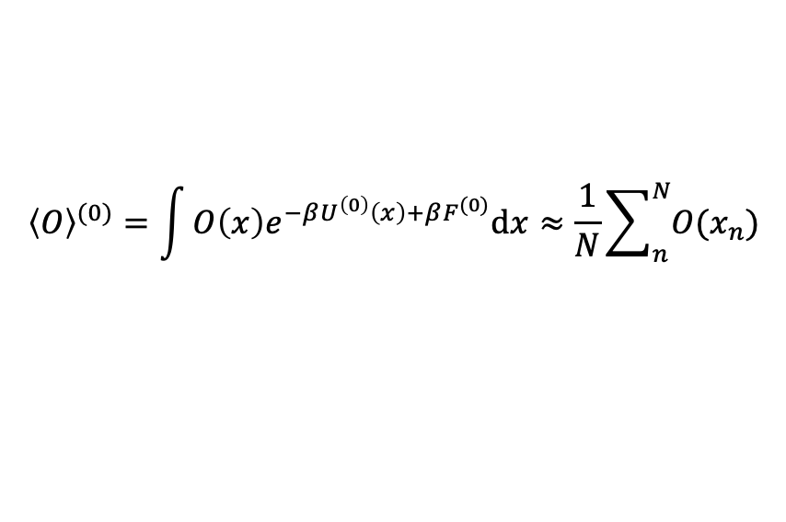
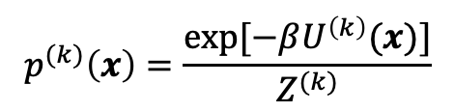

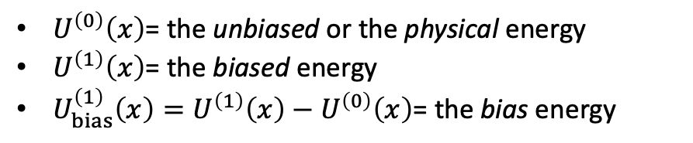
Importance sampling^{[1]} (Boltzmann reweighting)
is a method for systems that are “hard” to simulate.
introduces a biased energy model $U^{(1)}$ that is “easier” to simulate.
allows to compute observables of the equilibrium distribution that belongs to the physical model $U^{(0)}$ using Boltzmann reweighting.
works for estimating equilibrium expectations, but not for rates*.
$$p^{(k)}\left(x\right)=\frac{\exp{[−βU^{\left(k\right)}(x)]}}{Z^{(k)}}$$
$$U^{(1)}$$
$${\left\langle O\right\rangle }^{(0)}=\int{O\left(x\right)e^{−βU^{\left(0\right)}\left(x\right)+βF^{(0)}}dx}≈\frac{1}{N}\sum_{n}^{N}{O(x_{n})}$$
biased
$$\left\langle O\right\rangle =\int{O\left(x\right)p^{(0)}\left(x\right)dx}≈\frac{1}{N}\sum_{n}{O(x_{n})}$$
where $x_{n}∼p^{(0)}\left(x\right)$
$${\left\langle O\right\rangle }^{(0)}=\int{O\left(x\right)e^{−βU^{\left(1\right)}\left(x\right)+βF^{(1)}}\frac{e^{−βU^{\left(0\right)}\left(x\right)+βF^{(0)}}}{e^{−βU^{\left(1\right)}\left(x\right)+βF^{(1)}}}dx}$$
$$≈\frac{1}{N}\sum_{n}^{N}{O(x_{n})e^{−βU^{\left(0\right)}\left(x\right)+βU^{\left(1\right)}(x)+βF^{\left(0\right)}−βF^{\left(1\right)}}}$$
$$U^{(0)}$$
physical
$$\left\langle O\right\rangle =\int{O\left(x\right)p^{(1)}\left(x\right)\frac{p^{(0)}\left(x\right)}{p^{(1)}\left(x\right)}dx}≈\frac{1}{N}\sum_{n}{O\left(x_{n}\right)\frac{p^{(0)}\left(x_{n}\right)}{p^{(1)}\left(x_{n}\right)}}$$
where $x_{n}∼p^{(1)}\left(x\right)$
$$x$$
$U^{\left(0\right)}\left(x\right)$= the unbiased or the physical energy
$U^{\left(1\right)}\left(x\right)$= the biased energy
$U_{bias}^{\left(1\right)}\left(x\right)=U^{\left(1\right)}\left(x\right)−U^{\left(0\right)}\left(x\right)$= the bias energy

Slide 11
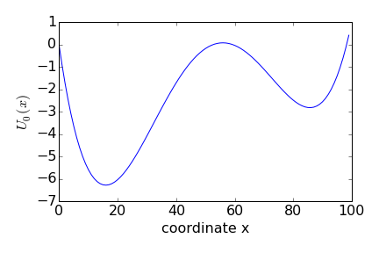
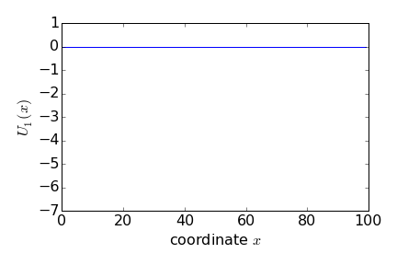
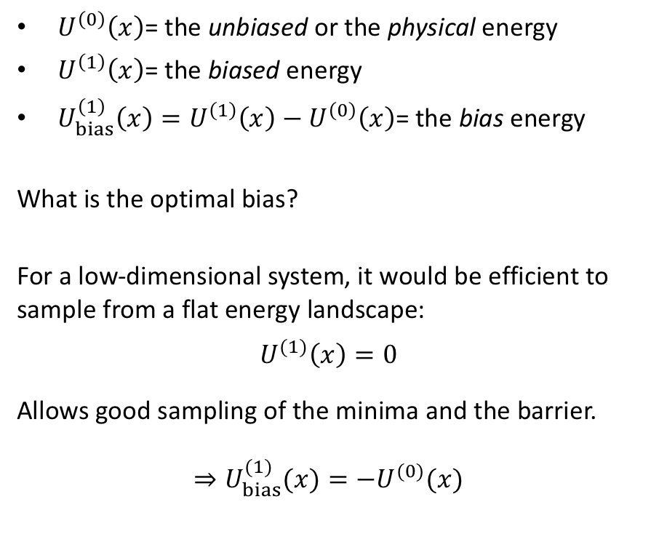
Boltzmann reweighting / importance sampling
$U^{\left(0\right)}\left(x\right)$= the unbiased or the physical energy
$U^{\left(1\right)}\left(x\right)$= the biased energy
$U_{bias}^{\left(1\right)}\left(x\right)=U^{\left(1\right)}\left(x\right)−U^{\left(0\right)}\left(x\right)$= the bias energy
What is the optimal bias?
For a low-dimensional system, it would be efficient to sample from a flat energy landscape:
$$U^{(1)}\left(x\right)=0$$
Allows good sampling of the minima and the barrier.
$⇒U_{bias}^{(1)}(x)=−U^{(0)}(x)$

Slide 12
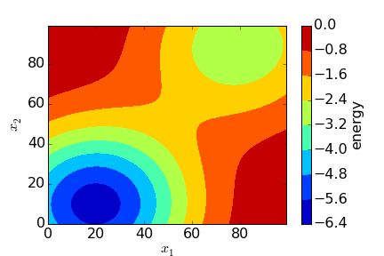
Importance sampling in high dimensions
Sampling uniformly is not possible in high dimensional space like the conformational space.
Notes:
TODO: replace U0 axis label in the plot! Add ticks to the order parameter line

Slide 13
Importance sampling in high dimensions
Introduce an “order parameter” that connects the relevant minima in the energy landscape.
order parameter or reaction coordinate
Notes:
TODO: replace U0 axis label in the plot! Add ticks to the order parameter line

Slide 14
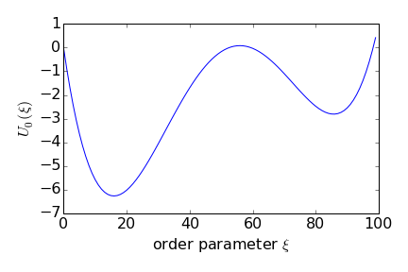

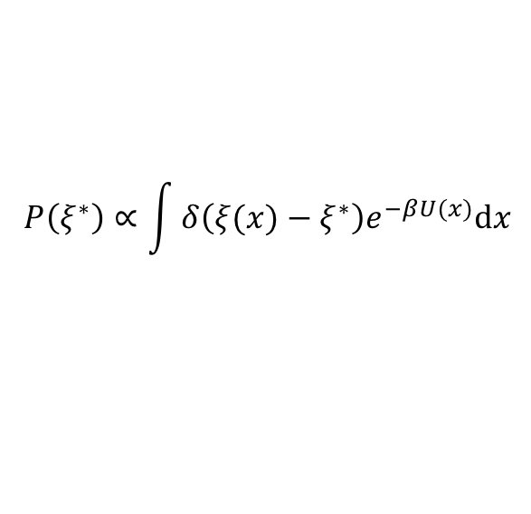
Importance sampling in high dimensions
Sample uniformly along the order parameter.
$$P\left(ξ^{∗}\right)∝\int{δ\left(ξ(x)−ξ^{∗}\right)e^{−βU(x)}dx}$$
$$−k_{B}T\log{P\left(ξ^{∗}\right)}$$
order parameter or reaction coordinate
Notes:
TODO: replace U0 axis label in the plot! Add ticks to the order parameter line

Slide 15
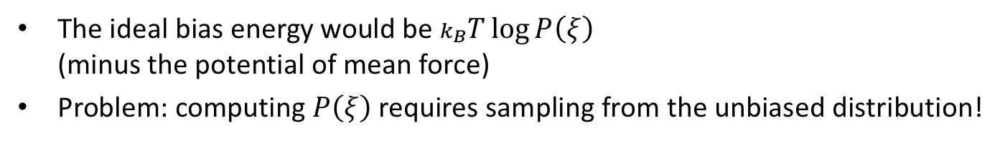
Importance sampling in high dimensions
The ideal bias energy would be $k_{B}T\log{P\left(ξ\right)}$
(minus the potential of mean force)
Problem: computing $P\left(ξ\right)$ requires sampling from the unbiased distribution!
$$P\left(ξ^{∗}\right)∝\int{δ\left(ξ(x)−ξ^{∗}\right)e^{−βU(x)}dx}$$
$$−k_{B}T\log{P\left(ξ^{∗}\right)}$$
order parameter or reaction coordinate
Notes:
TODO: replace U0 axis label in the plot! Add ticks to the order parameter line

Slide 16
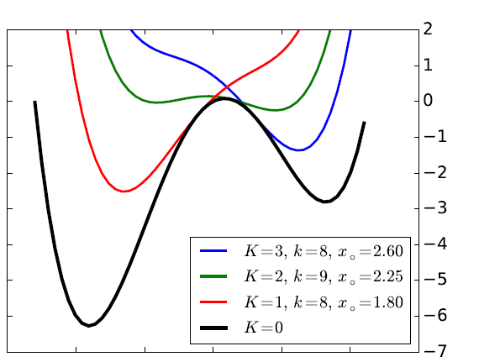
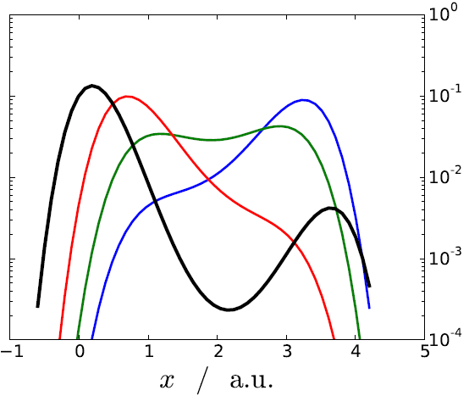
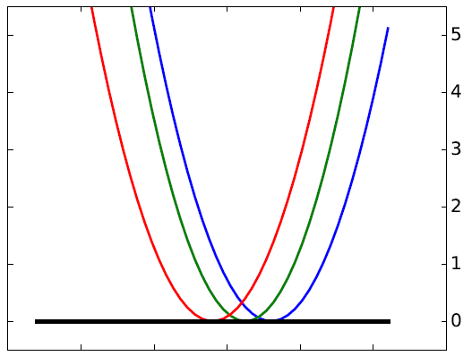
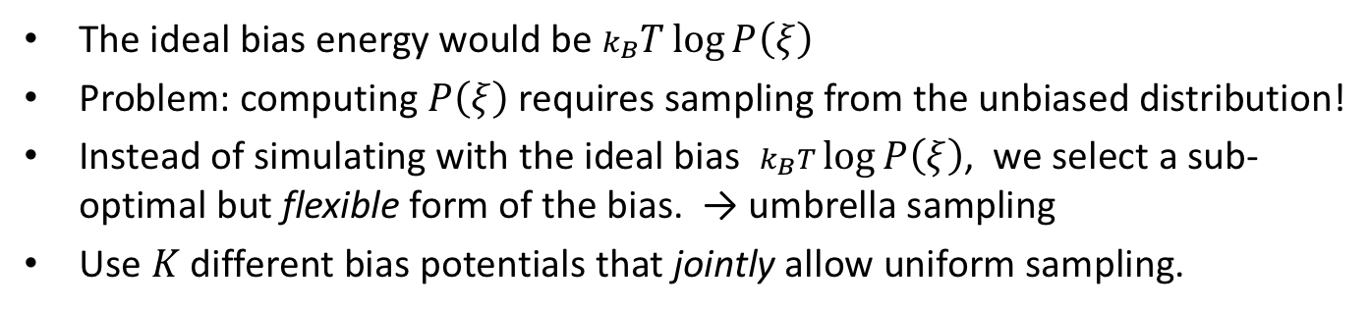
Umbrella sampling
The ideal bias energy would be $k_{B}T\log{P\left(ξ\right)}$
Problem: computing $P\left(ξ\right)$ requires sampling from the unbiased distribution!
Instead of simulating with the ideal bias $k_{B}T\log{P\left(ξ\right)}$, we select a sub-optimal but flexible form of the bias. → umbrella sampling
Use $K$ different bias potentials that jointly allow uniform sampling.
biased potentials bias potentials probability distributions
$U_{0}\left(x\right)+U_{bias}^{(k)}(x)$ $U_{bias}^{(k)}(x)$ $P_{biased}\left(x\right)∝e^{−β[U^{\left(0\right)}\left(x\right)+U_{bias}^{(k)}(x)]}$

Slide 17
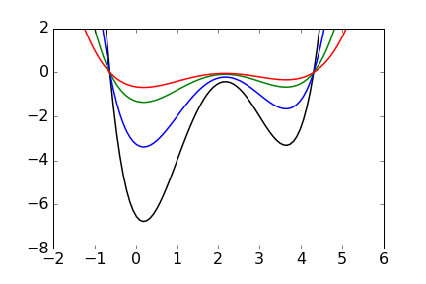
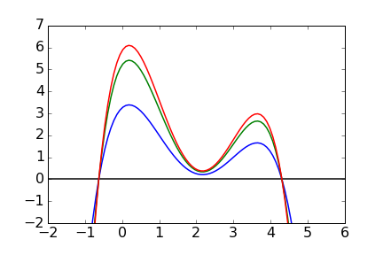
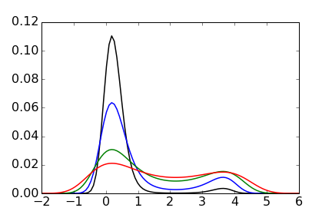
Multi temperature simulation
Multi-temperature simulations is another way of approximately producing a flat biased distribution.
Idea has to taken with a grain of salt: order parameter and the minima that it connects are assumed to stay the same for all temperatures.
biased potentials “bias potentials” probability distributions
$\frac{β^{(k)}}{β^{(0)}}U^{(0)}\left(x\right)$ $\frac{β^{(k)}−β^{(0)}}{β^{(0)}}U^{(0)}(x)$ $P_{biased}\left(x\right)∝e^{−β^{(k)}U^{(0)}\left(x\right)}$

Slide 18
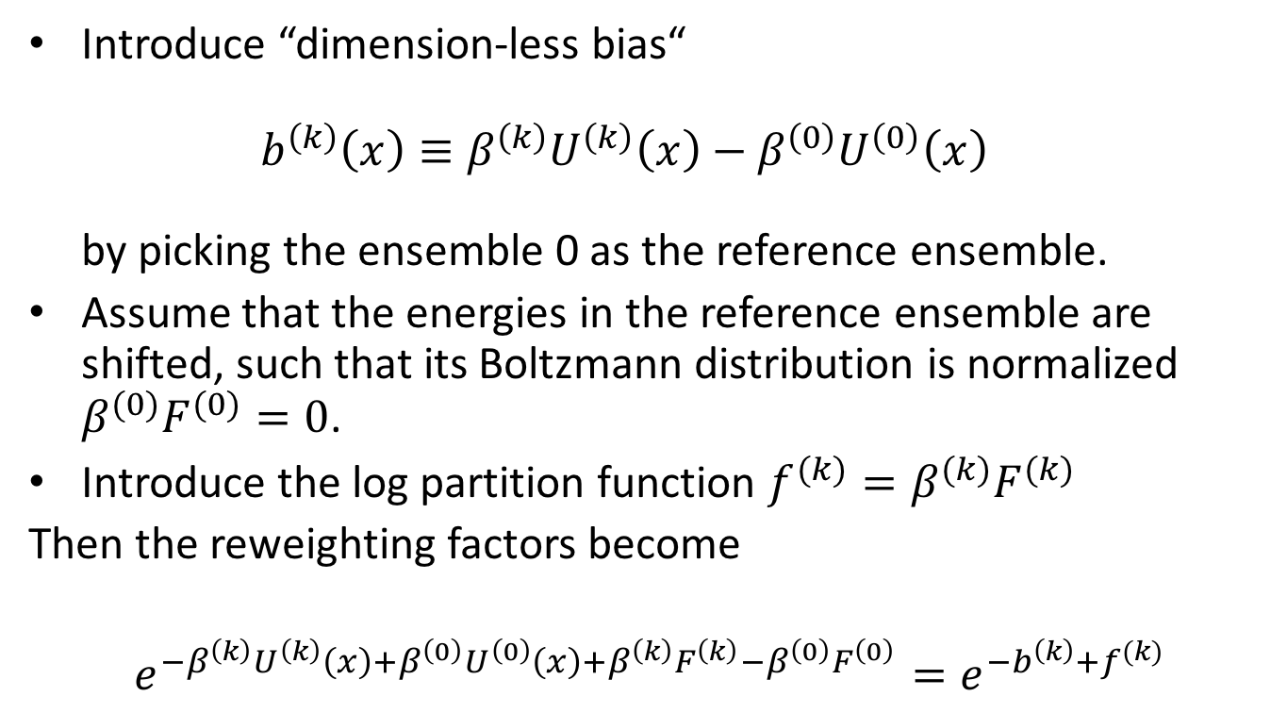
A bit of notation…
Introduce “dimension-less bias“
$b^{\left(k\right)}\left(x\right)≡β^{\left(k\right)}U^{\left(k\right)}\left(x\right)−β^{\left(0\right)}U^{\left(0\right)}\left(x\right)$
by picking the ensemble 0 as the reference ensemble.
Assume that the energies in the reference ensemble are shifted, such that its Boltzmann distribution is normalized $β^{(0)}F^{(0)}=0$.
Introduce the log partition function $f^{(k)}=β^{(k)}F^{(k)}$
Then the reweighting factors become
$$e^{−β^{\left(k\right)}U^{\left(k\right)}\left(x\right)+β^{\left(0\right)}U^{\left(0\right)}\left(x\right)+β^{\left(k\right)}F^{\left(k\right)}−β^{\left(0\right)}F^{\left(0\right)}}=e^{−b^{\left(k\right)}+f^{(k)}}$$

Slide 19
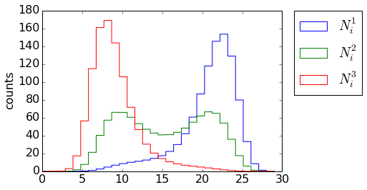


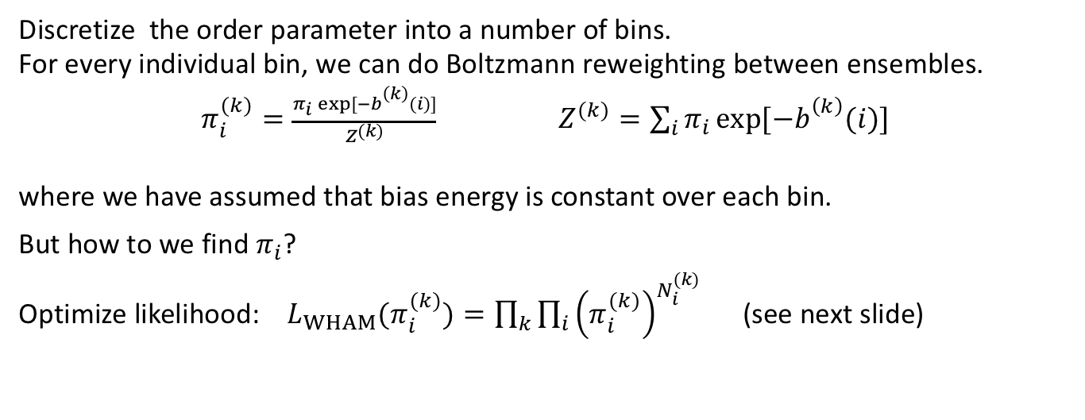
WHAM
Weighted Histogram Analysis Method
The MD simulation gives us realizations or samples. How do we find probabilities?
p
$$x$$
$$i$$
Discretize the order parameter into a number of bins.
For every individual bin, we can do Boltzmann reweighting between ensembles.
$π_{i}^{(k)}=\frac{π_{i}\exp{[−b_{}^{\left(k\right)}(i)]}}{Z^{(k)}}$ $Z^{(k)}=\sum_{i}{π_{i}\exp{[−b_{}^{\left(k\right)}(i)]}}$
where we have assumed that bias energy is constant over each bin.
But how to we find $π_{i}$?
Optimize likelihood: $L_{WHAM}(π_{i}^{(k)})=\prod_{k}{\prod_{i}{{\left(π_{i}^{(k)}\right)}^{N_{i}^{(k)}}}}$ (see next slide)

Slide 20
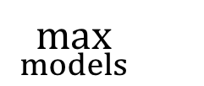
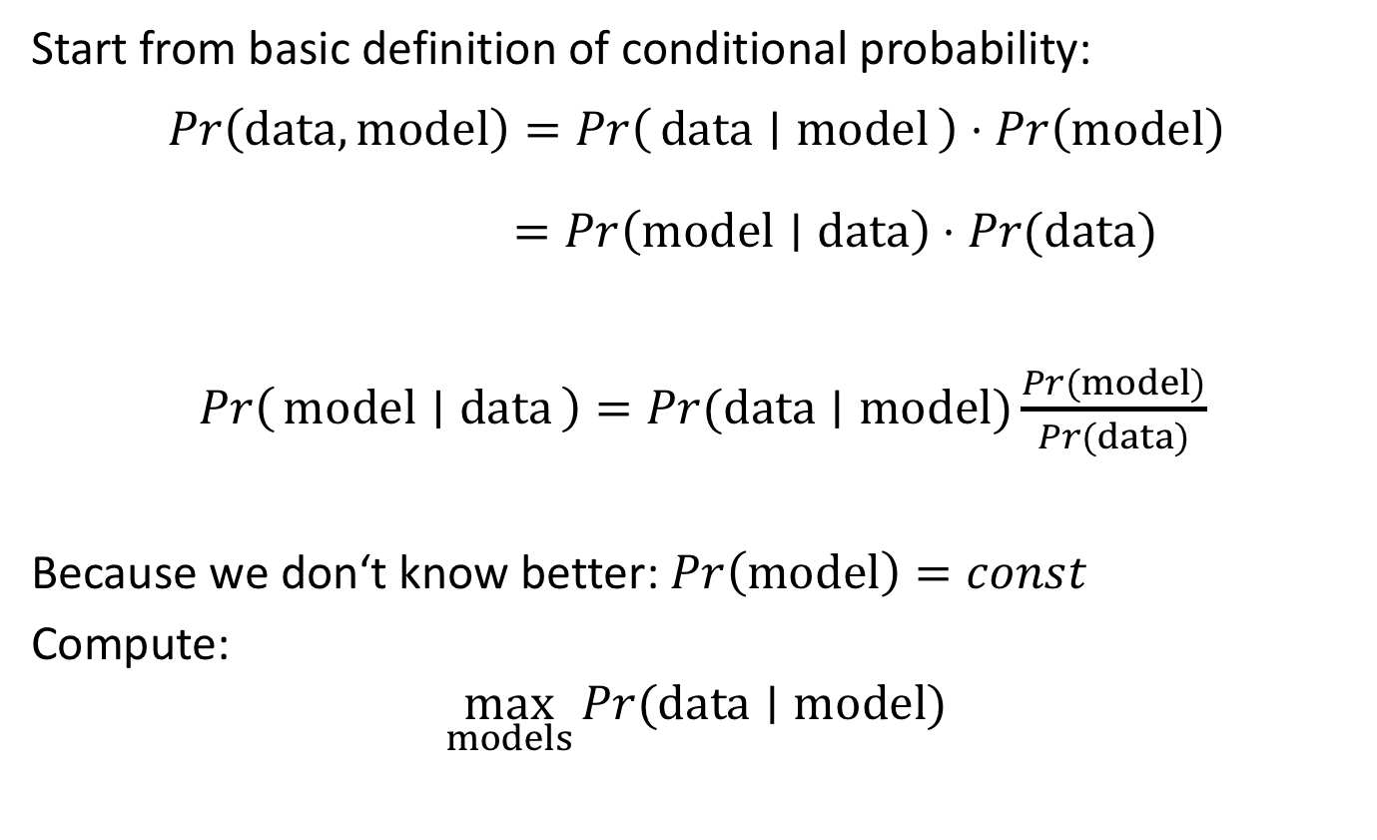
Maximum likelihood estimation
Start from basic definition of conditional probability:
$$Pr\left(data,model\right)=\operatorname{Pr}\left(data ∣ model\right)⋅\operatorname{Pr}\left(model\right)$$
$=\operatorname{Pr}\left(model∣data\right)⋅Pr⁡(data)$
$Pr\left(model ∣ data\right)=Pr⁡(data∣model)\frac{Pr⁡(model)}{Pr(data)}$
Because we don‘t know better: $\operatorname{Pr}\left(model\right)=const$
Compute:
$$\max_{models}{Pr⁡(data∣model)}$$
$$\max_{models}{}$$
posterior
likelihood L
prior

Slide 21
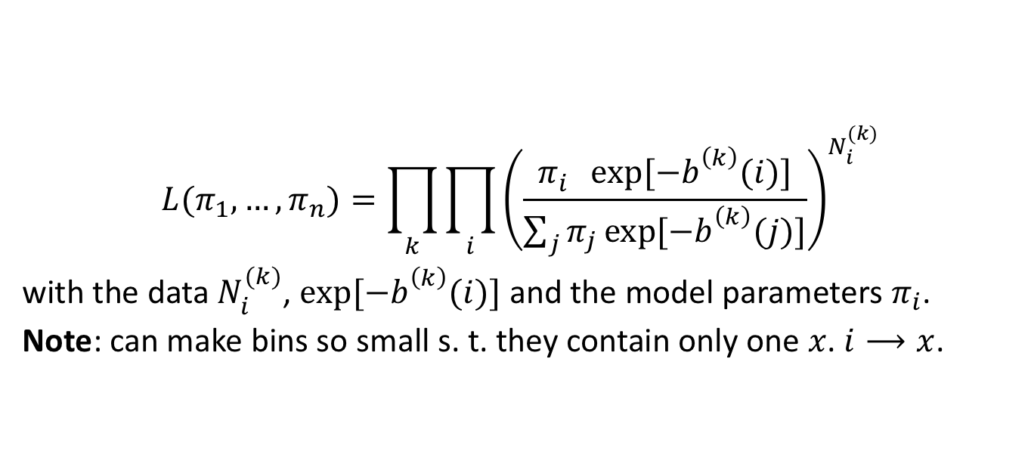
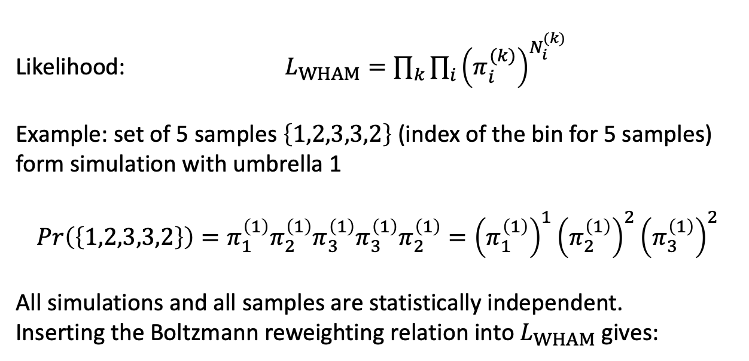
Likelihood for WHAM
Likelihood: $L_{WHAM}=\prod_{k}{\prod_{i}{{\left(π_{i}^{(k)}\right)}^{N_{i}^{(k)}}}}$
Example: set of 5 samples $\left\{1,2,3,3,2\right\}$ (index of the bin for 5 samples) form simulation with umbrella 1
$$Pr\left(\left\{1,2,3,3,2\right\}\right)=π_{1}^{\left(1\right)}π_{2}^{\left(1\right)}π_{3}^{\left(1\right)}π_{3}^{\left(1\right)}π_{2}^{\left(1\right)}={\left(π_{1}^{\left(1\right)}\right)}^{1}{\left(π_{2}^{\left(1\right)}\right)}^{2}{\left(π_{3}^{\left(1\right)}\right)}^{2}$$
All simulations and all samples are statistically independent.
Inserting the Boltzmann reweighting relation into $L_{WHAM}$ gives:
$$L(π_{1},…,π_{n})=\prod_{k}{\prod_{i}{{\left(\frac{π_{i}^{}\exp{[−b_{}^{\left(k\right)}(i)]}}{\sum_{j}{π_{j}\exp{[−b_{}^{\left(k\right)}(j)]}}}\right)}^{N_{i}^{(k)}}}}$$
with the data $N_{i}^{(k)}$, $\exp{[−b_{}^{\left(k\right)}(i)]}$ and the model parameters $π_{i}$.
Note: can make bins so small s. t. they contain only one $x$. $i⟶x$.
Notes:
Note 2: an arbitary chosen energy reference can be subtracted.

Slide 22

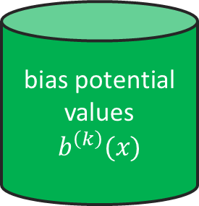
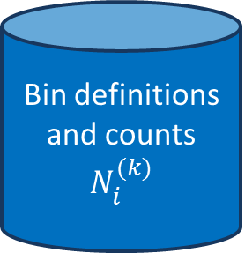
WHAM workflow
Bin definitions and counts
$$N_{i}^{(k)}$$
bias potential values
$$b^{\left(k\right)}(x)$$
$$L=\prod_{k}{\prod_{i}{{\left(\frac{π_{i}^{}\exp{[−b_{}^{\left(k\right)}(i)]}}{\sum_{j}{π_{j}\exp{[−b_{}^{\left(k\right)}(j)]}}}\right)}^{N_{i}^{(k)}}}}$$
probabilistic model:
optimize model parameters $π$
stationary probabilities (thermodynamics)

Slide 23


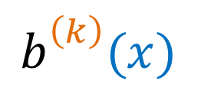
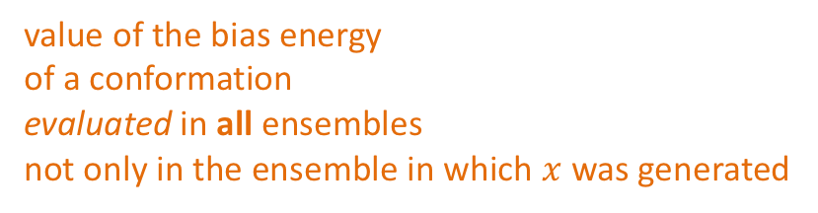
Computing the bias energies
A closer look at the anatomy of $b_{}^{\left(k\right)}(x)$:
in general multiple simulation runs
(independent trajectories)
$$b_{n}^{\left(k\right)}(x)$$
${\left\{b_{n}^{\left(k\right)}(x)\right\}}_{n}$
value of the bias energy
of a conformation
evaluated in all ensembles
not only in the ensemble in which $x$ was generated
for every conformation
This is 3-D data structure.
Since the trajectories might have different lengths this is a jagged/ragged array and not a tensor. In PyEmma it’s a list of 2-D numpy arrays:
btrajs = [
np.array([[0.0, ...], [1.2, ...]]),
np.array([[0.0, ...], [4.2, ...]]),
...
]

Slide 24
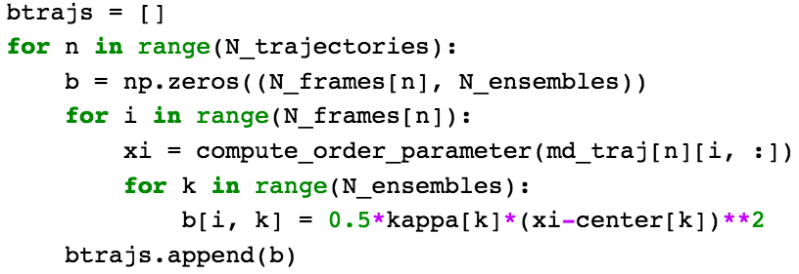

Computing the bias energies
Example: Umbrella sampling
All temperatures are the same
$$β^{(k)}=β=1/k_{B}T=1/(0.00198 kcal/mol K⋅300 K)$$
The bias is a quadratic function of an order parameter $ξ\left(x\right)$
$U^{\left(k\right)}\left(x\right)=\frac{1}{2}κ^{\left(k\right)}{\left(ξ(x)−ξ_{center}^{(k)}\right)}^{2}$
with the spring constants $κ^{\left(k\right)}$ and rest positions $ξ_{center}^{(k)}$.

Slide 25
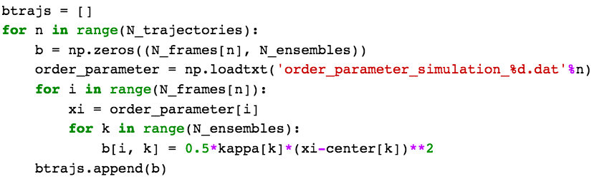
Computing the bias energies
Working with saved (pre-computed) order parameters:
Notes:
TODO: computing the ttrajs...

Slide 26
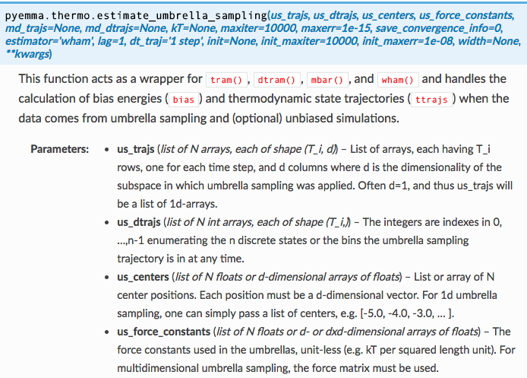
NOT computing the bias energies
order parameter
trajectories

Slide 27
Pyemma example

Slide 28
Combining free energy calculations with MSMs:
Multi Ensemble Markov Models

Slide 29
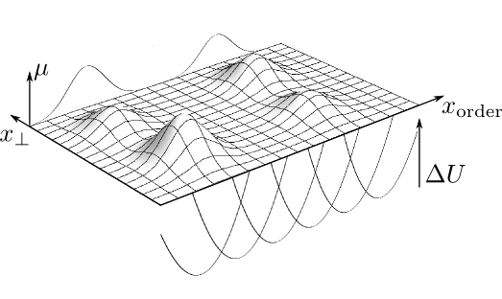

Problems of Umbrella sampling: slow orthogonal degrees of freedom
p(x)
Remember the WHAM likelihood:
$$L_{WHAM}=\prod_{k}{\prod_{i}{{\left(π_{i}^{(k)}\right)}^{N_{i}^{(k)}}}}$$
Second product means that samples are drawn from the equilibrium distribution $π_{i}^{(k)}$.

Slide 30

Problems of Umbrella sampling: slow orthogonal degrees of freedom
p(x)
In the energy landscape above, motion along $x_{⊥}$ can be highly autocorrelated.
So the assumption of independent samples may be wrong. → systematic error
Since we know that MSMs can be used to compute free energies reliably form correlated data, can’t we just somehow build an MSM along $x_{⊥}$?

Slide 31








MEMM
Multi Ensemble Markov Model $T_{ij}^{\left(k\right)}$
$$\left(\begin{matrix}T_{11}^{(1)} & ⋯ & T_{1n}^{(1)} \\ ⋮ & ⋱ & ⋮ \\ T_{n1}^{(1)} & ⋯ & T_{11}^{(1)}\end{matrix}\right)$$
index k = number of the Umbrella potential
= number of temperature in multi-temperature
simulations
indices i,j = number of the discrete Markov state,
i.e. bin number along $x_{⊥}$
or any other sensible state discretization
$$\left(\begin{matrix}T_{11}^{(2)} & ⋯ & T_{1n}^{(2)} \\ ⋮ & ⋱ & ⋮ \\ T_{n1}^{(2)} & ⋯ & T_{11}^{(2)}\end{matrix}\right)$$
2 × 2 example:
(2)
T₁₂
Ensemble 2
π
(2)
(2)
π
(2)
$$⋮$$
1
T₂₁
2
$$\left(\begin{matrix}T_{11}^{(K)} & ⋯ & T_{1n}^{(K)} \\ ⋮ & ⋱ & ⋮ \\ T_{n1}^{(K)} & ⋯ & T_{11}^{(K)}\end{matrix}\right)$$
(1)
(1)
T₁₂
(1)
Ensemble 1
π
π
1
(1)
2
T₂₁

Slide 32


MEMM
Multi Ensemble Markov Model $T_{ij}^{\left(k\right)}$
How the individual MSMs in the MEMM are coupled together?
- Part 1 of the answer:
Boltzmann reweighting of stationary distributions (like in WHAM)
$π_{i}^{(k)}=\frac{π_{i} \exp{[−b_{}^{\left(k\right)}(i)]}}{Z^{(k)}}$ $Z^{(k)}=\sum_{i}{π_{i}\exp{[−b_{}^{\left(k\right)}(i)]}}$
(2)
- Part 2 of the answer:
$π_{i}^{(k)}$ is the stationary distribution of $T_{ij}^{(k)}$.
We even require a stronger condition that $T_{}^{(k)}$ is reversible with respect to $π_{}^{(k)}$.
$π_{i}^{(k)}T_{ij}^{(k)}=π_{j}^{(k)}T_{ji}^{(k)}$
reversibility = detailed balance
T₁₂
π
(2)
(2)
π
(2)
1
T₂₁
2
(1)
(1)
T₁₂
(1)
π
π
1
(1)
2
T₂₁
$$Pr⁡(s(t+τ)=i and s(t)=j)=Pr⁡(s(t+τ)=j and s(t)=i)$$

Slide 33

(d)TRAM
(discrete) Transition-based Reweighting Analysis Method
How is the MEMM estimated?
Reminder - estimation of MEMs:
Likelihood for an MSM: $L_{MSM}=\prod_{i}{\prod_{j}{{\left(T_{ij}\right)}^{C_{ij}}}}$
Consider example trajectory ($1→2→2→1→2$)
$$Pr\left(1→2→2→1→2\right)=\operatorname{Pr}\left(1\right)⋅T_{12}⋅T_{22}⋅T_{21}⋅T_{12} \\ ∝{\left(T_{11}\right)}^{0}{\left(T_{12}\right)}^{2}{\left(T_{22}\right)}^{1}{\left(T_{21}\right)}^{1} \\ ={\left(T_{11}\right)}^{C_{11}}{\left(T_{12}\right)}^{C_{12}}{\left(T_{22}\right)}^{C_{22}}{\left(T_{21}\right)}^{C_{21}}$$
$$=\prod_{i=1}^{2}{\prod_{j=1}^{2}{{\left(T_{ij}\right)}^{C_{ij}}}}$$

Slide 34





(d)TRAM
(discrete) Transition-based Reweighting Analysis Method
How is the MEMM estimated?
Basically an MEMM is just a collection of MSMs.
$$L_{MEMM}(T_{}^{\left(1\right)},…,T_{}^{\left(K\right)})=\prod_{k}{L_{MSM}(T_{}^{\left(k\right)})}$$
Inserting gives:
$$L_{MEMM}=\prod_{k}{\prod_{i}{\prod_{j}{{\left(T_{ij}^{\left(k\right)}\right)}^{C_{ij}^{(k)}}}}}$$
Maximize $L_{MEMM}$ under the constraints:
$π_{i}^{(k)}T_{ij}^{(k)}=π_{j}^{(k)}T_{ji}^{(k)}$
$\sum_{j}{T_{ij}^{(k)}}=1$
$π_{i}^{(k)}=\frac{π_{i} \exp{[−b_{}^{\left(k\right)}(i)]}}{\sum_{j}{π_{j}\exp{[−b_{}^{\left(k\right)}(j)]}}}$
$T_{ij}^{(k)}≥0$

Slide 35






(d)TRAM: workflow
Markov states and transition counts $c_{ij}^{(k)}$
bias potential values
$$b^{\left(k\right)}(x)$$
$$L=\prod_{k}{\prod_{i}{\prod_{j}{{\left(T_{ij}^{\left(k\right)}\right)}^{c_{ij}^{(k)}}}}}$$
$$π_{i} \exp{[−b_{}^{\left(k\right)}(i)]}T_{ij}^{(k)}=π_{j} \exp{[−b_{}^{\left(k\right)}(j)]}T_{ji}^{(k)}$$
probabilistic model:
Optimize model parameters $π$and $T$.
stationary probabilities (thermodynamics)
$$π_{i}$$
kinetic probabilities (rates)
$$T_{ij}^{(k)}$$

Slide 36
Advantages of using (d)TRAM
Better estimation of free energies along the unbiased orthogonal degrees of freedom.
There is no initial equilibration transient where the simulation have to relax to global equilibrium.
Smaller de-correlation time (simulation time until one gets a new uncorrelated frame). More efficient usage of the data.

Slide 37

Kinetics and free energies are inseparably related in reversible systems.
Make use of detailed balance relation $\exp\left[−βf_{i}\right]T_{ij}=\exp\left[−βf_{j}\right]T_{ji}$
Define the Markov states.

Slide 38

Kinetics and free energies are inseparably related in reversible systems.
Make use of detailed balance relation $\exp\left[−βf_{i}\right]T_{ij}=\exp\left[−βf_{j}\right]T_{ji}$
Define the Markov states.
Biased simulation provides information about the $ΔF$‘s between the states.

Slide 39

Kinetics and free energies are inseparably related in reversible systems.
Make use of detailed balance relation $\exp\left[−βf_{i}\right]T_{ij}=\exp\left[−βf_{j}\right]T_{ji}$
Define the Markov states.
Biased simulation provides information about the $ΔF$‘s between the states
Unbiased simulations provide information about the transition probabilities in one direction.

Slide 40

Kinetics and free energies are inseparably related in reversible systems.
Make use of detailed balance relation $\exp\left[−βf_{i}\right]T_{ij}=\exp\left[−βf_{j}\right]T_{ji}$
Define the Markov states.
Biased simulation provides information about the $ΔF$‘s between the states.
Unbiased simulations provide information about the transition probabilities in one direction.
TRAM yields the missing probabilities, completing the model.

Slide 41
Real-world applications

Slide 42
PMI-Mdm2: medically relevant; complex mechanism
²⁵⁻¹⁰⁹Mdm2: amino acids 25-109 of Mdm2
  Mdm2 is a natural protein.
  Mdm2 is overexpressed (produced in increased quantity) in certain cancer types. This leads to pathogenic interaction of Mdm2 with other proteins
PMI: peptide (12 amino acids) was developed to stop this pathogenic interaction by blocking Mdm2’s binding site.
PMI is unfolded when unbound [2]
but folded when bound to Mdm2. [1]
→ We expect to see a process of coupled folding and binding.
image: X-ray crystal structure from [1]
[1] Pazgier et al., Proc. Natl. Acad. Sci. 106, 4665 (2009)
[2] Paul et al., Nat. Commun. 8, 1095 (2017)
Notes:
p=3.3nM/4.71mM/(1+3.3nM/4.71mM)

Slide 43





PMI-Mmd2: analysis of the physical data only
Not a single full unbinding event is contained in the physical data.
There are many long-lived states, that appear stable on time scales of 1 to 10 µs.
  The short (1µs) simulations do not escape these long-lived states.
  → No exit probabilities and not stationary weights ($π$) can be determined for these states.
→ No useful MSM could be estimated.
state 8
state 6
$T_{8j}$=?
$π_{8}$=?
$T_{6j}$=?
$π_{6}$=?

Slide 44





PMI-Mmd2: analysis of all simulation data with TRAM
We determine the dissociation constant $K_{d}={\left[P\right]}_{eq}{\left[L\right]}_{eq}/{\left[PL\right]}_{eq}$ from
our simulations using TRAM [3]: $0.34 nM$ [$0.22 nM$, $0.44 nM$]
experiment [3]: $3.02 nM$[$2.41 nM$, $3.63 nM$]
Agrees within the expected “force field” inaccuracies (factor of 10) [1,2].
We determine the residence time $k_{off}^{−1}$:
experimental value [3]
$26.8 s$ [$24.7 s$, $34.1 s$]
simulation result [3]:
$0.88 s$ [$0.48 s$, $1.33 s$]
Inclusion of biased data drastically reduces the statistical errors.
[1] Best et al., J. Chem. Theory Comput. 10, 5113 (2014) errors = 95% confidence intervals
[2] Rauscher et al., J. Chem. Theory Comput. 11, 5513 (2014)
[3] Paul ... Abualrous et al., Nat. Commun, 8, 1095 (2017)

Slide 45

Application 2: Trypsin-Benzamidine

Slide 46

PMI-Mdm2: binding mechanism

Slide 47
Further reading
Wu, Mey, Rosta, Noé: “Statistically optimal analysis of state-discretized trajectory data from multiple thermodynamic states”, J. Chem. Phys. 141, 214106 (2014)
Wu, Paul, Wehmeyer, Noé: “Multiensemble Markov models of molecular thermodynamics and kinetics”, PNAS 113, E3221–E3230 (2016)
Paul et al. “Protein-peptide association kinetics beyond the seconds timescale from atomistic simulations” Nat. Commun., 8, 1095 (2017)

Slide 48
Bin-less estimators

Slide 49










MBAR
$$π_{i}^{\left(k\right)}(≠N_{i}^{\left(k\right)})$$
Multistate Bennet acceptance ratio
$$L_{WHAM}=\prod_{k}{\prod_{i}{{\left(π_{i}^{(k)}\right)}^{N_{i}^{(k)}}}}$$
Width of the bin is never used.
Can put every sample in its own bin.
Then $N_{i}^{(k)}$ is either 1 or 0.
Ignore all factors of the form ${\left(π_{i}^{(k)}\right)}^{0}=1$.
$$L_{MBAR}=\prod_{k}{\prod_{x}{μ_{}^{\left(k\right)}(x)}}$$
$μ_{}^{\left(k\right)}\left(x\right)=\frac{e^{−b^{\left(k\right)}(x) }}{Z^{(k)}}μ_{}^{\left(ref\right)}\left(x\right)$
instead of $π_{i}^{(k)}=\frac{e^{−b_{}^{\left(k\right)}(i) }}{Z^{(k)}}π_{i}^{(ref)}$
$$i$$
$$μ^{(k)}(x)$$
$$x$$
$$μ^{(k)}(x)$$
WHAM: binning -> reweighting
MBAR: reweighting -> optional binning (for computing probabilities)
$$x$$

Slide 50
Bin-less TRAM
How to combine the benefits an MSM with bin-less reweighting?
For WHAM->MBAR we let go the bin-size to zero.
For dTRAM->TRAM this doesn‘t work. MSM with a high number of states are hard to handle.
Introduce the local equilibrium distribution.

Slide 51













The local equilibrium distribution
$$μ^{(1)}(x)$$
$μ^{\left(k\right)}(x_{j})$ : contribution of the sample $x_{j}$ to the Boltzmann distribution of ensemble $k$.
$μ_{i}^{\left(k\right)}(x_{j})$ : contribution of the sample $x_{j}$ to the Boltzmann distribution of ensemble $k$, given that the sample falls into Markov state $s_{i}$.
$$ℙ\left(x ∣ state i and ens. k\right)=\frac{ℙ⁡(x and x∈state i and ens. k)}{ℙ(state i and ens. k)}$$
$$⟹μ_{i}^{\left(k\right)}\left(x_{j}\right)=\frac{μ^{\left(k\right)}\left(x_{j}\right)χ_{i}\left(x_{j}\right)}{z_{i}^{\left(k\right)}}$$
$$=\frac{μ(x_{j})\exp\left[−b^{\left(k\right)}\left(x_{j}\right)\right]χ_{i}(x_{j})}{z_{i}^{(k)}}$$
$$x$$
$$μ^{\left(1\right)}(x)χ_{1}(x)$$
$$μ^{\left(1\right)}(x)χ_{2}(x)$$
$$x$$
$$μ_{1}^{(1)}(x)$$
$$μ_{2}^{(1)}(x)$$
$$x$$
Notes:
TODO: write out with bias

Slide 52







Formulation of the TRAM model
$$s_{t−τ}^{k}$$
$$s_{t}^{k}$$
$$s_{t+τ}^{k}$$
Discrete state
Continuous configuration
$$x_{t−τ}^{k}$$
$$x_{t}^{k}$$
$$x_{t+τ}^{k}$$
Simulation at ensemble $k$

Slide 53
Formulation of the TRAM model
$$s_{t−τ}^{k}$$
$$s_{t}^{k}$$
$$s_{t+τ}^{k}$$
Discrete state
Continuous configuration
$$x_{t−τ}^{k}$$
$$x_{t}^{k}$$
$$x_{t+τ}^{k}$$
Simulation at ensemble $k$
$ℙ\left(s_{t+τ}^{(k)}=j | s_{t}^{(k)}=i\right)=T_{ij}^{(k)}$ (modeling by MSM)

Slide 54





Formulation of the TRAM model
$$s_{t−τ}^{k}$$
$$s_{t}^{k}$$
$$s_{t+τ}^{k}$$
Discrete state
Continuous configuration
$$x_{t−τ}^{k}$$
$$x_{t}^{k}$$
$$x_{t+τ}^{k}$$
Simulation at ensemble $k$
$$μ_{1}^{(k)}(x)$$
$$μ_{2}^{(k)}(x)$$
$ℙ\left(x_{t}^{(k)} | s_{t}^{(k)}=i\right)=μ_{i}^{(k)}\left(x_{t}\right)$
(output according to local equilibrium)
$$x$$

Slide 55

Formulation of the TRAM model
Model for one (whole) trajectory:
$L(traj from ensemble k)=μ_{s(0)}^{(k)}⋅T_{s\left(0\right)s\left(1\right)}^{\left(k\right)}⋅μ_{s(1)}^{(k)}⋯T_{s\left(N−1\right)s\left(N\right)}^{\left(k\right)}$ $⋅μ_{s(N)}^{(k)}$
Rearranging:
$$L(k)=\prod_{i,j}{{\left(T_{ij}^{(k)}\right)}^{c_{ij}^{(k)}}}⋅\prod_{x∈X^{k}}{μ_{s(x)}^{(k)}}$$
Model for all trajectories from all ensembles:
$$L=\prod_{k}{L(k)}$$

Slide 56


TRAM: workflow
Markov states and transition counts
bias potential values
$$L=\prod_{i,j,k}{{\left(T_{ij}^{(k)}\right)}^{c_{ij}^{(k)}}}⋅\prod_{k}{\prod_{x∈X^{k}}{\frac{e^{−b^{(k)}(x)}μ\left(x\right)}{z_{s(x)}^{(k)}}}}$$
$$z_{i}^{(k)}T_{ij}^{(k)}=z_{j}^{(k)}T_{ji}^{(k)}$$
probabilistic model:
optimize model parameters $T$and $μ$ (and $z[μ]$)
stationary probabilities (thermodynamics)
kinetic probabilities (rates)

Slide 57

Relation between the methods

Slide 58


Bin-less estimators: why?
WHAM requires binning of the reweighting factors / bias energies
$e^{−b_{}^{\left(k\right)}(i) }=\exp{[−β^{\left(k\right)}U^{\left(k\right)}\left(i\right)+β^{(0)}U^{\left(0\right)}\left(i\right)]}$
Inconvenient if variations in $U_{}^{\left(k\right)}$ are large. For example multi-temperature simulations
$b_{}^{\left(k\right)}\left(i\right)=(β^{\left(k\right)}−β^{\left(0\right)})U\left(i\right)$
is related to the total potential energy. But this is additive in the number of particles $ΔU_{peak to peak}≈5\sqrt{N_{dof}}⋅kT$ (at $T=300K$)

Slide 59


TRAM: strategies for enhanced sampling of kinetics
Model system:

Slide 60



TRAM: strategies for enhanced sampling of kinetics
$ΔG$ MFPT

Slide 61




What is replica exchange?
${β^{(1)}U}^{(1)}$:
$β^{(0)}U^{(0)}$:
sample from generalized ensemble :
$$p\left(x_{i},x_{j},…,x_{k}\right)=\frac{e^{−β^{(0)}U^{(0)}(x_{i})}}{Z^{(0)}}⋅\frac{e^{−β^{(1)}U^{(1)}(x_{j})}}{Z^{(1)}}⋅…⋅\frac{e^{−{β^{(K)}U}^{(K)}(x_{K})}}{Z^{(K)}}$$
accept exchanges with Metropolis criterion
$p_{accept}=\min\left[1,\frac{e^{−β^{(1)}U^{(1)}(x_{2})}e^{−{β^{(2)}U}^{(2)}(x_{1})}}{e^{−β^{(1)}U^{(1)}(x_{1})}e^{−β^{(2)}U^{(2)}(x_{2})}}\right]$
with labels updated after an accepted exchange.
Fukunishi and Watanabe, J. Chem. Phys. 116, 9058 (2002)

Slide 62

The role of HREMD

Slide 63
What is valid input data for TRAM?

Slide 64


Overlap in (d)TRAM
Jo et al, J. Phys. Chem. B 120 8733 (2016) Rosta et al, J. Comput. Chem. 30, 1634 (2009)

Slide 65
Overlap in (d)TRAM
Jo et al, J. Phys. Chem. B 120 8733 (2016) Rosta et al, J. Comput. Chem. 30, 1634 (2009)

Slide 66




Overlap of biased distributions
Biased distributions have to overlap!
Diagnostics:
  Post-hoc replica exchange: How many exchanges would have been accepted if the simulation had been carried out with replica exchange between ensembles? How does this number compare to the number of simulated samples?
  $score=\left(N+M\right)\frac{1}{N M}\sum_{x∈X^{\left(k\right)}}{\sum_{y∈X^{\left(l\right)}}{\min\left[1, \frac{e^{−{βU}^{\left(k\right)}\left(x\right)}e^{−{βU}^{\left(l\right)}\left(y\right)}}{e^{−βU^{\left(k\right)}\left(y\right)}e^{−βU^{\left(l\right)}\left(x\right)}}\right]}} \text{≶}\text{ 1}$
  error of the free energies estimated by (M)BAR (equation from [1]). Alternative way to relate the overlap of distributions to the number of samples.
- - $U^{\left(1\right)}\left(x\right)$
- - $U^{\left(2\right)}(x)$
— $\exp{[−βU^{\left(1\right)}(x)]}$
— $\exp{[−βU^{\left(2\right)}(x)]}$
$$x$$
[1] Shirts and Chodera, Statistically optimal analysis of samples from multiple equilibrium states, J. Chem. Phys. 129, 124105 (2008)

Slide 67
Overlap in (d)TRAM
ensembles
enough local overlap between
biased probability distributions
reversible transitions
between Markov states
Markov states
Much of this is based on empirical evidence from numerical examples.
Notes:
TODO: orthogonal degree of freedom

Slide 68

TRAM: combining normal MD with biased MD
Markov states and transition counts
bias potential values
$$L=\prod_{i,j,k}{{\left(T_{ij}^{k}\right)}^{c_{ij}^{k}}}⋅\prod_{k}{\prod_{x∈X^{k}}{\frac{e^{−b^{k}(x)}μ\left(x\right)}{z_{s(x)}^{k}}}}$$
$$z_{i}^{k}T_{ij}^{k}=z_{j}^{k}T_{ji}^{k}$$
probabilistic model:
optimize model parameters $T$and $μ$ (and $z[μ]$)
stationary probabilities (thermodynamics)
kinetic probabilities (rates)

Slide 69

WHAM derivation
$$\log{L}=\sum_{i,k}{N_{i}^{(k)}\log{π_{i}^{(k)}}}$$
$$=\sum_{i,k}{N_{i}^{(k)}\log\left(\frac{π_{i}γ_{i}^{(k)}}{\sum_{j}{π_{j}γ_{j}^{(k)}}}\right)}$$
$$=\sum_{i,k}{N_{i}^{(k)}\log{π_{i}γ_{i}^{(k)}}}−\sum_{i,k}{N_{i}^{(k)}\log{\sum_{j}{π_{j}γ_{j}^{(k)}}}}$$
$$=\sum_{i,k}{N_{i}^{(k)}\log{π_{i}γ_{i}^{(k)}}}−\sum_{k}{N_{}^{(k)}\log{\sum_{j}{π_{j}γ_{j}^{(k)}}}}$$
$$\frac{∂L}{∂π_{n}}=\sum_{k}{\frac{N_{n}^{(k)}}{π_{n}γ_{n}^{(k)}}γ_{n}^{(k)}}−\sum_{k}{\frac{N^{\left(k\right)}γ_{n}^{\left(k\right)}}{\sum_{j}{π_{j}γ_{j}^{\left(k\right)}}}}=0$$
$$\frac{1}{π_{n}}\sum_{k}{N_{n}^{(k)}}=\sum_{k}{\frac{N^{\left(k\right)}γ_{n}^{\left(k\right)}}{\sum_{j}{π_{j}γ_{j}^{\left(k\right)}}}}$$
$$π_{n}=\frac{N_{n}}{\sum_{k}{\frac{N^{\left(k\right)}γ_{n}^{\left(k\right)}}{\sum_{j}{π_{j}γ_{j}^{\left(k\right)}}}}}$$

Slide 70

(d)TRAM: solution
update equations:
$$π_{i}^{new}=\frac{\sum_{j,k}{c_{ji}^{(k)}}}{\sum_{l,j}{\frac{\left(c_{ij}^{\left(l\right)}+c_{ji}^{\left(l\right)}\right)γ_{i}^{(l)}ν_{j}^{(l)}}{γ_{i}^{(l)}π_{i}ν_{j}^{(l)}+γ_{j}^{(l)}π_{j}ν_{i}^{(l)}}}}$$
$$ν_{i}^{\left(k\right),new}=ν_{i}^{(k)}\sum_{j}{\frac{\left(c_{ij}^{\left(k\right)}+c_{ji}^{\left(k\right)}\right)γ_{j}^{(k)}π_{j}}{γ_{i}^{(k)}π_{i}ν_{j}^{(k)}+γ_{j}^{(k)}π_{j}ν_{i}^{(k)}}}$$
transition matrix:
$$T_{ij}^{(k)}=\frac{\left(c_{ij}^{\left(k\right)}+c_{ji}^{\left(k\right)}\right)γ_{j}^{(k)}π_{j}}{γ_{i}^{(k)}π_{i}ν_{j}^{(k)}+γ_{j}^{(k)}π_{j}ν_{i}^{(k)}}$$
Notes:
Lagrange duality theory

Slide 71





dTRAM: workflow
Markov states and transition counts
$$c_{ij}^{(k)}$$
$$L=\prod_{i}{\prod_{j}{{\left(T_{ij}^{\left(k\right)}\right)}^{c_{ij}^{(k)}}}}$$
$$π_{i} \exp{[−b_{}^{\left(k\right)}(i)]}T_{ij}^{(k)}=π_{j} \exp{[−b_{}^{\left(k\right)}(j)]}T_{ji}^{(k)}$$
probabilistic model:
optimize model parameters $T$and $π$
stationary probabilities (thermodynamics)
$$π_{i}$$
kinetic probabilities (rates)
$$T_{ij}^{(k)}$$

Slide 72

NOT computing the bias energies
… but using the application-specific API:

Slide 73







Free energy: definition and use
By “free energies” we mean :
A) $–k_{B}T$ times the logarithm of probabilities of different conformational states within one thermodynamic ensemble
$$P(bound)=\frac{\int{χ_{bound}(x)e^{−βU(x)}dx}}{\int{e^{−βU(x)}dx}}$$
B) $–k_{B}T$ times the log of ratios of partition functions from different thermodynamic ensembles
$$e^{−β^{\left(1\right)}F^{\left(1\right)}+β^{(2)}F^{(2)}}=\frac{Z^{(1)}}{Z^{(2)}}=\frac{\int{e^{−β^{(1)}U^{(1)}(x)}dx}}{\int{e^{−β^{(2)}U^{(2)}(x)}dx}}$$
Uses:
calculating entropy $S=−{\left(\frac{∂F}{∂T}\right)}_{V,N}$ or
relative binding / solvation free energy
$$χ_{bound}=1$$
$$χ_{bound}=0$$

Slide 74
Example: umbrella sampling

