Slide 1
Telematics Chapter 9 CDN, ICN, P2P
D46A01
D462BA
D4213F
D1A08E
65A1FC
Univ.-Prof. Dr.-Ing. Jochen H. Schiller
Freie Universität Berlin
Institute of Computer Science
Computer Systems and Telematics (CST)

Slide 2
Content of this Chapter
CDN (Content Delivery Networks)
ICN (Information Centric Networking)
P2P (Peer to Peer Networks)

Slide 3
CDN – Application Example:
Principle: you upload a video to a webserver
Webserver has a database with uploaded videos
Webserver serves requests to play videos on demand
Problem: how do you scale this?
Billions of videos
Current video creation rate of 14 hours of new videos per second
Single server cannot deal with the load

Slide 4
Content Delivery Networks
Solution: Content Delivery Networks (CDN)
principle similar to DNS caches
CDNs have caches distributed everywhere and replicate content to your local cache
you access a cache close-by instead of a central server
Challenge 1: what/when to replicate?
Not viable to replicate everything: too much content
Challenge 2: how to route requests to local cache?
Origin server
in North America
CDN distribution node
CDN server
in Asia
CDN server
in S. America
CDN server
in Europe

Slide 5
Proprietary Approach to CDN
E.g. Google approach:
Google owns all the hardware and links. It is a proprietary network.
PULL strategy: the first request will have to fetch data to the central server and replicate it to the local cache
when cache is full, erase recently least used content.
PUSH strategy: content expected to be popular can be pre-provisioned in caches.
Google uses both PUSH and PULL strategies

Slide 6
Content Request Dispatching via DNS
Dispatching via DNS:
name server perform IP address resolution for youtube.com based on the geographical position of the source address of the resolution request.
name server uses special database for IP address geolocalisation
See for instance http://freegeoip.net or http://www.geocodeip.com
This enables redirection to local cache and load spreading
Remark: this is also how Facebook scales

Slide 7
Broker Approach to CDN
E.g. Akamai approach
Akamai: > 70k servers distributed globally
Caches using PUSH and PULL too
Akamai sells CDN service (e.g. to Yahoo)
Allows keeping hand on cookies & customer first contact
Allows not to have to maintain thousands of CDN servers

Slide 8
Content Request Dispatching via URL Translation
To download front page from Yahoo.com, initial HTTP request goes to Yahoo to get HTML (+manage cookie etc.)
But embedded images etc. and subsequent request use an URL such as yahoo.akamai.com/blabla
Akamai provide tool to automatically translate URL and HTML for its customers to use this solution
Such names are resolved by DNS like the Youtube solution, to redirect it to a local Akamai cache etc.

Slide 9
URL Translation example
Origin server (www.foo.com)
Distributes HTML
Replaces: http://www.foo.com/sports.ruth.gif with: http://www.cdn.com/www.foo.com/sports/ruth.gif
CDN company (cdn.com)
Distributes gif files
Authoritative DNS server to redirect requests
origin server
HTTP request for
www.foo.com/sports/sports.html
1
DNS query for
www.cdn.com
2
Client
CDN’s authoritative DNS server
3
HTTP request for
www.cdn.com/www.foo.com/sports/ruth.gif
CDN server near client

Slide 10
Content Request Dispatching via CNAME
CNAME aliasing in DNS in Yahoo name server
images.yahoo.com is listed as images.akamai.com
Akamai name server can then redirect to a particular Akamai cache.

Slide 11
More about CDNs
Routing requests
CDN creates a “map”, indicating distances from leaf ISPs and CDN nodes
When query arrives at authoritative DNS server:
Server determines ISP from which query originates
Uses “map” to determine best CDN server
CDN nodes create application-layer overlay network

Slide 12
Advantages of CDN
Robustness: so many caches that you can't do a DoS attack
Scalability: load is spread to thousands of servers
Smaller latency: content is accessed from a local cache

Slide 13
Content of this Chapter
CDN (Content Delivery Networks)
ICN (Information Centric Networking)
P2P (Peer to Peer Networks)

Slide 14
Information Centric Networking (ICN)
Principles
Similar to unmanaged/spontaneous CDN
Access content – not nodes
Publish/subscribe paradigm
Address content directly by name
Augment content with (self-)authentication
Ubiquitous in-network storage (caching)
Various approaches
Seminal: TRIAD (Gritter & Cheriton 2001)
Most popular: NDN (Van Jacobson et al. 2009)
Also see: Information-Centric Networking Research Group (ICNRG) irtf.org/icnrg

Slide 15
ICN Approaches
}
TRIAD
DONA Routing on names/RPF (Reverse Path Forwarding)
CCN/NDN
PSIRP/PURSUIT – Name resolution system publishes source routing identifiers (Bloom filters)
NetINF (4WARD/SAIL) - Name resolution system refers to publisher IDs, routes to pub. locators
Details, survey about current ICN approaches: Bengt Ahlgren, Christian Dannewitz, Claudio Imbrenda, Dirk Kutscher, Börje Ohlman: A survey of information-centric networking. IEEE Communications Magazine 50(7): 26-36 (2012)

Slide 16
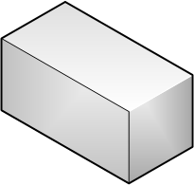
An ICN approach: Content Centric Networking (CCN)
Only two types of packets in the network:
Interest packets
Data chunks
In-network caching
peanuts.org
peanuts.org
peanuts.org
peanuts.org
I
FIB: *.org
FIB: *.org
Content Consumer
Content Supplier
peanuts.org
peanuts.org

Slide 17
An ICN approach: Content Centric Networking (CCN)
CCN Node

Slide 18
Advantages of ICN
Advantages:
simplified network stack
content awareness: in-network caching
multi-homing and mobility management
Drawbacks:
in-network state instability (content awareness!)
new attacks (interest for non-existing content?)
Bulk of Interest: Performance Measurement of Content-Centric Routing, In: Proc. of ACM SIGCOMM Poster, 2012

Slide 19
Content of this Chapter
CDN (Content Delivery Networks)
ICN (Information Centric Networking)
P2P (Peer to Peer Networks)

Slide 20
Peer-to-Peer (P2P) Architecture
In client-server architecture the server is by design the bottleneck
With a P2P architecture each client is also a server and is called a peer
Peers communicate between them through a logical network: an overlay
Peers may be directly or indirectly connected to one another via the overlay
Peers that directly connected are called neighbors
Across the overlay peers route based on names and not on addresses.
Peer
Peer
Peer
Peer
Peer
Peer
Peer

Slide 21
P2P Architecture
Goal: allow a more efficient use of resources (bandwidth, CPU etc.) compared to client-server architecture
Some advantages of P2P:
no central entity, no single point of failure
reduces/eliminates the demand for server clusters
content replication
flexibility, self-organization
some levels of anonymity
efficiency
the time for every peer to get a particular content grows logarithmically with the number of peers to be served, instead of a linearly with a client-server architecture

Slide 22
Peer-to-Peer: Some Applications
P2P protocols operate at the application layer
There are many P2P Applications today
P2P Telephony, e.g., Skype
P2P Instant Messaging, e.g., ICQ
P2P Content Sharing, e.g., Gnutella, Vuze, BitTorrent
P2P Resource Sharing, e.g., SETI@home
P2P Social Networks, e.g., Krawler
P2P Video Streaming, e.g., P2PTV, PDTP
…
IP Stack Model
Application Layer
Transport Layer
Network Layer
Data Link Layer
Physical Layer

Slide 23
Historical Background
Originally the Arpanet/Internet has a P2P design
All hosts provide services like (FTP, Telnet, …)
All hosts were equal
With increasing number of nodes the structure changed to a Client-Server architecture
Since 2000 and Napster’s breakthrough, new P2P applications are used massively

Slide 24
P2P vs Client-Server
“Opposite” of Client/Server
No central server  Information are highly distributed
Each peer can query, reply to queries, forward messages at the same time
Each peer “speaks” directly with other peers
Peer
Peer
Peer
Peer
Peer
Peer
Peer
Peer
Peer
Peer
Peer
Peer

Slide 25
P2P Overlay
Peer
Peer
Peer-to-Peer networks are overlay-networks
The focus is on the application layer
Peer
Peer
Peer
Physical topology of the network

Slide 26
Peer-to-Peer: General Problems
There are also some problems to solve
Retrieving of information
Discovery of other peers
Message routing
Keep network traffic low!
Classification of Peer-to-Peer Networks
Unstructured: Data are placed randomly
Structured: Data are placed systematically, e.g., in a Distributed Hash Table (DHT)

Slide 27
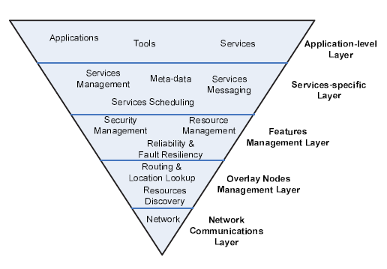
Peer-to-Peer: Overlay Architecture
Overlay architecture
Network communications
Network characteristics, how is the node connected
Overlay node management
Discovery of peers, routing
Features management
Security, reliability, fault resilience
Services-specific level
Application level
Tools on top of the P2P overlay
Main issue: The lookup problem
Where to store, and how to find a certain data item in a distributed system without any centralized control or coordination?

Slide 28
Peer-to-Peer: The Lookup Problem
I have item X.
Where to place X?
I want item X.
Where can I find X?
X
Peer
Peer
Peer
Peer
Peer
Peer
Peer

Slide 29
P2P Lookup Approaches
Peer
Centralized Approach
(using a server)
Central DB
Peer
Peer
1. request
2. response
Peer
6. file
5. request file
Peer
P2P Overlay Application
put(key, value)
remove(key)
value=get(key)
value
Distributed Hash Table
Distributed Approach
(using a DHT)
Peer
Peer
Peer

Slide 30
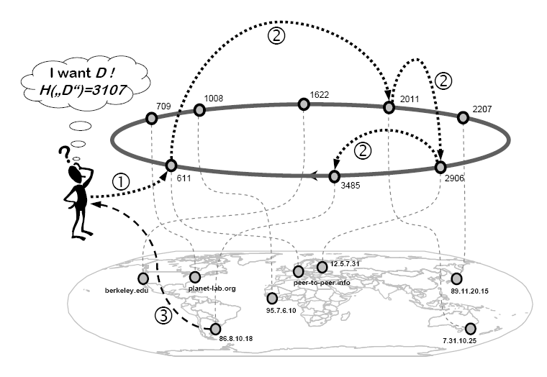
Distributed Hash Tables (DHT): General
DHTs are overlay networks that guarantee an upper bound for key look-ups
Each node and each object possesses a unique ID (hash key)
An object is stored on the node which is responsible for the object ID
A node is responsible for an ID if its own ID is the nearest to the object ID
All DHTs provide two basic routing operations
1. lookup(key) → node
2. put(object, key) → node

Slide 31
Distributed Hash Tables (DHT): General
Each node manages a small number of references to other nodes.
O(log N) references, N number of nodes
only the nodes matching particular requirements
By mapping nodes and data items into a common address space, routing to a node leads to the data items for which a certain node is responsible
Identifiers are distributed on the nodes nearly equally
Load for retrieving items may be balanced among the nodes

Slide 32
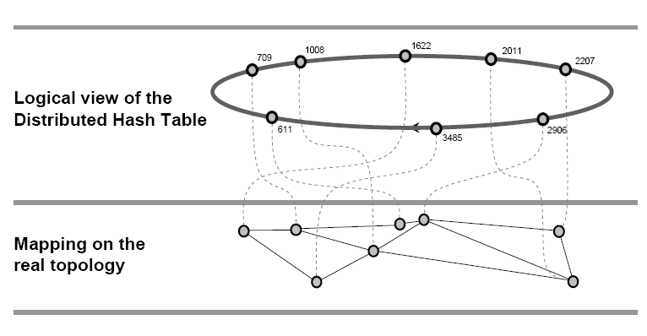
Distributed Hash Tables (DHT): General

Slide 33
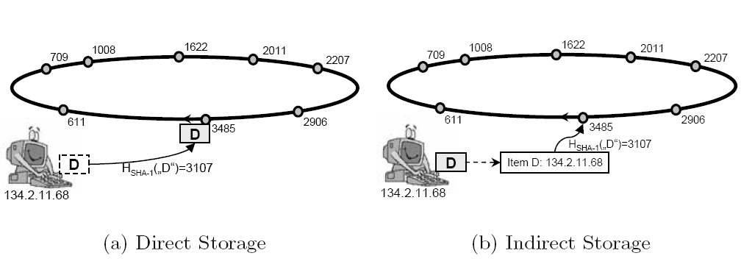
Distributed Hash Tables (DHT): General

Slide 34
DHT Properties
No node plays a particular role
Formation of hot spots or bottlenecks can be avoided.
Departure of a node does not have considerable effects on the DHT
DHTs are considered robust against random failures and attacks
Distributed index provides a definitive answer about results
If a data item is stored in the system, the DHT guarantees that the data is found
An item can be located by routing via O(log N) hops in the overlay

Slide 35
DHT Algorithms
Popular DHT algorithms:
Content Addressable Network (CAN)
Chord
Pastry
Tapestry

Slide 36
DHT Example: Pastry
Nodes are organized in a virtual ID ring from 0 to 2¹²⁸ – 1
Each node and object is assigned a 128 bit key (hash key)
Each ID is sequence of numbers in the base 2^{b} (b=1 binary, b=4 hex)
The routing is based on prefix matching
Considers the topological distance
Each node maintains
a forwarding table
a leaf set
Leaf set
Contains the L closest nodes
L/2 smaller nodes
L/2 larger nodes
Typical values for |L| are 2^{b} or 2 * 2^{b}

Slide 37
Pastry – Routing Table (1)
Routing table
log₂b N rows
Each row has 2^{b} – 1 entries
Each entry in row n has the same n digit prefix as the current node
Each entry in row n differs on the (n+1)-th position from the current node
Each of these entries has one of the 2^{b} -1 digits on the (n+1)-th position

Slide 38
Pastry – Routing Table (2)
Routing table
NodeID 34035761, b = 3
row
0
1
2
3
4
5
6
0 | 1 | 2 | 3 | 4 | 5 | 6 | 7
03761261 | 13541241 | 27235106 |  | 45521251 | 53610176 | 65547772 | 71154601
30771255 | 31521225 | 32236556 | 33400741 |  | 35716236 | 36124163 | 37715026
 | 34102724 | 34203162 | 34303735 | 34404216 | 34576555 | 34653437 | 34734152
34006624 | 34012773 | 34025354 |  | 34045631 | 34050032 | 34064645 | 34076214
34030342 | 34031643 | 34032346 | 34033652 | 34034040 |  | 34036123 | 34037437
34035073 | 34035152 | 34035031 |  | 34035070 |  | 34035667
34035701 | 34035717 |  |  | 34035740 |  |  | 34035774
smaller | 34035667 | 34035701 | 34035717 | 34035740
larger | 34035774 | 34036012 | 34036042 | 34036076
Leaf Set

Slide 39
DHT Routing with Pastry (1)
Routing in Pastry
Node n searches the node responsible for key k
Node n searches its forwarding table for a node with better prefix matching
A node which has at least one more digit matching k (compared to node n)
If such a node does not exists the leaf set is searched for a node which is lexicographically closer to k
This process is repeated in each node until the query arrives at the node which is responsible for key k
Intuitive: with each routing step the matching prefix grows for one position
O(log₂b N) (Overlay-) routing effort

Slide 40
DHT Routing with Pastry (2)
key: D469FC
D46A01
D462BA
D4213F
D1A08E
65A1FC

Slide 41
Overlay vs Physical Topology (1)
DHTs can route very efficiently in the overlay network
However, there is no relationship between the overlay- and physical topology
Neighbors in the overlay network are rarely neighbors on the physical network
DHTs may show high Overlay Stretch
The ratio of the accumulated physical route during the overlay routing for the search of a key and the real path length between source and destination nodes

Slide 42
Overlay vs Physical Topology (2)
key: D469FC
D46A01
D462BA
D4213F
D1A08E
65A1FC
Overlay Stretch = 17/2

Slide 43
Overlay vs Physical Topology (3)
Several methods to reduce the overlay stretch
Proximity Neighbor Selection (PNS) in Pastry
Each Pastry-node selects periodically a random entry from row i from its routing table
This random node replies with the i-th row from its routing table
After the response, the node computes pair wise the distance to the own entries and the entry from the response (e.g. PING/PONG)
If needed the own entry is replaced by the entry from the response if it is physically closer than the own entry (e.g. hop count, round trip time)

Slide 44
Overlay vs. Physical Topology (4)
Landmarking
Fixed set of Landmark-Nodes
Each node measures periodically its distance to all Landmark-Nodes
Sequence of the Landmark-Nodes
Idea: Nodes with the same Landmark-Distance-Sequence are with high probability physically close to each other
Nodes with same Landmark-Distance-Sequence assign each other numerical close overlay Ids
Example: 16 Landmark-Nodes in a Pastry-Network with hex IDs
Nodes with the same Landmark-Distance-Sequence assign to each other the same overlay-ID-prefix

Slide 45
Exmaple P2P Application: Bit-Torrent
Very popular nowadays for content sharing
Introduced in 2001 but became massively used only much later

Slide 46
Bit-Torrent Elements
torrent: key to the overlay network corresponding to a particular file
tracker: super nodes that keep track of the peers in a particular overlay (their IP addresses, and sharing statistics for each peers)
Example of trackers: The Pirate Bay, Mininova
indexer: An index is a list of .torrent files (usually including descriptions and other information) managed by a website and available for searches.
An index website can also be a tracker.
magnet: unique identifier for the file (like ISBN or catalog number)
Generated by content-based hash, i.e. can be generated by anyone who already has the file, without the need for a central authority
Magnet names can thus be considered as Unified Ressource Name
Examples of bit-torrent clients: Vuze, uTorrent, etc. are bit-torrent clients which implement the Bit-Torrent protocol
Examples of torrent search engines: Pirate Bay, ISO hunt
Notes:
Appeared in 2001, but became popular much later

Slide 47
Bit-Torrent Protocol Overview
A file is broken up into a series of atomic chunks
e.g. 256kB each, or more, up to a few MBs, depending on the size of the file
Torrent file describes the number of chunks
The content originator/uploader is a seeder
Any peer which has the full file and stays online is a seeder.
Peers are generally uploading and downloading at the same time.
Peers that just download are called leechers
2 methods used for lookup:
Centralized approach: through a tracker, a peer interested in a particular file can learn how many seeders are there and who they are etc.
Distributed approach: using a DHT, each peer is a tracker for some content
Through the overlay, the peer can ask other peers/seeder for some chunks, starting with the rarest chunks first

Slide 48
Bit-Torrent Protocol Overview
Peers exchange chunks (upload+download)
Seeds just send chunks (upload only)
Scaling property: the original seeder only has to upload each chunk once, and it can be uploaded to any number of peers!
Tit-for-tat: connection from peer to leechers are dropped after some time in order to discourage free-riding
Each peer keeps track of its top 4 peers
every 30s tries a random new connection to another peer and periodically drops connection to the worst peer

Slide 49
P2P Summary
The Peer-to-Peer principle is not really new
However, with the growth of the Internet and emerging of new applications a new wave of P2P applications was created
A P2P network is a overlay network on the Application Layer
In a P2P network all peers have the same role
There are also companies using P2P legally!
Skype uses a P2P overlay to get passed NAT, using resources of peers that are not behind NATs to relay traffic for conversations between 2 peers that are each behind a NAT
mininova music distribution
inside of data centers (inside Facebook which uses 70k servers)

