Slide 1
TI II: Computer Architecture
Microarchitecture
Microprocessor Architecture
Microprogramming
Pipelining (superscalar, multithreaded, hazards, prediction, vector processing)
Notes:
In diesem Kapitel werden die folgenden Themen behandelt:
Aufbau von Mikroprozessoren
Steuerwerk
Rechenwerk
Registerwerk
Adresswerk
Systembusschnittstelle
Leistungssteigerung von Rechensystemen
Pipeline
Pipeline hazards
Prediction
Vector-Pipelining
Superscalar Processors
VLIW
Multi-Threading
Beispiele zu Mikroprozessoren

Slide 2
Content
Introduction
  Single Processor Systems
  Historical overview
  Six-level computer architecture
Data representation and Computer arithmetic
  Data and number representation
  Basic arithmetic
Microarchitecture
  Microprocessor architecture
  Microprogramming
  Pipelining
Instruction Set Architecture
  CISC vs. RISC
  Data types, Addressing, Instructions
  Assembler
Memories
  Hierarchy, Types
  Physical & Virtual Memory
  Segmentation & Paging
  Caches

Slide 3
Where are we now? - The Six-Level-Computer
Level 5
Problem-oriented language level
Java, C#, C++, C, Haskell, Cobol, …
Translation (Compiler)
Javac,
VS .NET
Level 4
Assembly language level
Java Byte Code, MSIL/CIL
Translation (Assembler)
JVM, CLR;
JIT/Interpreter
Level 3
Operating system machine level
Unix, Windows, iOS
Partial interpretation (operating system)
JVM, CLR;
JIT/Interpreter
Level 2
ISA (Instruction Set Architecture) level
x64, x86, PPC, ARM, …
Interpretation (microprogram) or direct execution
microprogram/
none
Level 1
Microarchitecture level
Netburst, ISSE, ASX, <none>, …
Hardware
hardware
Level 0
Digital logic level
Core i7-3960X, ARM9, PPC620, …

Slide 4
Basic architecture of a simple micro processor
data and address bus
bus interface
data
data
instructions
(opt.)
(opt.)
register
control
signals
data
control unit
external
control signals
ALU
control signals
data

Slide 5
Basic architecture of a simple microcomputer
Central
processing unit (CPU)
    Do not mix it up!
Control
unit
Ar
ithmetic
logical unit
(ALU)
I/O de
vices
Registers
Main
Disk
Printer
…
…
memory
Bus

Slide 6
Basic architecture of a simple ALU – see chapter 2
s₁ | s₂ | ALU1 | ALU2
0 | 0 | X | Y
0 | 1 | X | 0
1 | 0 | Y | 0
1 | 1 | Y | X
register X
register Y
s₁
multiplexer
s₂
c_{in}
s₃ | s₄ | s₅ | ALU3
0 | 0 | 0 | ALU1 + ALU2 +c_{in}
0 | 0 | 1 | ALU1 – ALU2 – Not(c_{in})
0 | 1 | 0 | ALU2 – ALU1 – Not(c_{in})
0 | 1 | 1 | ALU1 ∨ ALU2
1 | 0 | 0 | ALU1 ∧ ALU2
1 | 0 | 1 | Not(ALU1) ∧ ALU2
1 | 1 | 0 | ALU1 ⊕ ALU2
1 | 1 | 1 | ALU1 ↔ ALU2
zero
ALU1
ALU2
s₃
sign
arithmetic logic
s₄
over-
circuit
s₅
flow
ALU3
c_{out}
s₆
shifter
s₇
s₆ | s₇ | Z
0 | 0 | ALU3
0 | 1 | ALU3 ÷ 2
1 | 0 | ALU3 × 2
1 | 1 | store Z
register Z

Slide 7
Internal architecture of a simple and simplified microprocessor
clock
status signals
control signals
system clock
reset
control unit
registers
controller, decoder
opcode
registers
execution unit
control register
operand register
arithmetic logic unit
floating point unit
execution unit
address generation, load
store, branch execution,
memory management
status register
system
bus
interface
data bus buffer
address bus buffer
V_{CC}
GND
data bus
control bus
address bus

Slide 8
Control Unit
clock
status signals
control signals
system clock
reset
control unit
controller, decoder
opcode
registers
control register

Slide 9
Overview
clock
The control unit controls all the components
The clock generates the system clock for distribution to all components
Opcode registers contain the portion of the instruction that specifies the currently executed operation to be performed (and maybe some additional opcodes)
The decoder (often micro-programmable) generates all control signals for the components and uses status signals and opcode as input
The control register stores the current status of the control unit
control unit
status signals
control signals
system clock
reset
controller, decoder
opcode
registers
control register

Slide 10
Clocking / synchronization
clock
Synchronous sequential circuit
  Typically, CPUs use dynamic (clocked) logic
  State is stored in gate capacitances
  Static logic uses flip-flops instead
Minimum clock-speed required
  Otherwise, stored bits are lost due to leakage before the next clock-cycle
Complex clock distribution network on-chip required
control unit
status signals
control signals
system clock
reset
controller, decoder
opcode
registers
control register

Slide 11
Micro programmable control unit
clock
The processor stores a microprogram for each instruction
  Microprogram: sequence of micro instructions
  Normal users cannot change the microprogram
  of a processor
  However, manufacturers can update the microprogram
Pure RISC processors typically do not use microprograms but a
fixed sequential circuit
Example micro instruction:
Single bits of the micro instruction represent micro operations, thus a setting of the control signals for the components
control unit
status signals
control signals
system clock
reset
controller, decoder
opcode
registers
control register
next address
registers
ALU operation
ALU operands
interface control
address generation
external control signals

Slide 12
Phases of instruction execution
clock
Instruction fetch
  Load the next instruction into the opcode register
Instruction decode
  Get the start address of the microprogram representing
  the instruction
Execution
  The microprogram controls the instruction execution by sending
  the appropriate signals to the other components and evaluating the returned signals
control unit
status signals
control signals
system clock
reset
controller, decoder
opcode
registers
control register

Slide 13
Opcode register
clock
The opcode register consists of several registers because
  different instructions may have different sizes
  (1 byte, 2 bytes, 3 bytes …)
  opcode prefetching may speed-up program execution
    while decoding the current instruction the following
    instructions may be prefetched
    this supports pipelining, branch prediction etc. (covered later)
control unit
status signals
control signals
system clock
reset
controller, decoder
opcode
registers
control register

Slide 14
Control register
clock
The control register stores the current state
of the control unit.
This influences e.g. instruction decoding, operation mode.
The meaning of the bits depend on the processor.
Examples:
    Interrupt enable bit
      determines if the processor reacts to interrupts
    Virtual machine extensions enable
      enable hardware assisted virtualization on x86 CPUs
    User mode instruction prevention
      if set, certain instructions cannot be executed in user level
    see e.g. https://en.wikipedia.org/wiki/Control_register
control unit
status signals
control signals
system clock
reset
controller, decoder
opcode
registers
control register

Slide 15
Questions & Tasks
  Look at the internal architecture of a simple microprocessor. Where are potential performance bottlenecks?
  Who decides if data flows to an execution or control unit?
  What are advantages / disadvantages of micro programming?
  Name examples of control and status signals to / from the environment!
  Why do we need a reset?
  What limits the clock frequency (min/max)?

Slide 16
Execution unit
execution unit
operand register
arithmetic logic unit
floating point unit
execution unit
address generation, load
store, branch execution,
memory management
status register

Slide 17
Overview
execution unit
The execution unit executes all logic and arithmetic
operations controlled by the control unit.
Examples:
    Integer and float arithmetic operations
    Logic operations, shifting, comparisons
    All address related operations
    Speculative operations (covered later)
    Complex memory management, memory protection
    …
Status register informs the control unit about the state of the processor after an operation
    Examples: carry, overflow, zero, sign
Operand registers, accumulators etc.: additional registers for temporary results, fetched operators etc.
operand register
arithmetic logic unit
floating point unit
status register
execution unit
address generation, load
store, branch execution,
memory management

Slide 18
Connection to the control unit
Single bits of a micro instruction directly control e.g. ALU and operand register
next address
registers
ALU operation
ALU operands
interface control
address generation
external control signals
s₃ | s₄ | s₅ | ALU3
0 | 0 | 0 | ALU1 + ALU2 +c_{in}
0 | 0 | 1 | ALU1 – ALU2 – Not(c_{in})
0 | 1 | 0 | ALU2 – ALU1 – Not(c_{in})
0 | 1 | 1 | ALU1 ∨ ALU2
1 | 0 | 0 | ALU1 ∧ ALU2
1 | 0 | 1 | Not(ALU1) ∧ ALU2
1 | 1 | 0 | ALU1 ⊕ ALU2
1 | 1 | 1 | ALU1 ↔ ALU2
execution unit
operand register
arithmetic logic unit
floating point unit
ALU1
ALU2
arithmetic logic
s₃
s₄
s₅
status register
circuit
ALU3

Slide 19
Status register (flag register, Condition Code Register CCR)
Single bits representing the state of the processor after an operation are stored in the status register.
Common bits in the status register (often called flags):
    Auxiliary Carry, AF
    Carry Flag, CF
    Zero Flag, ZF
    Even Flag, EF
    Sign Flag, SF
    Parity Flag, PF
    Overflow Flag, OF
    …
execution unit
operand register
arithmetic logic unit
floating point unit
status register
AF
CF
ZF
EF
SF
PF
OF
…

Slide 20
Description of the status flags 1
Auxiliary Carry (AF)
    Indicates a carry between the nibbles (4 bit halves of a byte)
    Used for BCD (binary coded digit) arithmetic
    Also called half-carry flag, digit carry, decimal adjust flag
Carry Flag (CF)
    Indicates a carry produced by the MSBs
    Allows for addition/subtraction of numbers larger than a single word by sequential additions/subtractions taking the carry into account
Zero Flag (ZF)
    Indicates that the result of an operation was zero
    Used for conditional branches or loops (e.g. if x=y then… is translated into SUB x,y,z; BZ…)

Slide 21
Description of the status flags 2
Even Flag (EV)
    Indicates if the result is even or odd (LSB)
Sign Flag (SF)
    Indicates if the result is negative (MSB = 1) in two’s complement
    Used e.g. for conditional branches (if x > y then … is translated into SUB y,x,z; BNP…)
Parity Flag (PF)
    Indicates if the number of set bits is even or odd
    Used e.g. for error detection
Overflow Flag (OF)
    Indicates that the result of an operation is too large to be represented (e.g. during addition or subtraction)

Slide 22
Program Status Word (PSW)
Status register plus control register determine the current state of a processor
    Result of an operation
    Privilege level
    …
Together with the program counter (address of the current or next instruction) these registers determine the state of the processor at a certain instruction of a program (or process, task, …).
The PSW combines the registers and program counter for simpler manipulation.
    Pushed to stack before context switch (e.g. switch to another process)
    Pulled from stack to continue execution of an interrupted process
Different names and semantics depending on processor architecture…

Slide 23
Typical (simple) operations of an ALU
Arithmetic
    Addition with/without carry
    Subtraction with/without carry
    Increment/decrement
    Multiplication with/without sign
    Division with/without sign
    Two’s complement
Logical
    NOT
    AND
    OR
    XOR
Shift and rotation
    Shift left
    Shift right
    Rotate right without carry
    Rotate right with carry
    Rotate left without carry
    Rotate left with carry
Memory
    Transfer
    Load, store

Slide 24
Questions & Tasks
  What do we need a status register for?
  What is the idea behind the PSW? When and why do we have to save it?
  How can we add very, very long integers (that do not fit into the operand registers of the ALU)?
  When do we typically use the flags?
  How do we know when the ALU finished its calculations?

Slide 25
Registers

Slide 26
Registers
Extend the registers of the execution unit
Storage of frequently used operands
Much faster than the main storage
clock
control unit
status signals
control signals
system clock
reset
registers
controller, decoder
opcode
registers
execution unit
control register
operand register
arithmetic logic unit
floating point unit
execution unit
address generation, load
store, branch execution,
memory management
status register
system
bus
interface
data bus buffer
address bus buffer
V_{CC}
GND
data bus
control bus
address bus

Slide 27
Registers
Very fast memory with very low access time (< 1 ns)
Direct selection of single registers via dedicated control lines
    No address decoder / decoding necessary
All registers are on-chip
    No external access necessary with delays due to run-time, multiplexing, buffering etc.
Can offer additional functions
    Increment/decrement
    Shift
    Set to zero, hardwired to zero
Several independent input/output port
    Simultaneous writing and reading of several (different) registers possible
    Today’s superscalar processors are able to write 4 registers and read 8 registers in one clock cycle
registers
registers

Slide 28
Register file – example
R₀
R₁
general purpose registers
(operands, addresses)
R_{n}
register file
USP
user stackpointer
SSP
supervisor stackpointer
FB
frame pointer
special purpose registers
BP
base pointer
VB
vectorbase register
PC
program counter
status register
PSW
control register

Slide 29
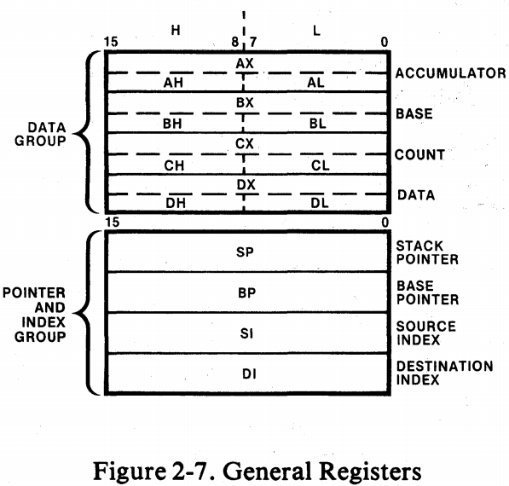
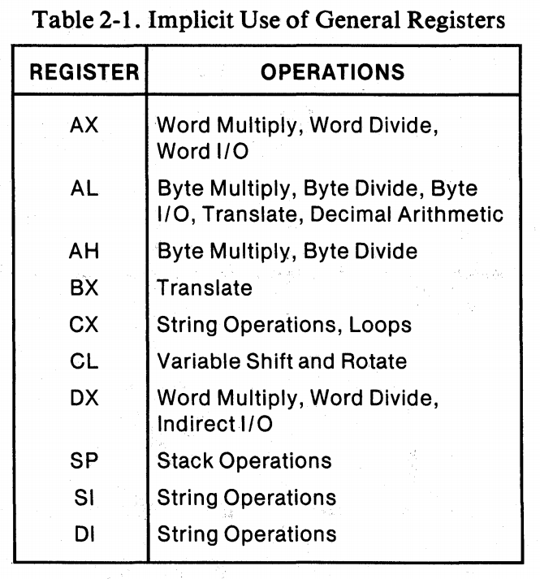
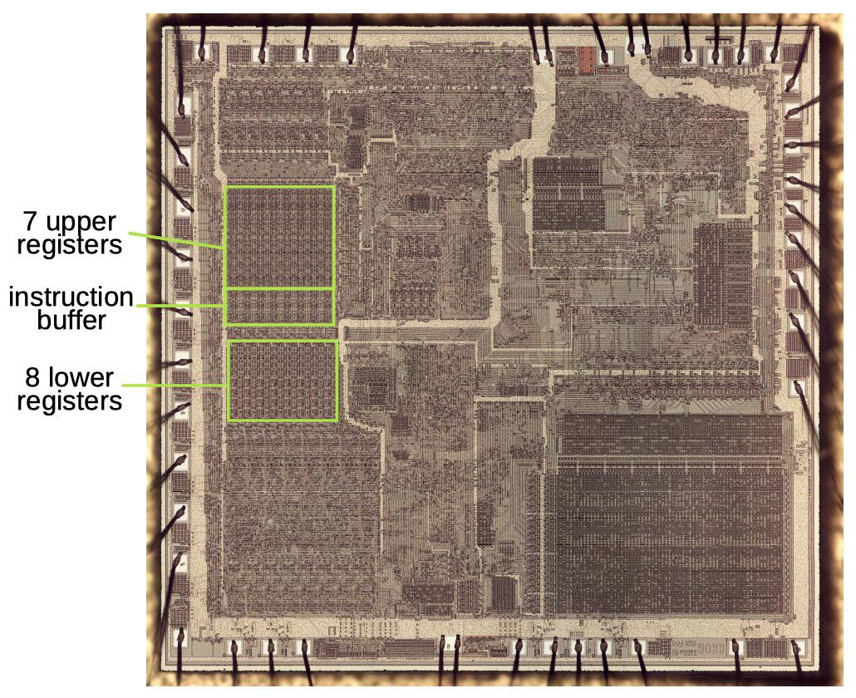
Register file – example: Intel 8086 (first generation personal computers)
The 8086 Family User‘s Manual, Intel, October 1979
http://www.righto.com/2020/07/
the-intel-8086-processors-registers.html

Slide 30
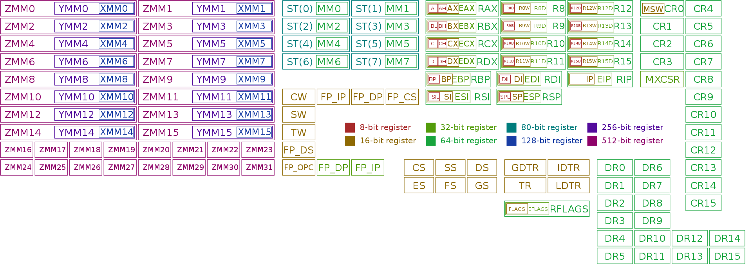
Register file – example: x86-64 (current Intel/AMD processors)
https://en.wikipedia.org/wiki/X86

Slide 31
Special registers: base pointer and index
The base pointer contains the start address of a memory region
    The memory could e.g. represent an array
The index represents the offset relative to the base pointer
    Selection of a single element e.g. of an array
Base pointer + index gives the absolute address of an element
Programming can be done relative to the base pointer
    This allows for e.g. moving or copying the array without changing the relative addressing
memory
index register
element_{i}
base pointer
element₀

Slide 32
Special functions of index registers
Post-increment
    Automatic increment of the register by n after addressing the memory
Pre-decrement
    Automatic decrement of the register by n before addressing the memory
Auto-increment / auto-decrement
Auto-scaling by factor n (1, 2, 4, 8 etc.)
    Used to access memory in bytes/words/…
Saves time as the ALU is freed from this additional operation when using the index!

Slide 33
The (runtime-) stack
Part of the memory (typically in the main memory) that is organized as stack following the LIFO (Last-In-First-Out) principle.
Purpose
    Stores the PSW (status of processor, program counter) during subroutine call / interrupt processing
    Parameter passing
    Storage of temporary results
Processors often come with several stacks for different purposes: system stack, user stack, data stack, …
Hardware support
    special register: stack pointer – address of the newest data on the stack
Special instructions to transfer data to/from the stack
    PUSH: transfer the value of a register on top of the stack
    POP (PULL): load a register with the value on top of the stack and remove this element

Slide 34
Management of a stack pointer
memory address
PUSH: stack grows
POP: stack shrinks
The stack pointer always points to the address of the element on top of the stack.
Stacks quite often grow from “top-to-bottom”, i.e., from higher to lower addresses.
PUSH x: decrement the stack pointer, then load the value of register x on top of the stack (i.e. into the memory at the address the stack pointer points to)
POP x: load the value stored at the address the stack pointer points to into register x, then increment the stack pointer (i.e. reduce the size of the stack by one element)
Here we can use index registers with pre-decrement and post-increment.
SP
n
n+2
n+1
n
n-1
n-2
PUSH
POP
SP
n-1
SP
n+1
n+2
n+2
n+1
n+1
n
n
n-1
n-1
n-2
n-2
value of register x
value for register x

Slide 35
Address generation unit
execution unit
address generation, load
store, branch execution,
memory management

Slide 36
Address generation unit
Specialized part of the execution unit
Basic operation: calculate an address based on control signals from the control unit and possibly additional content of registers
    e.g. base pointer + index = address
Can be very simple, but also very complex
    MMU (memory management unit)
    many different modes, memory protection, virtual address space
    cache optimization, branch prediction, speculative loading etc.
    covered later!
execution unit
address generation, load
store, branch execution,
memory management

Slide 37
System bus interface
system
bus
interface
data bus buffer
address bus buffer
data bus
control bus
address bus

Slide 38
System bus interface
The system bus interface (Bus Interface Unit, BIU) is the connection of the microprocessor to its environment (all the other components of a micro computer)
Purpose
    Buffering of addresses and data (operands and instructions)
    Adaptation of clock cycles, bus width, voltages
    Tristate: detaching the processor from the external bus
system
bus
interface
data bus buffer
address bus buffer
data bus
control bus
address bus

Slide 39
Internal bus system
clock
status signals
control signals
system clock
reset
control unit
registers
controller, decoder
opcode
registers
execution unit
control register
operand register
arithmetic logic unit
floating point unit
execution unit
address generation, load
store, branch execution,
memory management
status register
system
bus
interface
data bus buffer
address bus buffer
V_{CC}
GND
data bus
control bus
address bus

Slide 40
Internal bus system - optimized
Example
    prefetch Bus
    two operand buses
    result bus
clock
control unit
status signals
control signals
system clock
reset
registers
controller, decoder
opcode
registers
execution unit
control register
operand register
arithmetic logic unit
floating point unit
execution unit
address generation, load
store, branch execution,
memory management
status register
system
bus
interface
data bus buffer
address bus buffer
V_{CC}
GND
data bus
control bus
address bus

Slide 41
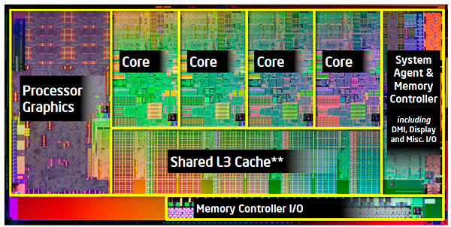
Additional components of a microprocessor
Current microprocessors can comprise:
    Cache memory (fast memory for instructions and operands, covered later)
    Vector processing unit
    Graphics processor
    Signal processing unit
    Neural networks, AI support
    Interrupt controller
    ...

Slide 42
Questions & Tasks
  Why are registers faster than the main memory?
  How can special purpose registers speed-up the processor?
  What is the purpose of a stack? Why not using a “normal” memory?
  What is the purpose of a base pointer + index? Can’t we directly address elements?
  How can we speed-up the internal processing in micro processors?
  Check the layout of current processors, GPUs, AI processors etc.! Can you find some of the components?

Slide 43
Performance enhancement

Slide 44
Performance enhancements in computer systems
How to enhance the performance of a computer system?
Technology
    Faster technologies, new materials, higher clock frequencies often require redesigns
    Expensive plus physical limitations
Architecture
    Increase parallelism (increased number of transistors, larger bus widths, replicated functional units)
    Multi-core processors go this way in basically all computer systems

Slide 45
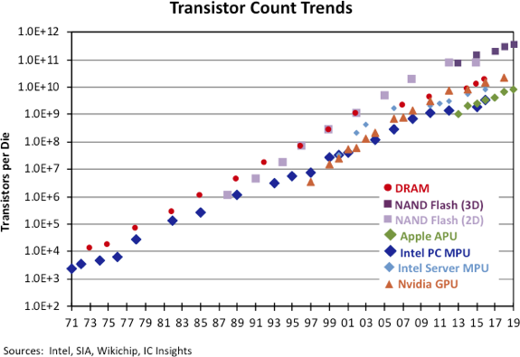
Technological progress
https://www.semiconductor-digest.com/2020/03/10/transistor-count-trends-continue-to-track-with-moores-law/
https://en.wikipedia.org/wiki/Moore%27s_law

Slide 46
Structural enhancements
Performance enhancement

Slide 47
Structural enhancements
Classification of computer architectures according to Flynn
Be aware: historical classification, does not really fit anymore…
Considers parallelism in instructions and data (operands)
SISD (Single Instruction Single Data)
    A single serial stream of instructions operates on data (classical von-Neumann principle)
memory
instructions
Classical:
IBM-PC, IBM 370,
DEC Micro-VAX,…
CPU
data

Slide 48
Structural enhancements
SIMD (Single Instruction Multiple Data)
    All processors perform the same instructions on different data (array processor)
instructions
memory
data
CPU 0
Example image processing:
each processor operates on a
part of the picture
data
CPU 1
data
CPU n

Slide 49
Structural enhancements
MIMD (Multiple Instruction Multiple Data)
    All processors perform different instructions on different data
memory
instructions
CPU 0
Classical:
IBM 3084, Cray-2,
Today:
Most computer systems are many core processors, have specialized components operating in parallel etc.
data
instructions
CPU 1
data
instructions
CPU n
data

Slide 50
Structural enhancements
MISD (Multiple Instruction Single Data)
    Several instructions operate on the same data
    Uncommon, but why not: for fault tolerance the same computation can be done in parallel, then the results compared
Many authors leave this class empty – we can discuss this!
To summarize: this taxonomy does not really help today any longer as almost all of today’s computer systems fall into the MIMD class…

Slide 51
Pipeline processing
Performance enhancement

Slide 52
Pipeline processing
Processing of 3 similar jobs with 4 identical sub tasks each.
Serial processing
1 2 3 4
1 2 3 4
1 2 3 4
Job 1
Job 2
Job 3
Pipeline processing
1 2 3 4
Job 1
1 2 3 4
Job 2
1 2 3 4
Job 3

Slide 53
Example: laundry pipelining
Doing the laundry can be split into 4 separate tasks:
    Put the dirty laundry into the washing machine and start the program
    Put the wet clothes into the tumbler
    Iron, smooth out creases, pleat, fold …
    Put the clothes into the closet

Slide 54
Laundry pipelining
very realistic …
6:00 7:00 8:00 9:00 10:00 11:00 12:00 13:00 14:00
Jobs
A
B
C
D
6:00 7:00 8:00 9:00 10:00 11:00 12:00 13:00 14:00
A
B
C
D

Slide 55
Pipelining I
Pipelining
    Subdivision of an operation into several phases or sub operations
    Synchronous execution of the sub operations in different functional units
    Each functional unit is responsible for a single function
All functional units together plus their interconnection is called pipeline.
Instruction pipelining
    The pipeline principle is applied to processor instructions
    Successive instructions are executed one after another with a delay of a single cycle

Slide 56
Pipelining II
Each stage of a pipeline is called pipeline stage or pipeline segment.
The whole pipeline is clocked in a way that each cycle an instruction can be shifted one step further through the pipeline.
In an ideal scenario, an instruction is executed in a k stage pipeline within k cycles by k stages (…we will see problems due to hazards later).
If every clock cycle a new instruction is loaded into the pipeline, then k instructions are executed simultaneously and each instruction needs k cycles in the pipeline.

Slide 57
Pipelining III
Latency: Duration of the complete processing of an instruction. This is the time an instruction needs to go through all k stages of the pipeline.
Throughput: Number of instructions leaving the pipeline per clock cycle. This number should be close to 1 for a scalar processor.

Slide 58
Speed-up of Instruction execution
Hypothetical processor without pipeline: n×k cycles
(k stage pipeline, n instructions)
Pipelined processor with a k stage pipeline: k+(n-1) cycles
(under ideal conditions: k cycles latency, throughput of 1)
This results in a speed-up of:
Assuming an infinite number of instructions (n∞) the speed-up of a processor with a k stage pipeline equals k.

Slide 59
Pipelining
Sequential execution:
1. Instruction
2. Instruction
instruction
fetch
instruction
decode
operand
fetch
execution
write back
result
instruction
fetch
instruction
decode
. . .
Pipelining:
1. Instruction
instruction
fetch
instruction
decode
operand
fetch
execution
write back
result
2. Instruction
instruction
fetch
instruction
decode
operand
fetch
execution
write back
result
3. Instruction
instruction
fetch
instruction
decode
operand
fetch
execution
write back
result

Slide 60
Architecture of a 5-stage pipeline I
Instruction Fetch (IF)
    Load the opcode of the instruction from memory (or instruction cache) into the opcode register
    Increment the program counter
Instruction Decode (ID)
    Generate internal signals based on the opcode or jump to the appropriate microprogram
Operand Fetch (OF)
    Load the operands from the registers into the operand registers of the ALU
    Calculate the effective address using the address generating unit for load/store or branch instructions

Slide 61
Architecture of a 5-stage pipeline I
Execution (EXE, ALU operation)
    The execution unit performs the requested operation
Result Write Back (WB)
    Write back the result into a register or memory
    Instructions without a result do nothing
    Load/store instructions put the address on the address bus and transfer the data between register and memory

Slide 62
Performance enhancement: two pipelines

Slide 63
Performance enhancement: specialized EXE-units

Slide 64
Questions & Tasks
  Do you know some more examples for pipelining in your life?
  How much can a pipeline speed-up a single instruction?
  What determines the clock speed of a pipeline?
  What could be bottlenecks in pipeline processing? Think of the tasks of the different stages!

Slide 65
Pipelining - Types of Pipeline Hazards
Performance enhancement

Slide 66
Pipeline Hazards
Pipeline hazards: phenomena that disrupt the smooth execution of a pipeline.
Example:
    If we assume a unified cache with a single read port (instead of separate I- and D-caches)
     a memory read conflict appears among IF and OF stages.
    The pipeline has to stall one of the accesses until the required memory port is available.
A stall is also called a pipeline bubble.

Slide 67
Three types of pipeline hazards
Data hazards arise because of the unavailability of an operand
    For example, an instruction may require an operand that will be the result of a preceding, still uncompleted instruction.
Structural hazards may arise from some combinations of instructions that cannot be accommodated because of resource conflicts
    For example, if the processor has only one register file write port and two instructions want to write in the register file at the same time.
Control hazards arise from branch, jump, and other control flow instructions
    For example, a taken branch interrupts the flow of instructions into the pipeline
 the branch target must be fetched before the pipeline can resume execution.
Common solution is to stall the pipeline until the hazard is resolved, inserting one or more “bubbles” in the pipeline.

Slide 68
Data hazards
Types of Pipeline Hazards

Slide 69
Pipeline hazards due to data dependence
After a load instruction the loaded value is not available to the following instruction in the next cycle.
If an instruction needs the result of a preceding instruction it has to wait.
Example:
  ADD R1,R2,R1; R1R1+R2
  ADD R3,R1,R3; R3R3+R1

Slide 70
Pipeline hazards due to data dependence
After a load instruction the loaded value is not available to the following instruction in the next cycle.
If an instruction needs the result of a preceding instruction it has to wait.
Example:
  ADD R1,R2,R1; R1R1+R2
  ADD R3,R1,R3; R3R3+R1

Slide 71
Data hazards
Dependencies between instructions may cause data hazards when Instr₁ and Instr₂ are so close that their overlapping within the pipeline would change their access order to registers.
Three types of data hazards
  Read After Write (RAW)
    Instr₂ tries to read operand before Instr₁ writes it
  Write After Read (WAR)
    Instr₂ tries to write operand before Instr₁ reads it
  Write After Write (WAW)
    Instr₂ tries to write operand before Instr₁ writes it
Instr₁
Instruction
fetch
Instruction
decode
Operand
fetch
Execution
Operand
write back
Instr₂
Instruction
fetch
Instruction
decode
Operand
fetch
Execution
Operand
write back

Slide 72
Read-after-Write-Conflict (True Dependence)
Using a simple 5 stage pipeline this example shows that the operand fetch phase of the 2nd instruction comes before the 1st instruction writes back its result
  Delaying the pipeline is necessary!
register
1. instruction
Instruction
fetch
Instruction
decode
Operand
fetch
Execution
Operand
write back
2. instruction
Instruction
fetch
Instruction
decode
Operand
fetch
Execution
Operand
write back
time
Pipeline – bubble (delay)

Slide 73
Pipeline conflict due to a data hazard
add Reg2,Reg1,Reg2
IF
ID
EX
MEM
WB
wrong register read!
Reg2 old
Reg2 new
mul Reg1,Reg2,Reg1
IF
ID
EX
MEM
WB
cycle time
time
add Reg2,Reg1,Reg2; Reg2  Reg1 + Reg2
mul Reg1,Reg2,Reg1; Reg1  Reg1 * Reg2

Slide 74
Data hazards in an instruction pipeline
load Reg1,A
IF
ID
EX
MEM
WB
load Reg2,B
IF
ID
EX
MEM
WB
add Reg2,Reg1,Reg2
IF
ID
EX
MEM
WB
mul Reg1,Reg2,Reg1
IF
ID
EX
MEM
WB
cycle time
time

Slide 75
Data hazards in an instruction pipeline
load Reg1,A
IF
ID
EX
MEM
WB
load Reg2,B
IF
ID
EX
MEM
WB
add Reg2,Reg1,Reg2
IF
ID
EX
MEM
WB
mul Reg1,Reg2,Reg1
IF
ID
EX
MEM
WB
cycle time
time

Slide 76
WAR and WAW - Can they happen in our simple pipeline?
WAR and WAW can’t happen in the simple 5 stage pipeline, because:
  All instructions take 5 stages
  Register reads are always in stage 2
  Register writes are always in stage 5
WAR and WAW may happen e.g. in superscalar pipes.

Slide 77
Solutions for data hazards from true data dependences
Software solution (Compiler scheduling)
  putting no-op (NOP) instructions after each instruction that may cause a hazard
  instruction scheduling
   rearrange code to reduce no-ops

Slide 78
Software solutions
Insertion of NOP instructions by the compiler
Instruction
fetch
Instruction
decode
Operation
execution
Write back
result
LOAD R1, <addr>
NOP
ADD R1, R2, R3
SUB R4, R5, R6
LOAD
. . .
. . .
. . .
NOP
LOAD
. . .
. . .
ADD
NOP
LOAD
. . .
SUB
ADD
NOP
-- -- --
instr 4
SUB
ADD
NOP
instr 5
instr 4
SUB
ADD
. . .
instr 5
instr 4
SUB

Slide 79
Software solutions
Reordering of instructions by the compiler
Instruction
fetch
Instruction
decode
Operation
execution
Write back
result
LOAD R1, <addr>
SUB R4, R5, R6
ADD R1, R2, R3
LOAD
. . .
. . .
. . .
SUB
LOAD
. . .
. . .
ADD
SUB
LOAD
. . .
instr 4
ADD
SUB
-- -- --
instr 5
instr 4
ADD
SUB
. . .
instr 5
instr 4
ADD

Slide 80
Hardware solutions
Hardware solutions: Hazard detection logic necessary!
Delay Insertion
  Stalling/Interlocking: stall pipeline for one or more cycles
Bypass techniques
  Forwarding:
    Result Forwarding
    Example: The result in ALU output of Instr₁ in EX stage can immediately be forwarded back to ALU input of the EX stage as an operand for Instr₂
    Load Forwarding
    Example: The load memory data register from MEM stage can be forwarded to ALU input of EX stage
  Forwarding with interlocking: Assuming that Instr₂ is data dependent on the load instruction Instr₁ then Instr₂ has to be stalled until the data loaded by Instr₁ becomes available in the load memory data register in MEM stage.
  Even when forwarding is implemented from MEM back to EX, one bubble occurs that cannot be removed.

Slide 81
Questions & Tasks
  Are hazards rather rare events or common? Think of typical programs, processes, operating systems, tasks of a computer etc.!
  Can we remove a true dependence? What can we do?
  Why is result forwarding really helpful? Think of typical program sequences!
  WAR and WAW sound strange. Find examples when they may happen!

Slide 82
Side Note: The MIPS Pipeline
As defined in Patterson & Hennessy, Computer Organization and Design – The Hardware/Software Interface, Section 4.5
Instruction Fetch (IF)
  Fetch instruction from memory. [→ main memory!]
Instruction Decode (ID)
  Read registers while decoding the instruction. The regular format of MIPS instructions allows reading and decoding to occur simultaneously.
Execution (EXE)
  Execute the operation [all arithmetical and logical operations] or calculate an address [load and store].
Memory Access (MEM)
  Access an operand in data memory. [Only relevant for load/store instructions, otherwise passive stage]
Write Back (WB)
  Write the result into a register.

Slide 83

Side Note: The MIPS Pipeline
Source: Ben Juurlink, TU Berlin, lecture slides for „Advanced Computer Architectures“, 2015
Write affected register during first half of write back stage
Read operand registers during second half of instruction decode stage

Slide 84
Data hazard: Hardware solution by stalling
ADD R2,R1,R2
MUL R1,R2,R1
time

Slide 85
Data hazard: Hardware solution by stalling
ADD R2,R1,R2
MUL R1,R2,R1
time
HW-”bubbles”

Slide 86
Data hazard: Hardware solution by forwarding
ADD R1,R2,R3
Pipeline filled with problems…
SUB R4,R1,R3
AND R6,R1,R7
OR R8,R1,R9
time

Slide 87
Data hazard: Hardware solution by forwarding
ADD R1,R2,R3
SUB R4,R1,R3
AND R6,R1,R7
OR R8,R1,R9
time

Slide 88
Data hazard: Hardware solution by forwarding
ADD R1,R2,R3
SUB R4,R1,R3
AND R6,R1,R7
OR R8,R1,R9
time

Slide 89
Data hazard: Hardware solution by forwarding
ADD R1,R2,R3
SUB R4,R1,R3
AND R6,R1,R7
OR R8,R1,R9
time
→ Solution: Don’t wait until result is written back to register, but forward it to the next stage immediately

Slide 90
Data hazard: Hardware solution by forwarding
ADD R1,R2,R3
SUB R4,R1,R3
AND R6,R1,R7
OR R8,R1,R9
time
→ Result Forwarding from EX to EX

Slide 91
Result forwarding
Example:
The result in ALU output of Instr₁ in EX stage can immediately be forwarded back to ALU input of EX stage as an operand for Instr₂

Slide 92
Data hazard: Hardware solution by forwarding
ADD R1,R2,R3
SUB R4,R1,R3
AND R6,R1,R7
OR R8,R1,R9
time
→ Forward from MEM to EXE

Slide 93
Load forwarding
Example:
The load memory data register from MEM stage can be forwarded to ALU input of EX stage.

Slide 94
Load-use data hazard
LW R1,$0
SUB R4,R1,R3
time

Slide 95
Load-use data hazard
LW R1,$0
SUB R4,R1,R3
time
→ Data hazard even with forwarding!

Slide 96
Load-use data hazard
LW R1,$0
SUB R4,R1,R3
time
→ Need stalling AND forwarding

Slide 97
Forwarding with interlocking
Assuming that Instr₂ is data dependent on the load instruction Instr₁.
Then, Instr₂ has to be stalled until the data loaded by Instr₁ becomes available in the load memory data register in MEM stage.
→ Even when forwarding is implemented from MEM back to EX, one bubble occurs that cannot be removed.

Slide 98
Bypass techniques
Registers
Result forwarding
Bypass 1
Bypass 2 Load forwarding
Operand register A
Operand register B
Internal Data bus
Control lines from the control unit
ALU
Result register
from cache or main memory

Slide 99
Example
LOAD <Address>, R1 R1  (<Address>)
ADD R1, R2, R3 R3  R1 + R2
SUB R4, R5, R6 R6  R4 - R5
Instruction
fetch
Instruction
decode
Operation
execution
Write back
result
Yet another (simple) pipeline…
LOAD
. . .
. . .
. . .
During the execution phase of the ADD instruction the result of the LOAD is written into the register and, thus, the bypass is needed to provide the result early enough.
ADD
LOAD
. . .
. . .
SUB
ADD
LOAD
. . .
Bypass
instr 1
SUB
ADD
-- -- --
. . .
instr 1
SUB
ADD
. . .
. . .
instr 1
SUB

Slide 100
Questions & Tasks
  Bypassing looks fine – what is the price to pay?
  What is an assumption for load forwarding to work? Think of memory access times!

Slide 101
Structural hazards
Types of Pipeline Hazards

Slide 102
Three types of pipeline hazards
✓
Data hazards arise because of the unavailability of an operand
    For example, an instruction may require an operand that will be the result of a preceding, still uncompleted instruction.
Structural hazards may arise from some combinations of instructions that cannot be accommodated because of resource conflicts
    For example, if the processor has only one register file write port and two instructions want to write in the register file at the same time.
Control hazards arise from branch, jump, and other control flow instructions
    For example, a taken branch interrupts the flow of instructions into the pipeline
 the branch target must be fetched before the pipeline can resume execution.
Common solution is to stall the pipeline until the hazard is resolved, inserting one or more “bubbles” in the pipeline.

Slide 103
Pipeline bubble due to a structural hazard
load Reg2,A
WB
IF
ID
EX
MEM
WB
Register file
mul Reg3,Reg4,Reg5
WB
IF
ID
EX
MEM
WB
cycle time
time

Slide 104
Solutions to the structural hazard
Arbitration with interlocking: hardware that performs resource conflict arbitration and interlocks one of the competing instructions
Resource replication: In the example a register file with multiple write ports would enable simultaneous writes.
    However, now output dependencies may arise!
    Therefore, additional arbitration and interlocking necessary
    or the first (in program flow) value is discarded and the second used.

Slide 105
Control hazards
Types of Pipeline Hazards

Slide 106
Three types of pipeline hazards
✓
Data hazards arise because of the unavailability of an operand
    For example, an instruction may require an operand that will be the result of a preceding, still uncompleted instruction.
Structural hazards may arise from some combinations of instructions that cannot be accommodated because of resource conflicts
    For example, if the processor has only one register file write port and two instructions want to write in the register file at the same time.
Control hazards arise from branch, jump, and other control flow instructions
    For example, a taken branch interrupts the flow of instructions into the pipeline
 the branch target must be fetched before the pipeline can resume execution.
Common solution is to stall the pipeline until the hazard is resolved, inserting one or more “bubbles” in the pipeline.
✓

Slide 107
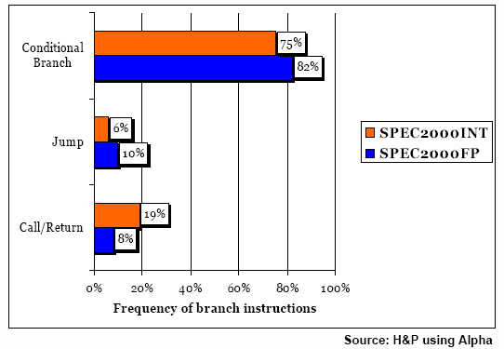
Hazards due to control dependence
Conditional Jumps and branches stop linear program execution, program might continue elsewhere
Jump instruction normally detected in the Instruction Decode stage of the pipeline
    If a jump is detected, the pipeline already contains instructions, that are immediately behind this instruction

Slide 108
Hazards due to control dependence
Jumps are very common in programs
C Syntax
n=10
s=0
for(i=0; i<n; i++) {
s = s + i;
}
…
MMIX Syntax
LOC #100
s IS $1
i IS $2
test IS $3
n IS 10
Main SETL s,0
SETL i,0
For ADD s,s,i
ADD i,i,1
SUB test,i,n
BNZ test,For
...
TRAP 0,Halt,0

Slide 109
Example
ADC R4,R5,R4 ; R4  R4 + R5 + C
CMP R1,R2 ; R1 = R2 ?
BEQ Label ; PC  <Label Adresse>
ADD R3,R1,R2 ; R3  R1 + R2
Label: SUB R6,R4,R5 ; R6  R4 - R5
SLL R0 ; R0  shift_left(R0)

Slide 110
Example
Instruction
fetch
Instruction
decode
Operation
execution
Write back
result
ADC
. . .
. . .
. . .
CMP R1,R2
ADC R4,R5,R4
BEQ Label
ADD R3,R1,R2
Label: SUB R6,R4,R5
SLL R0
BEQ
ADC
. . .
. . .
ADD
BEQ
ADC
. . .
SUB
ADD
-- -- --
ADC
SLL
SUB
ADD
-- -- --
. . .
SLL
SUB
ADD
. . .
. . .
SLL
SUB
The ADD instruction is still in the pipeline and therefore executed before the jump is realized!

Slide 111
Solutions
Hardware Solutions
Pipeline Flushing
    Flush (empty) pipeline before realizing the jump
Speculative Branch
    In case of a conditional jump: Estimate result of condition and load pipeline (speculative)
    Wrong speculation: Pipeline Flushing
    Branch prediction used in most modern processors

Slide 112
Simple solutions
Hardware Interlocking
    This is the simplest way to deal with control hazards: the hardware must detect the branch and apply hardware interlocking to stall the next instruction(s).
Software Solutions
    Insertion of NOP instructions by the compiler after every branch
    Re-Ordering of instructions by the compiler
    Instead of NOPs, instructions that will be executed anyway and that do not influence the branch condition will be put into the pipeline immediately after the branch instruction (early days of RISC processors)

Slide 113
Solution: Decide branch direction earlier
Flushing or Locking is often not acceptable
Reordering is often not possible
Calculation of the branch direction and of the branch target address should be done in the pipeline as early as possible.
Best solution
    Already in ID stage after the instruction has become recognized as branch instruction.
    or even earlier: if history shows that address contains a branch

Slide 114
Branch Prediction
Branch prediction foretells the outcome of conditional branch instructions, excellent branch handling techniques are essential for today's and for future microprocessors.
IF stage finds a branch instruction
    predict branch direction
The branch delay slots are speculatively filled with instruction
    of the consecutively following path
    of the path at the target address
After resolving of the branch direction
    decide upon correctness of prediction
In case of misprediction  discard wrongly fetched instructions
    rerolling when a branch is mispredicted is expensive:
      9 cycles on Itanium
      11 or more cycles in the Pentium II

Slide 115
Branch-Target Buffer or Branch-Target Address Cache
The Branch Target Buffer (BTB) or Branch-Target Address Cache (BTAC) stores branch and jump target addresses.
It should be known already in the IF stage whether the as-yet-undecoded instruction is a jump or branch.
The BTB is accessed during the IF stage.
The BTB consists of a table with branch addresses, the corresponding target addresses, and prediction information.
Variations
    Branch Target Cache (BTC): stores one or more target instructions additionally.
    Return Address Stack (RAS): a small stack of return addresses for procedure calls and returns is used additional to and independent of a BTB.

Slide 116
Branch-Target Buffer or Branch-Target Address Cache
Branch address | Target address | Prediction Bits

Slide 117
Two Basic Techniques of Branch Prediction
Static Branch Prediction
    The prediction direction for an individual branch remains always the same.
Dynamic Branch Prediction
    The prediction direction depends upon previous (the “history” of) branch executions.

Slide 118
Static Branch Prediction
The prediction direction for an individual branch remains always the same!
    The machine cannot dynamically alter the branch prediction (in contrast to dynamic branch prediction which is based on previous branch executions).
Static branch prediction comprises
    machine-fixed prediction (e.g. always predict taken)
    compiler-driven prediction.
If the prediction followed the wrong instruction path, then the wrongly fetched instructions must be squashed from the pipeline.

Slide 119
Static Branch Prediction - machine-fixed
Wired taken/not-taken prediction
    The static branch prediction can be wired into the processor by predicting that all branches will be taken (or all not taken).
Direction based prediction
    Backward branches are predicted to be taken and forward branches are predicted to be not taken
     helps for loops

Slide 120
Static Branch Prediction - compiler-based
Opcode bit in branch instruction allows the compiler to reverse the hardware prediction.
There are two approaches the compiler can use to statically predict which way a branch will go:
    it can examine the program code, or
    it can use profile information (collected from earlier runs)

Slide 121
Dynamic Branch Prediction
In dynamic branch prediction the prediction is decided on the computation history of the program execution.
In general, dynamic branch prediction gives better results than static branch prediction, but at the cost of increased hardware complexity.
Example: One-bit predictor
Taken
Predict Not Taken
Predict
Taken
Not Taken
Taken
Not Taken
Formerly used: Alpha 21064 (1bit in instruction cache), Motorola PowerPC 604

Slide 122
One-bit vs. Two-bit Predictors
A one-bit predictor correctly predicts a branch at the end of a loop iteration, as long as the loop does not exit.
In nested loops, a one-bit prediction scheme will cause two mispredictions for the inner loop:
    One at the end of the loop, when the iteration exits the loop instead of looping again, and
    One when executing the first loop iteration, when it predicts exit instead of looping.
Such a double misprediction in nested loops is avoided by a two-bit predictor scheme.
Two-bit Prediction: A prediction must miss twice before it is changed when a two-bit prediction scheme is applied.

Slide 123
Two-bit Predictors
(Hysteresis Scheme)
Not Taken
Predict
Strongly
Not Taken
00
Predict
Weakly
Not Taken
01
Taken
Not Taken
Not Taken
Taken
Predict
Weakly
Taken
10
Predict
Strongly
Taken
11
Taken
Not Taken
Taken
Realization: Intel XScale, Sun UltraSPARC IIi

Slide 124
Two-bit Predictors
(Saturation Counter Scheme)
Not Taken
Predict
Strongly
Not Taken
00
Predict
Weakly
Not Taken
01
Taken
Not Taken
Taken
Not Taken
Predict
Weakly
Taken
10
Predict
Strongly
Taken
11
Taken
Not Taken
Taken

Slide 125
Predicated Instructions
Provide predicated or conditional instructions and one or more predicate registers.
Predicated instructions use a predicate register as additional input operand.
The Boolean result of a condition testing is recorded in a (one-bit) predicate register.
Predicated instructions are fetched, decoded, and placed in the instruction window like non predicated instructions.

Slide 126
Predication Example
if (x == 0) { /* branch b1 */
a = b + c;
d = e - f;
}
g = h * i; /* instruction independent of branch b1 */
(Pred = (x == 0) ) /* branch b1: Pred is set to true if x equals 0 */
if Pred then a = b + c; /* The operations are only performed */
if Pred then d = e - f; /* if Pred is set to true */
g = h * i;

Slide 127
Predication
Pro
    Able to eliminate a branch and therefore the associated branch prediction  increasing the distance between mispredictions.
    The run length of a code block is increased  better compiler scheduling.
Contra
    Predication affects the instruction set, adds a port to the register file, and complicates instruction execution.
    Predicated instructions that are discarded still consume processor resources; especially the fetch bandwidth.
Predication is most effective when control dependencies can be completely eliminated, such as in an if-then with a small then body.
The use of predicated instructions is limited when the control flow involves more than a simple alternative sequence.

Slide 128
Branch handling techniques and implementations
Technique | Implementation examples
No branch prediction | Intel 8086
Static prediction
always not taken | Intel i486
always taken | Sun SuperSPARC
backward taken, forward not taken | HP PA-7x00
semistatic with profiling | early PowerPCs
Dynamic prediction
1-bit | DEC Alpha 21064, AMD K5
2-bit | PowerPC 604, MIPS R10000, Cyrix 6x86 and M2, NexGen 586
two-level adaptive | Intel PentiumPro, Pentium II, AMD K6
Hybrid prediction | DEC Alpha 21264
Predication | Intel/HP Merced, most DSPs, ARM processors, TI TMS320C6201, …
Eager execution (limited) | IBM mainframes: IBM 360/91, IBM 3090
Disjoint eager execution | none yet

Slide 129
Performance of branch handling techniques
Class | Technique | Rough Accuracy (Spec 89)
Static | always not taken | 40%
 | always taken | 60%
 | backward taken, forward not taken | 65%
Software | Static analysis | 70%
 | Profiling | 75%
Dynamic | 1-bit | 80%
 | 2-bit | 93%
 | two-level adaptive | 95 – 97.5%
Adapted from: Dave Archer, Branch Prediction: Introduction and Survey, 2007

Slide 130
Pipelining basics: Summary
Hazards limit performance
    Structural hazards: need more HW resources
    Data hazards: need detection and forwarding
    Control hazards: early evaluation, delayed branch, prediction
Compilers may reduce cost of data and control hazards
    Compiler Scheduling
    Branch delay slots
    Static branch prediction
Increasing length of pipe increases impact of hazards
Pipelining helps instruction bandwidth, not latency
Multi-cycle operations (floating-point) and interrupts make pipelining harder

Slide 131
Questions & Tasks
  How can we resolve structural hazards?
  What are the limits of branch prediction? Think of multi-tasking, interrupts, multi-user etc.
  Why can compilers sometimes optimize branches better than the processor?
  A k-stage pipeline can result in a speed-up of k. So why not having very long pipelines?

Slide 132
Vector Pipelining
Pipelining

Slide 133
Vektor Pipelining
Vector processor: a processor operating on a one-dimensional array of floating point numbers using a vector pipeline in the execution unit following the SIMD principle (single instruction, multiple data)
Vector = Array of floating point numbers (≠ math. vector!)
Operation on single values often called scalar processing.
Vector computers often contain scalar units besides many vector processing units – or CPUs may contain several vector units operating in parallel to scalar units.
Today, this approach is common in graphic processors but also standard CPUs (MMX, SSE, AVX, AltiVec, …)

Slide 134
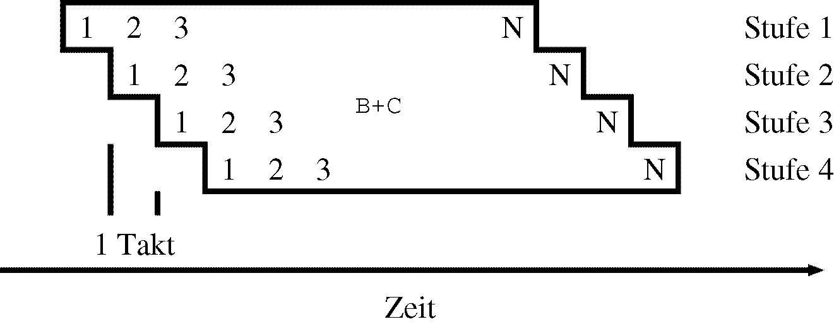
Example: Addition
A(J) = B(J) + C(J), J = 1,2,...,N
Component wise addition of the vectors B and C, i.e. the single floating point numbers of the arrays B(1),...,B(N) and C(1),...,C(N), with a single instruction and storing the result in the result vector A.
The execution of the operation is overlapping, i.e. first the operation of B(1)+C(1) starts, then B(2)+C(2)etc.
Typical stages in the vector pipeline:
    Operand fetch
    Exponent alignment
    Shift of significand
    Addition
    Normalization
    Rounding
    Write back
stage 1
stage 2
stage 3
stage 4
cycle
time

Slide 135
Characteristics of vector pipelines
A single vector instruction allows the processing of two arrays of floating point numbers using this pipeline.
No separate address calculations for each operand needed (as this is the case for scalar units) – special hardware fetches the elements of an array from registers/memory.
Useful only for “longer” vectors as the pipeline need some time to fill before it produces a result per cycle.
    “long” depends on the architecture
No dependency checking needed between the operations as they are independent by definition (different elements of an array).
One can think of an enhanced EXE stage for floating point operations in CPUs.

Slide 136
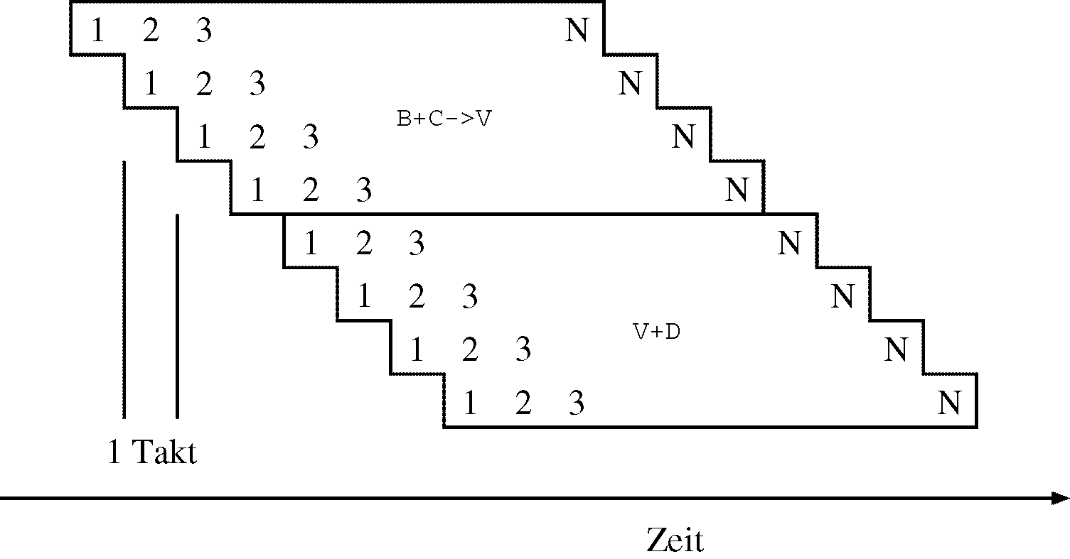
Chaining of vector pipelines
Chaining
    Apply the pipelining idea to a sequence of vector instructions.
    Forward the results of each element to the next pipeline immediately.
B*C->V
B(J)*C(J)+D(J), J=1,2,...,N
V+D
cycle
time

Slide 137
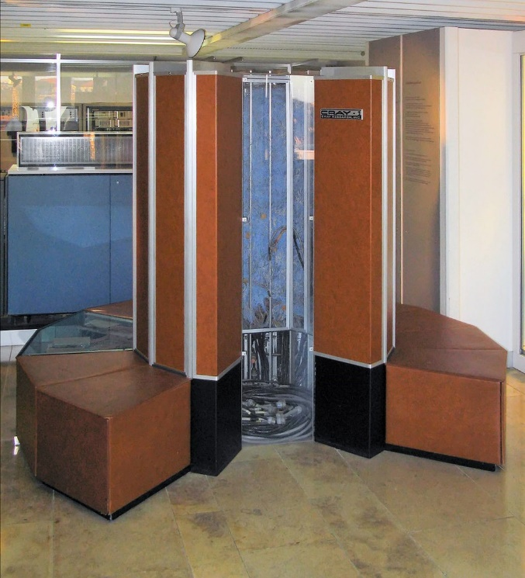
History: chaining of 4 pipelines (Cray 1, 1976)
Memory
Main memory
access
Register file
(7 stages)
V0
Register file
Addition
V2
(3 stages)
Register file
V1
Register file
Shifting
V3
(4 stages)
Register file
AND
Register file
https://en.wikipedia.org/wiki/Cray-1
V4
(2 stages)
V5

Slide 138
Simple Example
Component-wise multiplication of vectors
  A(i)= B(i) * C(i), i = 1, …, 100
Standard processor
i = 1
b = b(i)
c = c(i)
a = b * c
a(i) = a
i++
if i<101
Vector processor
vload b, 1, 100
vload c, 1, 100
vmult a, b, c
vstore a, 1, 100

Slide 139
Superscalar processors
Pipelining

Slide 140
Superscalar processors
Definition
    Superscalar machines are distinguished by their ability to (dynamically) issue multiple instructions each clock cycle from a conventional linear instruction stream.
Consequence
    value of CPI (cycles per instructions) << 1.0 possible!

Slide 141
Superscalar Pipeline
Instructions in the instruction window are free from control dependences due to branch prediction, and free from name dependences due to register renaming.
So, only (true) data dependencies and structural conflicts remain to be solved.
functional units
Instruction
Fetch

Slide 142
Sections of a Superscalar Pipeline
The ability to issue and execute instructions out-of-order partitions a superscalar pipeline in three distinct sections
    in-order section with the instruction fetch, decode and rename stages - the issue is also part of the in-order section in case of an in-order issue,
    out-of-order section starting with the issue in case of an out-of-order issue processor, the execution stage, and usually the completion stage, and again an
    in-order section that comprises the retirement and write-back stages.
functional units
Instruction
Fetch

Slide 143
Fetch, decode, rename
Fetch
  Get a bunch of commands
Decode
  Decode the new instruction
Rename
  Externally visible register are mapped to internal shadow registers
  Avoid WAW/WAR-conflicts
  Mapping stored in a rename map (Intel: alias table)
  core execution units free from name dependencies due to register renaming.
functional units
Instruction
Fetch

Slide 144
Issue
The issue logic examines the waiting instructions in the instruction window and simultaneously assigns (issues, dispatches) a number of instructions to the functional units (FUs) up to a maximum issue bandwidth.
Several instructions can be issued simultaneously (the issue bandwidth).
The program order of the issued instructions is stored in the reorder buffer.
Instruction issue from the instruction buffer can be:
  in-order (only in program order) or out-of-order
functional units
Instruction
Fetch

Slide 145
Reservation Station(s)
A reservation station is a buffer for a single instruction with its operands.
Reservation stations can be central to a number of FUs
or each FU has one or more own reservation stations.
Instructions await their operands in reservation stations.
functional units
Instruction
Fetch

Slide 146
Dispatch
An instruction is said to be dispatched from a reservation station to the FU when all operands are available, and execution starts.
If all its operands are available during issue and the FU is not busy, an instruction is immediately dispatched, starting execution in the next cycle after the issue.
So, the dispatch is usually not a pipeline stage.
An issued instruction may stay in the reservation station for zero to several cycles.
Dispatch and execution is performed out of program order.
Other authors interchange the meaning of issue and dispatch or use different semantic.

Slide 147
Completion
When the FU finishes the execution of an instruction and the result is ready for forwarding and buffering, the instruction is said to complete.
Instruction completion is out of program order.
During completion the reservation station is freed and the state of the execution is noted in the reorder buffer.
The state of the reorder buffer entry can denote an interrupt occurrence.
The instruction can be completed and still be speculatively assigned, which is also monitored in the reorder buffer.
functional units
Instruction
Fetch

Slide 148
Commitment
After completion, operations are committed in-order.
An instruction can be committed:
    if all previous instructions due to the program order are already committed or can be committed in the same cycle,
    if no interrupt occurred before and during instruction execution, and
    if the instruction is no more on a speculative path.
By or after commitment, the result of an instruction is made permanent in the architectural register set,
    usually by writing the result back from the rename register to the architectural register.
functional units
Instruction
Fetch

Slide 149
Precise Interrupt / Precise Exception
If an interrupt occurred, all instructions that are in program order before the interrupt signaling instruction are committed, and all later instructions are removed.
Precise exception means that all instructions before the faulting instruction are committed and those after it can be restarted from scratch.
Depending on the architecture and the type of exception, the faulting instruction should be committed or removed without any lasting effect.

Slide 150
Retirement
An instruction retires when the reorder buffer slot of an instruction is freed either
    because the instruction commits (the result is made permanent) or
    because the instruction is removed (without making permanent changes).
A result is made permanent by copying the result value from the rename register to the architectural register.
    This is often done in an own stage after the commitment of the instruction with the effect that the rename register is freed one cycle after commitment.
functional units
Instruction
Fetch

Slide 151
Questions & Tasks
  Where do we have vector pipelines today?
  What makes vector pipelines so efficient?
  How do super scalar pipelines avoid WAR and WAW hazards?
  What does the programmer or compiler see from the super scalar pipeline or renaming registers? How is the ISA affected?
  Where does the vector pipeline fit into a super scalar pipeline?

Slide 152
Example: Dynamic Scheduling for an FP-Unit using Tomasulo’s Algorithm
Roberto Tomasulo, IBM, 1967 (https://en.wikipedia.org/wiki/Tomasulo_algorithm)
Key features: hardware support for register renaming, all EXE units have a reservation station, a common data bus (CDB) broadcasts results to all reservation stations
Common in many of today’s processors
Simplifications in the following example:
  Single Issue Processor (in-order)
  Instruction Queue can hold 4 instructions from ID-Unit
  up to 3 instructions can be fetched and decoded in parallel
  1 FP Adder with 3 Reservation Stations
  1 FP Multiplier with 2 Reservation Stations
  no speculative execution (→ no Reorder Buffer needed)
  only 4 FP registers
Notes:
Nun folgt Anwendungsbeispiel
Zur Vereinfachung schauen wir im Folgenden einen Ausschnitt einer superskalaren Pipeline an → zoomen hinein in den Teil zwischen Issue-Unit und Retire-WB-Unit der vorherigen Folie
→ klar machen, dass der Rest der Pipeline in Realität natürlich nicht vergessen werden darf
Der im folgenden verwendete Algorithmus wurde von Robert Tomasulo 1967 für den IBM System/360 implementiert, kommt aber auch heute noch zum Einsatz
Erlaubt die dynamische Ausnutzung mehrerer parallel arbeitender Funktionseinheiten
Händelt dabei sowohl RAW-Hazards als auch WAW- und WAR-Hazards (Erinnerung: letztere nur in superskalaren Pipelines relevant)
Annahmen für dieses Beispiel:
Single Issue: Nur eine Instruktion pro Taktzyklus ge-issued (sofern RS frei ist), issue ausschließlich in-order
Instruction Queue bietet Platz für 4 Instruktionen, die zuvor durch IF und ID-Units der Pipeline gelaufen sind
Dabei können IF und ID jeweils bis zu 3 Instruktionen parallel holen und dekodieren
Für Berechnungen zur Verfügung stehen 1 FP Addierer (für Addition und Subtraktion) und 1 FP Multiplizierer
Es gibt 3 Reservation Stations für den FP Addierer und 2 Reservation Stations für den FP Multiplizierer
Wichtig: es findet keine spekulative Ausführung statt, darum wird auch kein Reorder Buffer benötigt
→ die Berechnung der auf einen Branch folgenden Befehle findet erst statt, wenn Branch ausgewertet ist
→ ggfs. fälschlich geladene Befehle werden ge-flushed, bevor sie berechnet und wirksam geworden sind
→ auf Reorder Buffer und komplizierte Commit-Retire-Unit kann verzichtet werden
Außerdem zur Vereinfachung nur 4 FP Register, mehr benötigen wir für diese einfachen Berechnungsbeispiele nicht

Slide 153
Example: Dynamic Scheduling for a FP-Unit using Tomasulo’s Algorithm
from ID Unit
FP Registers
ID | RS | Value
F0
F1
F2
F3
Instruction Queue
Reservation Stations of FP Adder
Reservation Stations of FP Multiplier
ID | op | RS1 | Val1 | RS2 | Val2 | busy
Add3 |  |  |  |  |  | 0
Add2 |  |  |  |  |  | 0
Add1 |  |  |  |  |  | 0
ID | op | RS1 | Val1 | RS2 | Val2 | busy
Mul2 |  |  |  |  |  | 0
Mul1 |  |  |  |  |  | 0
FP Adder
FP Multiplier
Source: Ben Juurlink, TU Berlin, lecture slides for „Advanced Computer Architectures“, 2015
Notes:
Wie sehen dann die Komponenten dieser FP-Unit aus?
Oben links: Instruction Queue, erhält die dekodierten Instruktionen von ID Unit und puffert sie
Oben rechts: Register File mit den 3 FP Registern F0 bis F2
→ zusätzlich zum gespeicherten Wert wird hier auch die ID der RS gespeichert, die mit der Berechnung dieses Registerinhalts beauftragt ist
Unten: Reservation Stations für den FP Addierer (links) und den FP Multiplizierer (rechts)
→ RS puffern die Instruktionen für die FP Unit, bis alle Operanden verfügbar sind und die Berechnung tatsächlich durchgeführt werden kann
Aufbau der RS:
op: Opcode für die auszuführende Operation
RS1: RS, die den 1. Operanden berechnet; 0, wenn der Operand bereits verfügbar ist
Val1: Wert des 1. Operanden; n/a, wenn der Operand noch nicht verfügbar ist
RS2: RS, die den 2. Operanden berechnet
Val2: Wert des 2. Operanden
Busy: Flag, ob RS besetzt ist oder nicht (kurze Erklärung, dass in den Einträgen immer etwas drin stehen kann, ggfs. Restkapazität vom Vorgänger)

Slide 154
Example: Dynamic Scheduling for a FP-Unit using Tomasulo’s Algorithm
from ID Unit
FP Registers
ID | RS | Value
F0
F1
F2
F3
Instruction Queue
FP Operation Bus
Reservation Stations of FP Adder
Reservation Stations of FP Multiplier
ID | op | RS1 | Val1 | RS2 | Val2 | busy
Add3 |  |  |  |  |  | 0
Add2 |  |  |  |  |  | 0
Add1 |  |  |  |  |  | 0
ID | op | RS1 | Val1 | RS2 | Val2 | busy
Mul2 |  |  |  |  |  | 0
Mul1 |  |  |  |  |  | 0
FP Adder
FP Multiplier
Notes:
Instruction Queue braucht Verbindung zu den Reservation Stations, um sie entsprechend ihrer Verfügbarkeit mit neuen Instruktionen versorgen zu können
→ Merke: ausschließlich In-Order-Issuing

Slide 155
Example: Dynamic Scheduling for a FP-Unit using Tomasulo’s Algorithm
from ID Unit
FP Registers
ID | RS | Value
F0
F1
F2
F3
Instruction Queue
FP Operation Bus
Operand
Busses
Reservation Stations of FP Adder
Reservation Stations of FP Multiplier
ID | op | RS1 | Val1 | RS2 | Val2 | busy
Add3 |  |  |  |  |  | 0
Add2 |  |  |  |  |  | 0
Add1 |  |  |  |  |  | 0
ID | op | RS1 | Val1 | RS2 | Val2 | busy
Mul2 |  |  |  |  |  | 0
Mul1 |  |  |  |  |  | 0
FP Adder
FP Multiplier
Notes:
Register File braucht Verbindung zu den Reservation Stations, um die Werte der Operanden mitteilen zu können

Slide 156
Example: Dynamic Scheduling for a FP-Unit using Tomasulo’s Algorithm
from ID Unit
FP Registers
ID | RS | Value
F0
F1
F2
F3
Instruction Queue
FP Operation Bus
Operand
Busses
Reservation Stations of FP Adder
Reservation Stations of FP Multiplier
ID | op | RS1 | Val1 | RS2 | Val2 | busy
Add3 |  |  |  |  |  | 0
Add2 |  |  |  |  |  | 0
Add1 |  |  |  |  |  | 0
ID | op | RS1 | Val1 | RS2 | Val2 | busy
Mul2 |  |  |  |  |  | 0
Mul1 |  |  |  |  |  | 0
FP Adder
FP Multiplier
Common Data Bus (CDB)
Notes:
Und Berechnungsergebnisse sollen nicht nur in Register File zurückgeschrieben werden, sondern auch direkt geforwarded werden können an die Reservation Stations, die auf das Ergebnis warten
Common Data Bus (CDB)
Schema-Zeichnung fertig
Hinweis: Muss nicht aus dem Kopf gezeichnet werden können, aber bei gegebenem Schema sollte ein Beispiel wie hier durchgespielt werden können

Slide 157
Example: Dynamic Scheduling for a FP-Unit using Tomasulo’s Algorithm
from ID Unit
FP Registers
MUL.D F0,F1,F2
ADD.D F3,F0,F2
SUB.D F0,F1,F2
with MUL.D F0,F1,F2
→ F0=F1*F2
ID | RS | Value
F0 |  | 0.0
F1 |  | 1.0
F2 |  | 2.0
F3 |  | 3.0
Instruction Queue
FP Operation Bus
Operand
Busses
Reservation Stations of FP Adder
Reservation Stations of FP Multiplier
ID | op | RS1 | Val1 | RS2 | Val2 | busy
Add3 |  |  |  |  |  | 0
Add2 |  |  |  |  |  | 0
Add1 |  |  |  |  |  | 0
ID | op | RS1 | Val1 | RS2 | Val2 | busy
Mul2 |  |  |  |  |  | 0
Mul1 |  |  |  |  |  | 0
FP Adder
FP Multiplier
Common Data Bus (CDB)
Notes:
Nun an einem konkreten Beispiel: FP Multiplikation, gefolgt von FP Addition und FP Subtraktion
Register initial gefüllt wie angegeben
Nun kommen im ersten Takt alle 3 Instruktionen aus der ID Unit… <Klick weiter>

Slide 158
Example: Dynamic Scheduling for a FP-Unit using Tomasulo’s Algorithm
from ID Unit
FP Registers
SUB.D F0,F1,F2
ADD.D F3,F0,F2
MUL.D F0,F1,F2
MUL.D F0,F1,F2
ADD.D F3,F0,F2
SUB.D F0,F1,F2
with MUL.D F0,F1,F2
→ F0=F1*F2
ID | RS | Value
F0 |  | 0.0
F1 |  | 1.0
F2 |  | 2.0
F3 |  | 3.0
Instruction Queue
FP Operation Bus
Operand
Busses
Reservation Stations of FP Adder
Reservation Stations of FP Multiplier
ID | op | RS1 | Val1 | RS2 | Val2 | busy
Add3 |  |  |  |  |  | 0
Add2 |  |  |  |  |  | 0
Add1 |  |  |  |  |  | 0
ID | op | RS1 | Val1 | RS2 | Val2 | busy
Mul2 |  |  |  |  |  | 0
Mul1 |  |  |  |  |  | 0
FP Adder
FP Multiplier
Common Data Bus (CDB)
Notes:
Instruction Queue entsprechend mit den 3 Instruktionen in FIFO-Manier gefüllt
Rosa markiert im folgenden alles, was mit der Multiplikation zusammenhängt,
Blau alles, was mit der Addition zusammenhängt,
Gelb alles, was mit der Subtraktion zusammenhängt

Slide 159
Example: Dynamic Scheduling for a FP-Unit using Tomasulo’s Algorithm
from ID Unit
FP Registers
SUB.D F0,F1,F2
ADD.D F3,F0,F2
MUL.D F0,F1,F2
ADD.D F3,F0,F2
SUB.D F0,F1,F2
with MUL.D F0,F1,F2
→ F0=F1*F2
ID | RS | Value
F0 | Mul1 | 0.0
F1 |  | 1.0
F2 |  | 2.0
F3 |  | 3.0
Instruction Queue
FP Operation Bus
Operand
Busses
Reservation Stations of FP Adder
Reservation Stations of FP Multiplier
ID | op | RS1 | Val1 | RS2 | Val2 | busy
Add3 |  |  |  |  |  | 0
Add2 |  |  |  |  |  | 0
Add1 |  |  |  |  |  | 0
ID | op | RS1 | Val1 | RS2 | Val2 | busy
Mul2 |  |  |  |  |  | 0
Mul1 | * | 0 | 1.0 | 0 | 2.0 | 1
FP Adder
FP Multiplier
Common Data Bus (CDB)
Notes:
RS für Multiplikation ist verfügbar, daher kann Instruktion am Kopf der Instruction Queue ge-issued werden an Mul1
Änderungen an RS Mul1:
Opcode ist * für Multiplikation
Beide RS sind 0, da die Operanden direkt verfügbar sind
Values werden aus Register File übertragen
Busy-Flag wird gesetzt
Änderungen am Register File:
Für F0 wird RS Mul1 eingetragen, da diese den aktuellsten Inhalt des Registers produziert
➔ Alle Operanden für Mul1 sind vorhanden und Multiplizierer ist frei, Execution wird angestoßen

Slide 160
Example: Dynamic Scheduling for a FP-Unit using Tomasulo’s Algorithm
from ID Unit
FP Registers
SUB.D F0,F1,F2
MUL.D F0,F1,F2
ADD.D F3,F0,F2
SUB.D F0,F1,F2
with MUL.D F0,F1,F2
→ F0=F1*F2
ID | RS | Value
F0 | Mul1 | 0.0
F1 |  | 1.0
F2 |  | 2.0
F3 | Add1 | 3.0
Instruction Queue
FP Operation Bus
Operand
Busses
Reservation Stations of FP Adder
Reservation Stations of FP Multiplier
ID | op | RS1 | Val1 | RS2 | Val2 | busy
Add3 |  |  |  |  |  | 0
Add2 |  |  |  |  |  | 0
Add1 | + | Mul1 | n/a | 0 | 2.0 | 1
ID | op | RS1 | Val1 | RS2 | Val2 | busy
Mul2 |  |  |  |  |  | 0
Mul1 | * | 0 | 1.0 | 0 | 2.0 | 1
FP Adder
FP Multiplier
Common Data Bus (CDB)
Notes:
RS für Addition ist verfügbar, daher kann Instruktion am Kopf der Instruction Queue ge-issued werden an Add1
Änderungen an RS Add1:
Opcode ist + für Addition
Operand 1 ist nicht verfügbar, sondern wird von Mul1 berechnet
Operand 2 ist verfügbar und wird aus dem Register File übertragen
Busy-Flag wird gesetzt
Änderungen am Register File:
- Für F3 wird RS Add1 eingetragen, da diese den aktuellsten Inhalt des Registers produziert
➔ Add1 ist abhängig vom Ergebnis von Mul1 und kann mit der Ausführung noch nicht beginnen
Randbemerkung: Hier wurde implizit ein Register Renaming vorgenommen → Add1 wartet nicht länger auf Register F0, sondern auf das Ergebnis von RS Mul1
Tomasulo‘s Algorithmus eliminiert Namensabhängigkeiten

Slide 161
Example: Dynamic Scheduling for a FP-Unit using Tomasulo’s Algorithm
from ID Unit
FP Registers
MUL.D F0,F1,F2
ADD.D F3,F0,F2
SUB.D F0,F1,F2
with MUL.D F0,F1,F2
→ F0=F1*F2
ID | RS | Value
F0 | Add2 | 0.0
F1 |  | 1.0
F2 |  | 2.0
F3 | Add1 | 3.0
Instruction Queue
FP Operation Bus
Operand
Busses
Reservation Stations of FP Adder
Reservation Stations of FP Multiplier
ID | op | RS1 | Val1 | RS2 | Val2 | busy
Add3 |  |  |  |  |  | 0
Add2 | - | 0 | 1.0 | 0 | 2.0 | 1
Add1 | + | Mul1 | n/a | 0 | 2.0 | 1
ID | op | RS1 | Val1 | RS2 | Val2 | busy
Mul2 |  |  |  |  |  | 0
Mul1 | * | 0 | 1.0 | 0 | 2.0 | 1
FP Adder
FP Multiplier
Common Data Bus (CDB)
Notes:
Als letztes wird Subtraktion ge-issued, da eine entsprechende RS noch verfügbar ist
Änderungen an RS Add2:
Opcode ist - für Addition
Beide RS sind 0, da die Operanden direkt verfügbar sind
Values werden aus Register File übertragen
Busy-Flag wird gesetzt
Wichtig: Änderungen am Register File:
Der RS-Eintrag für F0 wird ge-updated auf Add2, da diese RS den aktuellsten Inhalt des Registers produziert!
Konsequenz: Ergebnis von Mul1 wird tatsächlich nie in das Register File übertragen, sondern nur direkt weiterverwendet in Add1
➔ Alle Operanden für Add2 sind vorhanden und Addierer ist frei, Execution wird angestoßen

Slide 162
Example: Dynamic Scheduling for a FP-Unit using Tomasulo’s Algorithm
from ID Unit
FP Registers
MUL.D F0,F1,F2
ADD.D F3,F0,F2
SUB.D F0,F1,F2
with MUL.D F0,F1,F2
→ F0=F1*F2
ID | RS | Value
F0 |  | -1.0
F1 |  | 1.0
F2 |  | 2.0
F3 | Add1 | 3.0
Instruction Queue
FP Operation Bus
Operand
Busses
Reservation Stations of FP Adder
Reservation Stations of FP Multiplier
ID | op | RS1 | Val1 | RS2 | Val2 | busy
Add3 |  |  |  |  |  | 0
Add2 |  |  |  |  |  | 0
Add1 | + | Mul1 | n/a | 0 | 2.0 | 1
ID | op | RS1 | Val1 | RS2 | Val2 | busy
Mul2 |  |  |  |  |  | 0
Mul1 | * | 0 | 1.0 | 0 | 2.0 | 1
FP Adder
FP Multiplier
Common Data Bus (CDB)
Notes:
Annahme: Berechnung von Mul1 dauert länger als die Berechnung von Add2
Reasonable Assumption
Add2 ist fertig und schreibt Ergebnis auf den Common Data Bus
Von dort wird das Register File für F0 aktualisiert
Ergebnis geht auch an die anderen RS, interessiert dort aber niemanden

Slide 163
Example: Dynamic Scheduling for a FP-Unit using Tomasulo’s Algorithm
from ID Unit
FP Registers
MUL.D F0,F1,F2
ADD.D F3,F0,F2
SUB.D F0,F1,F2
with MUL.D F0,F1,F2
→ F0=F1*F2
ID | RS | Value
F0 |  | -1.0
F1 |  | 1.0
F2 |  | 2.0
F3 | Add1 | 3.0
Instruction Queue
FP Operation Bus
Operand
Busses
Reservation Stations of FP Adder
Reservation Stations of FP Multiplier
ID | op | RS1 | Val1 | RS2 | Val2 | busy
Add3 |  |  |  |  |  | 0
Add2 |  |  |  |  |  | 0
Add1 | + | 0 | 2.0 | 0 | 2.0 | 1
ID | op | RS1 | Val1 | RS2 | Val2 | busy
Mul2 |  |  |  |  |  | 0
Mul1 |  |  |  |  |  | 0
FP Adder
FP Multiplier
Common Data Bus (CDB)
Notes:
Nun wird Mul1 irgendwann fertig und schreibt das Ergebnis auf den Common Data Bus
Da im Register File kein Eintrag auf Mul1 wartet, wird das Ergebnis hier nicht eingetragen
Ergebnis geht auch an die anderen RS, Add1 lauscht darauf und aktualisiert seinen Eintrag
Nun kann auch Add1 ausgeführt werden
→ Operanden sind da und Addierer ist frei

Slide 164
Example: Dynamic Scheduling for a FP-Unit using Tomasulo’s Algorithm
from ID Unit
FP Registers
MUL.D F0,F1,F2
ADD.D F3,F0,F2
SUB.D F0,F1,F2
with MUL.D F0,F1,F2
→ F0=F1*F2
ID | RS | Value
F0 |  | -1.0
F1 |  | 1.0
F2 |  | 2.0
F3 |  | 4.0
Instruction Queue
FP Operation Bus
Operand
Busses
Reservation Stations of FP Adder
Reservation Stations of FP Multiplier
ID | op | RS1 | Val1 | RS2 | Val2 | busy
Add3 |  |  |  |  |  | 0
Add2 |  |  |  |  |  | 0
Add1 |  |  |  |  |  | 0
ID | op | RS1 | Val1 | RS2 | Val2 | busy
Mul2 |  |  |  |  |  | 0
Mul1 |  |  |  |  |  | 0
FP Adder
FP Multiplier
Common Data Bus (CDB)
Notes:
Irgendwann wird auch Add1 fertig und schreibt das Ergebnis auf den Common Data Bus
Von dort wird das Register File für F3 aktualisiert
Ergebnis geht auch an die anderen RS, interessiert dort aber niemanden

Slide 165
Example: Dynamic Scheduling for a FP-Unit using Tomasulo’s Algorithm
Possible Extensions:
  out-of-order Issuing
  Multiple-Issue
  Speculative Execution using the Reorder Buffer
  → Out of scope for this Bachelor’s module
Notes:
Dieses stark vereinfachte Beispiel kann (und muss, um in der Realität eingesetzt werden zu können) erweitert werden um:
Out of order Issuing
Multiple-Issue (siehe Übungszettel, sie bekommen eine andere, vereinfachte Pipeline, auf der sie unter Anleitung aber ohne Tomasulo das Scheduling vornehmen sollen)
Spekulative Ausführung → dann brauchen wir auch einen Reorder Buffer und dann wird es ein bisschen komplizierter
Too much für Bachelormodul
Was kann sie in Aufgaben erwarten?
Schema bleibt so wie hier auf den Folien und wird bei jeder Aufgabe angegeben → nicht auswendig lernen, Umgang damit verstehen!
Anzahl der Einträge kann sich ändern, also:
Mehr oder weniger große Instruction Queue
Mehr oder weniger großes Register File
Mehr oder weniger Reservation Stations
Vielleicht sogar mehrere Addierer/Multiplizierer
Beschränkung auf reine FP Instruktionen, keine Integerarithmetik dazwischen, keine Branches, keine Load/Stores
Anzahl der Instruktionen kann sich ändern

Slide 166
Example Components of a Superscalar Processor
I-cache
MMU
32 (64)
BHT
BTAC
Branch
Unit
Instruction Fetch Unit
Data
Bus
Instruction Decode and
Register Rename Unit
Bus
Inter-
face
Unit
32 (64)
Instruction
Issue Unit
Instruction Buffer
Address
Bus
Reorder Buffer
Load/
Store
Unit
Floating-
Point
Unit(s)
Integer
Unit(s)
Retire
Unit
Control
Bus
Floating-
Point
Registers
General
Purpose
Registers
Rename
Registers
MMU
D-cache

Slide 167
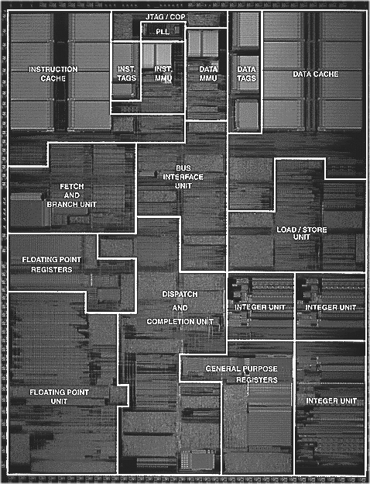
Floor plan of the PowerPC 604
Instruction
Cache
Data Tags
Data
Caches
Bus Interface
Unit
Fetch and Branch Unit
Load/Store
Unit
Floating Point Registers
Dispatch and Completion
Unit
Integer
Unit
Integer
Unit
Floating
Point
Unit
General
Purpose
Register
Integer
Unit

Slide 168
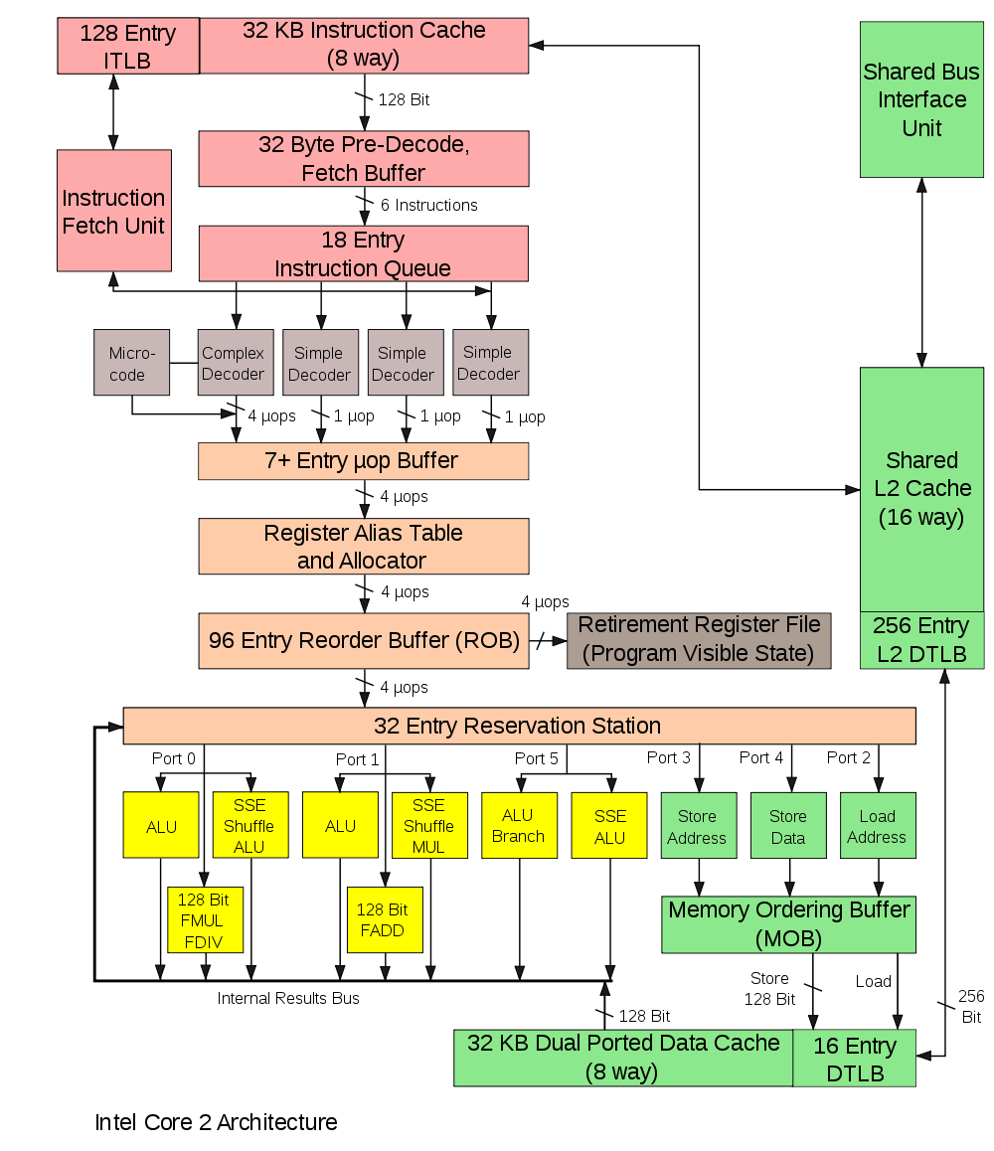
Example: Intel Core 2 Architecture

Slide 169
(Future) Processor Architecture Principles
Speed-up of a single-threaded application
  Simultaneous Multithreading
  Advanced superscalar
  Superspeculative
  Multiscalar processors
Speed-up of multi-threaded applications
  Chip multiprocessors (CMPs)
  Simultaneous multithreading

Slide 170
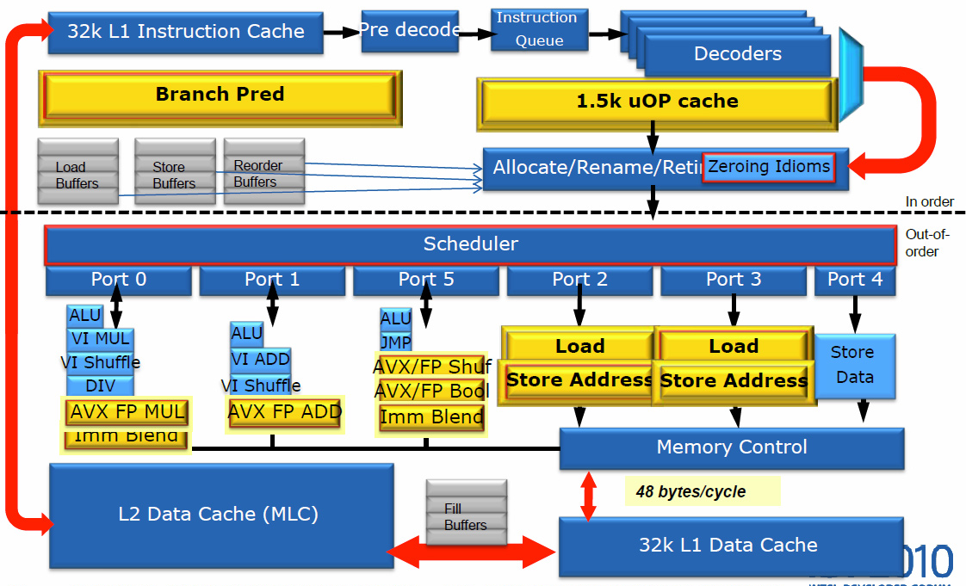
Example: Intel Sandy Bridge

Slide 171
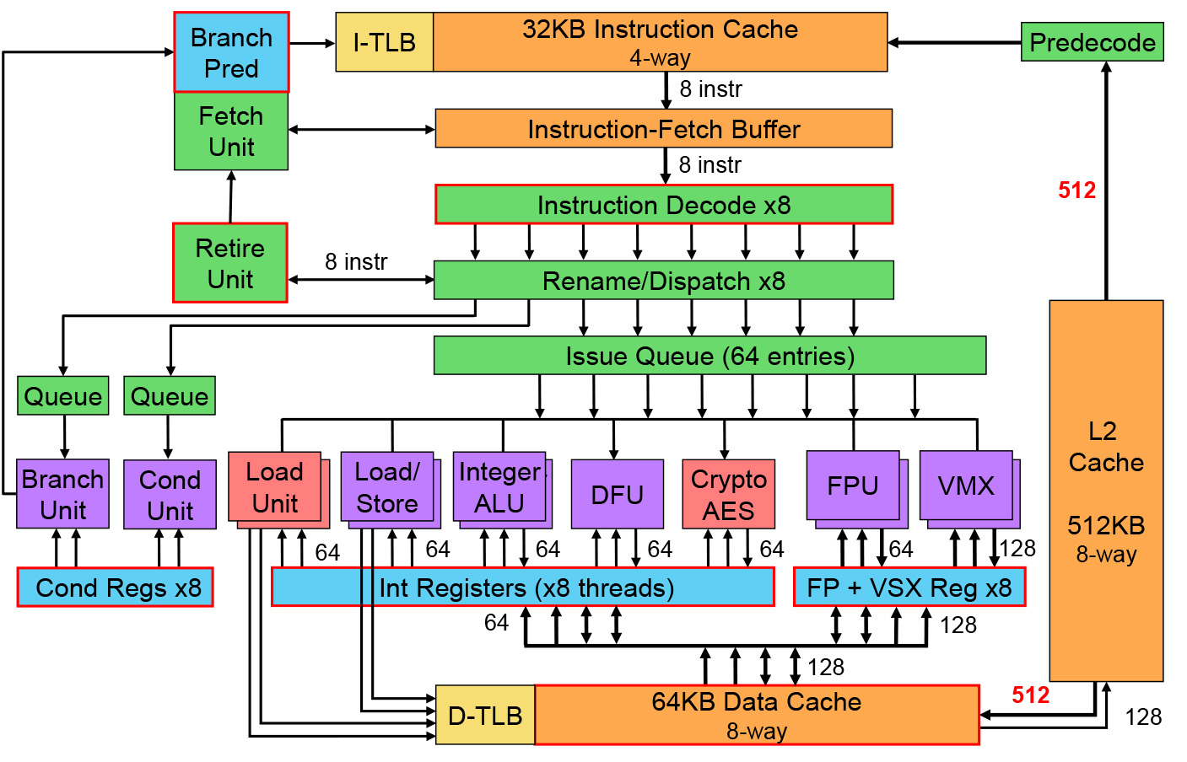
Example: Power8

Slide 172
Questions & Tasks
  Check the architecture of your favorite CPU and try to find the different stages of the pipeline!
  What are the key features of Tomasulo’s algorithm?
  What is the role of the Common Data Bus?

Slide 173
Summary
Architecture of a microprocessor
    Control unit, execution unit, registers, interfaces, busses
Performance enhancement of computers
    Technology
    Structures
Pipelining
    Methods
    Hazards
    Branch prediction
    Vector pipelining
Superscalar processors
    Tomasulo

