Slide 1
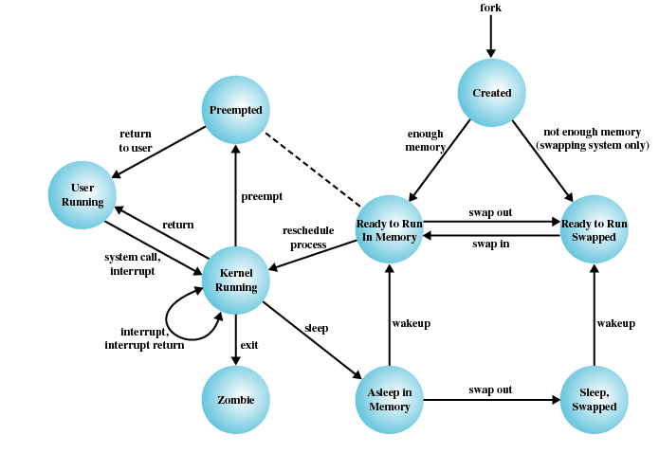
TI III: Operating Systems & Computer Networks
Introduction and Motivation
Prof. Dr.-Ing. Jochen Schiller
Computer Systems & Telematics
Freie Universität Berlin, Germany

Slide 2
Content
Introduction and Motivation
Subsystems, Interrupts and System Calls
Processes
Memory
Scheduling
I/O and File System
Booting, Services, and Security

Slide 3
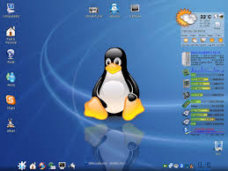
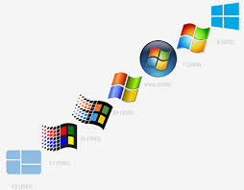
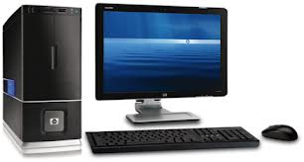
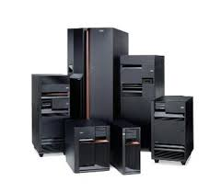
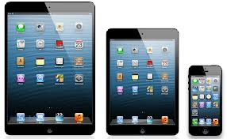
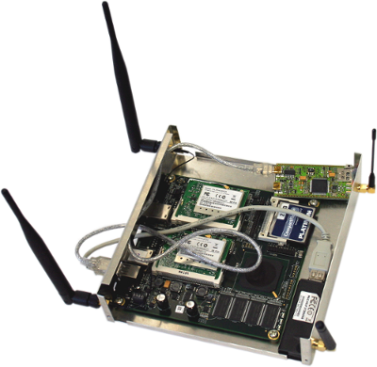
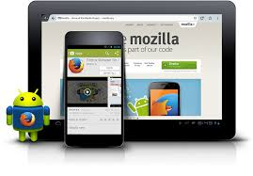
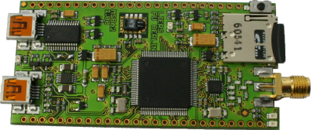
Motivation

Slide 4
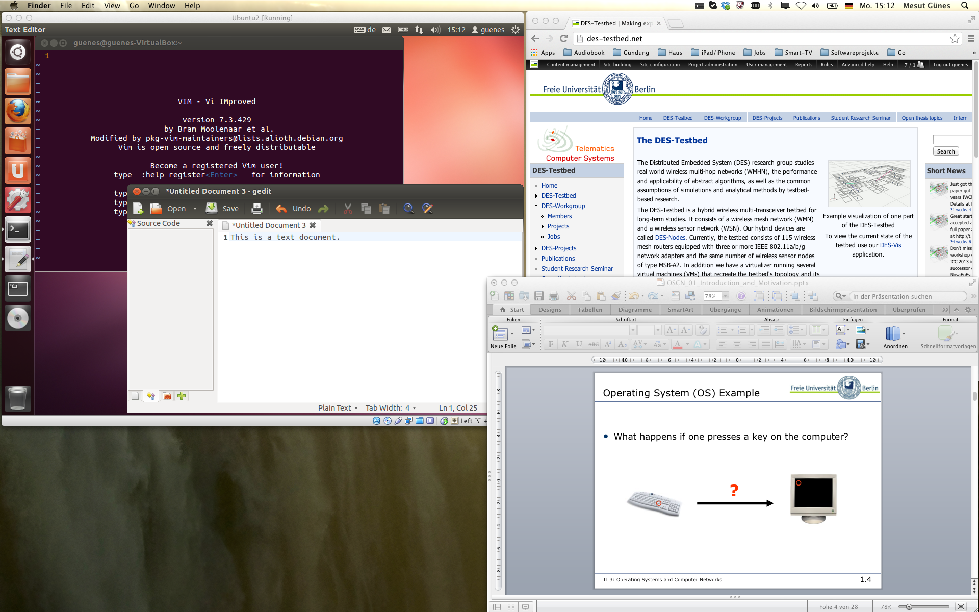

Slide 5
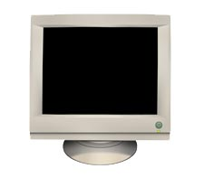
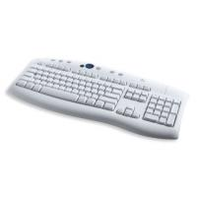
Operating System (OS) Example
What happens if one presses a key on the computer?
?

Slide 6
Operating System Example
User Application
Browser
Editor
...
Operating System
Process Management
Input/Output
Memory Management
Keyboard
Driver
Video Adapter
Driver
Hardware
Keyboard
Controller
Video
Adapter
...

Slide 7
Layers of Abstraction
User Interface
(Shell, GUI, ...)
User Applications
System Interface
(system calls, C functions)
Operating System / Kernel
Hardware Interface
(ISA, I/O Ports, ...)
Hardware

Slide 8
System Interface and System Calls
System interface is the only way for user applications to interact with the operating system.
System interface consists of system calls (supervisor calls) ➙ POSIX.
High-level programming languages hide systems calls in library routines.
User Applications
Library
Operating System
Hardware

Slide 9
POSIX
Portable Operating System Interface (POSIX)
  E.g. https://standards.ieee.org/standard/1003_1,2013Edition.html
POSIX defines
  Application programming interface (API)
  Command line shells
  Utilities
UNIX like Operating Systems
POSIX oriented operating systems
  Unix
  Linux
  Windows
  Mac OS X
  …

Slide 10
Questions & Tasks
  Why are there so many different operating systems? What are differences?
  What are benefits of layering? Are there any drawbacks?
  Do you know other examples of layering?
  Check out your favorite programming language for system calls. Are there any?
    That‘s one of the reasons we use the language C here …
  Read about POSIX
    Check IEEE, e.g. https://standards.ieee.org/standard/1003_1,2013Edition.html
    or at least Wikipedia…
  Go to RIOT and check out an OS for the IoT
    https://riot-os.org/

Slide 11
Tasks of an Operating System
Typical services of a general purpose OS includes:
  Program execution
  Access to I/O-devices
    Hardware abstraction
  Controlled access to files
    Non-volatile memory
  Access control
    Security / user management
  Error detection and error handling
    Both hardware and software
  Logging
Special purpose operating systems focus on different services, e.g., real-time or communication requirements.

Slide 12
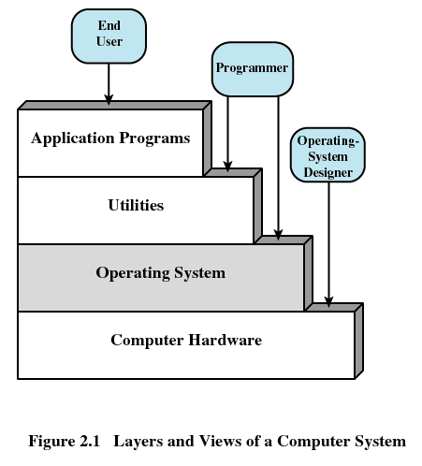
Goals of an Operating System
Ease of use for users and programmers
Efficiency when managing limited resources
Possibility to evolve
  New hardware standards
  Changing user requirements

Slide 13
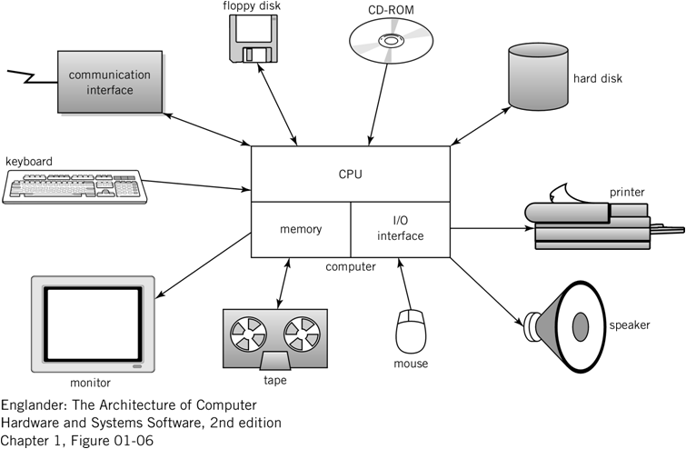
Managing Resources
Hardware provides the basic computing resources such as
  Processor(s)
  Memory
  Persistent storage
  Network connection
OS virtualizes resources to permit controlled sharing and isolation
  virtual instances of a resource are created
OS provides virtual resources for user applications

Slide 14
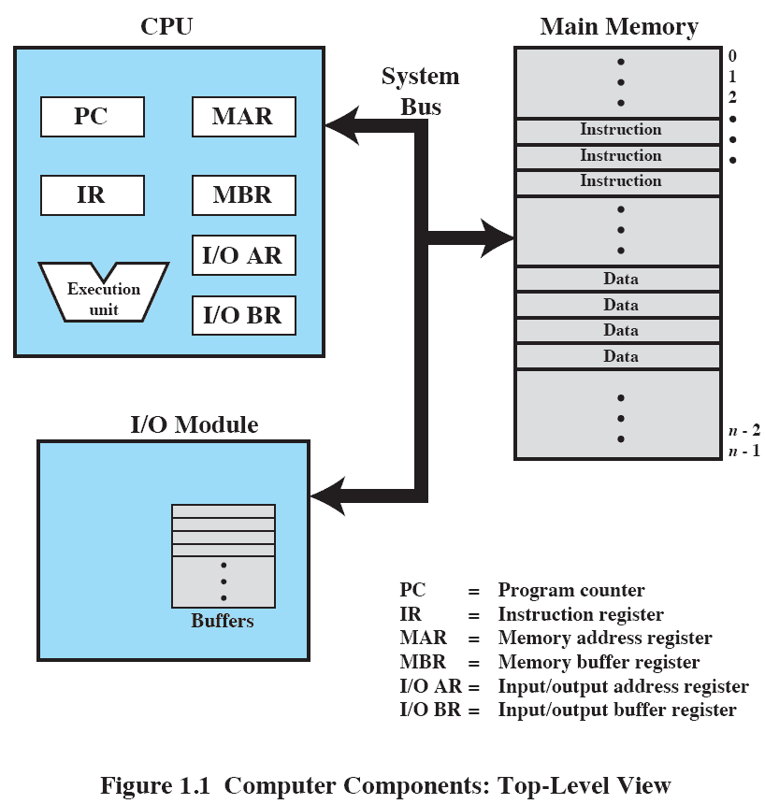
Computer Components

Slide 15
Virtual Resources
Virtual resources and corresponding real resources:
  Processes processor(s)
  Virtual Memory main memory
  Files persistent memory
  Ports network adapter
Advantages:
  Easy to use through procedural interface (system calls)
  Secure against hardware and software errors or manipulation

Slide 16
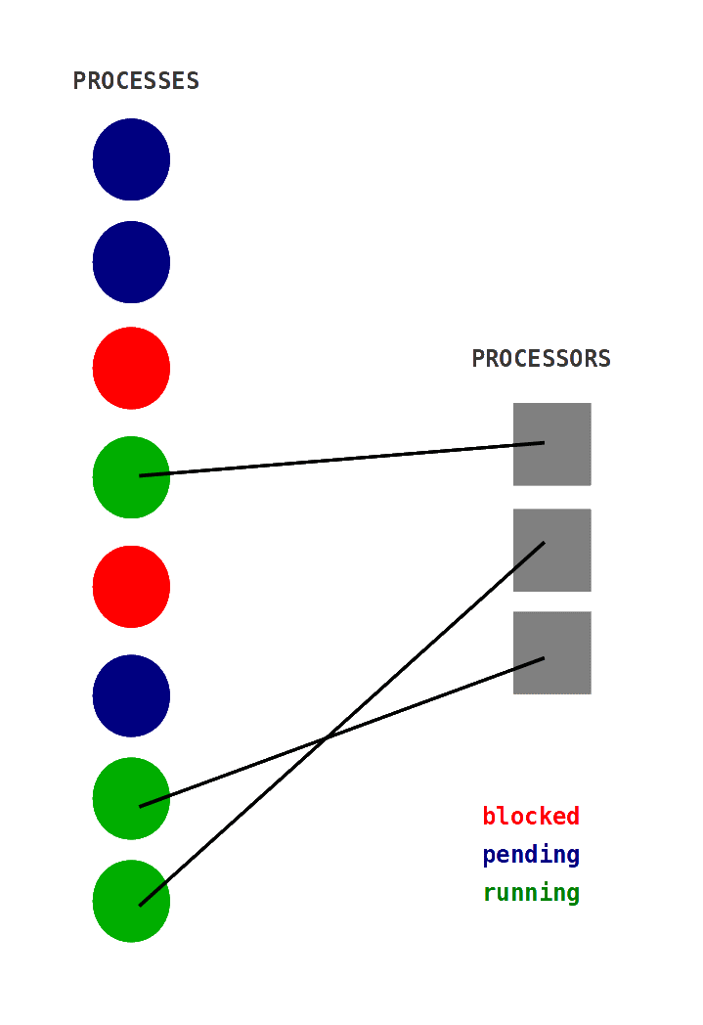
Processes
Number of processes is not limited by the number of processors: Multitasking
Processor is used efficiently:
  Time is not wasted by processes that are waiting on I/O devices
Reduced latency (=response time)
Different process states, e.g.,
  running – executing
  pending – ready to execute
  blocked – not ready to execute

Slide 17
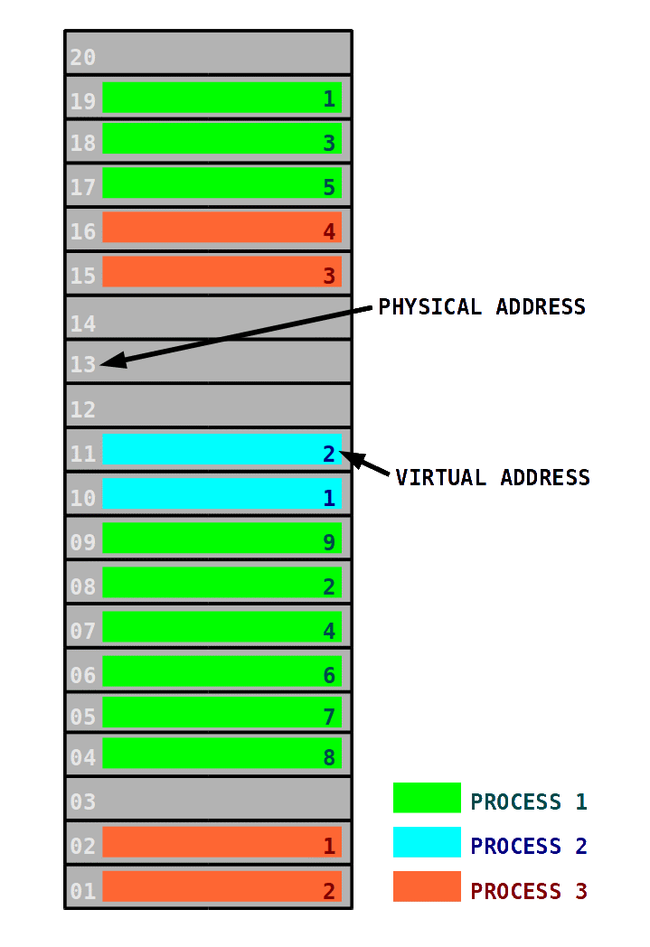
Virtual Memory
Managed by the Memory Management Unit (MMU)
Transportability:
  position independent code – program does not depend on
  memory architecture
Security:
  memory access is restricted to memory units “owned” by a process
Efficiency:
  external fragmentation is avoided

Slide 18
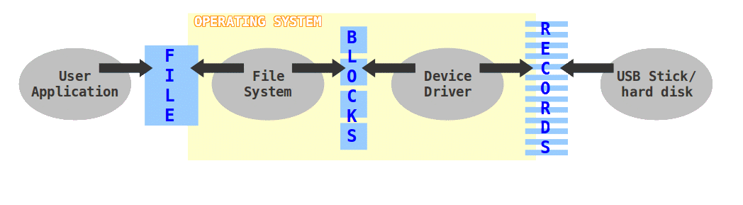
Files
Managed by a file system
Persistent objects for long-term data storage
Stored in secondary memory (e.g., tape, hard disk, USB flash drive)
Similar to virtual memory - file name instead of virtual address

Slide 19
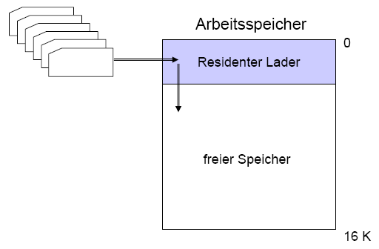
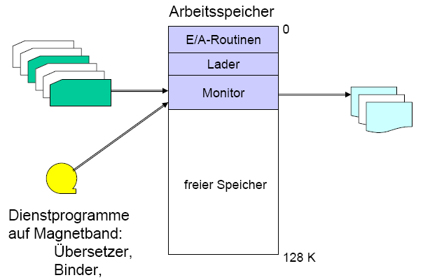
History of Operating Systems
Development of operating systems follows changes in computer architecture
Loader (1950, IBM 704)
  Loads programs into memory
Batch System
(1960,IBM 7090, Zuse Z 23, Telefunken TR4)
  Processing of jobs stored
  on punch cards
  Manual job control by
  human operator

Slide 20
History of Operating Systems
Multi-User / Time Sharing Systems
(1970, IBM OS/360, TSS, T.H.E., Multics, UNIX)
  Many terminals connected to one computer
  Interactive control for users
  Multitasking
Personal Computing und Client/Server
(1980/90, Apple Lisa, MS Windows, Linux, Solaris, HP-UX)
  Intelligent workstations
  GUI / Window mode

Slide 21
Protection Rings
Hardware provides hierarchical privilege levels
  Inner rings have access to outer rings’ resources
  Outer rings may access inner rings through predefined gateways
Operating system kernel
(highest privilege)
Operating system
services (e.g. device
drivers, libraries)
Unused in many OSs
Ring 0
Ring 1
Ring 2
Applications
(lowest privilege)
Ring 3

Slide 22
Operating System Kernel
Kernel implements basic layer of abstraction
Runs with full access to hardware (Ring 0)
Context Switch: switching from one process to another
  A certain amount of time is required for doing the administration, e.g., saving and loading registers.

Slide 23
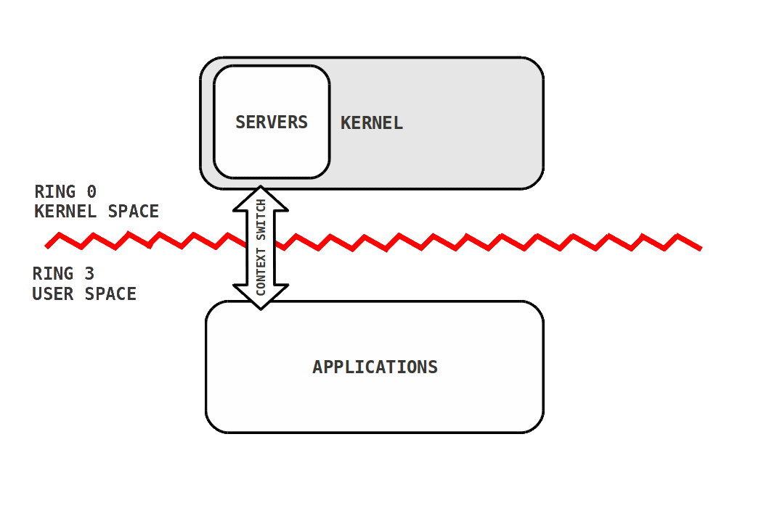
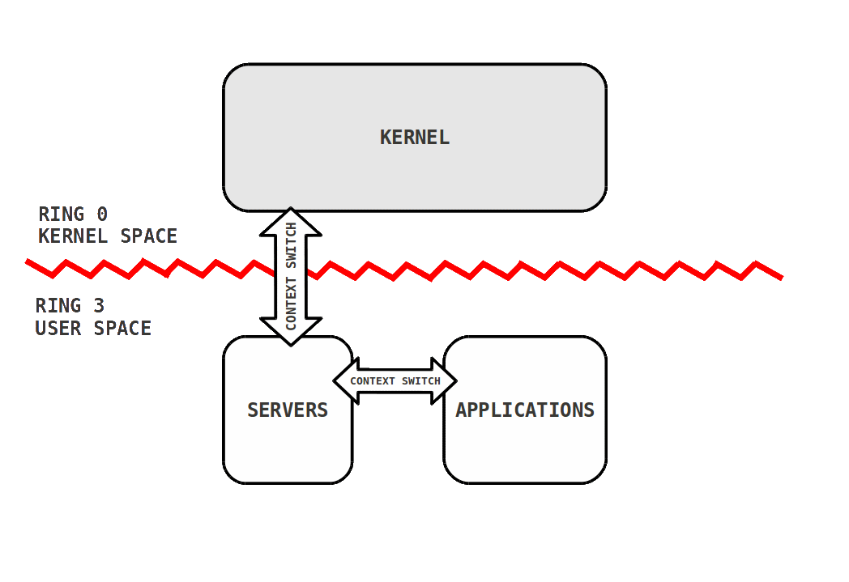
Monolithic versus Microkernel
Monolithic Kernel
Pro:
  less context switches
  no expensive communication
Contra:
  complications when exchanging functionality
Microkernel
Pro:
  strict interfaces
  less complexity, clear structure
Contra:
  speed
  synchronization

Slide 24
Questions & Tasks
  What is the basic idea of an OS?
  Can we run a computer without an OS?
  How could a VERY simple OS look like?
  What does virtualization in the context of an OS mean? How does it help? Where else do computers use virtualization?
  Check the number of processes, the resources they use, the memory mapping etc. on your computer. Depending on the OS there are many tools for that!
  What could be reasons for not using that many protection rings?
  What do we need to protect the OS? Think of memory protection, HW support, processor mode etc.
  Do we have pure micro kernel OSs today? Do we at least use ideas form micro kernels? Why are many of the famous OSs today rather big monolithic systems?

Slide 25
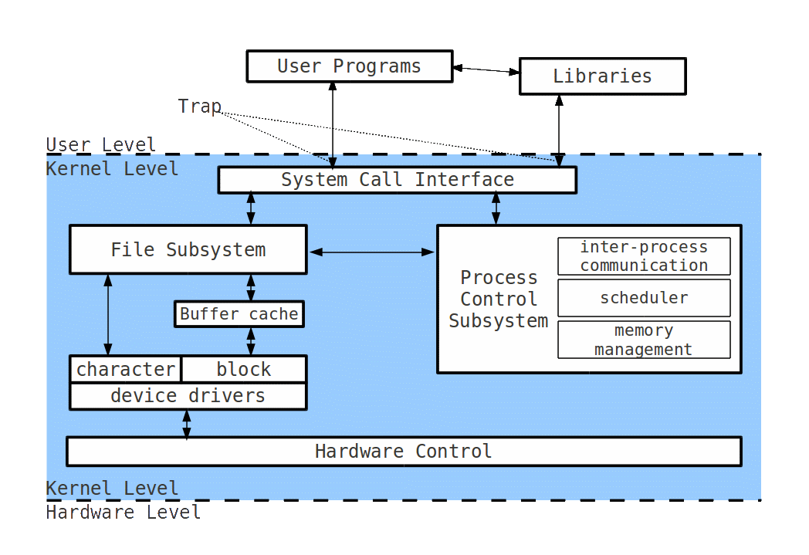
Examples – UNIX

Slide 26
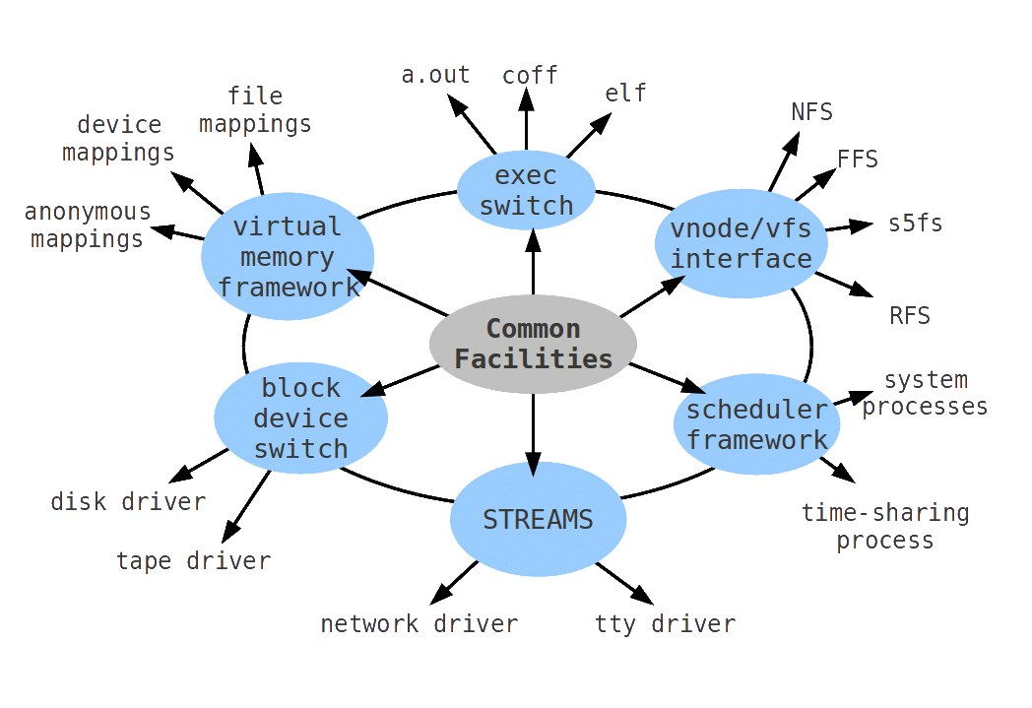
Examples – UNIX by Services

Slide 27
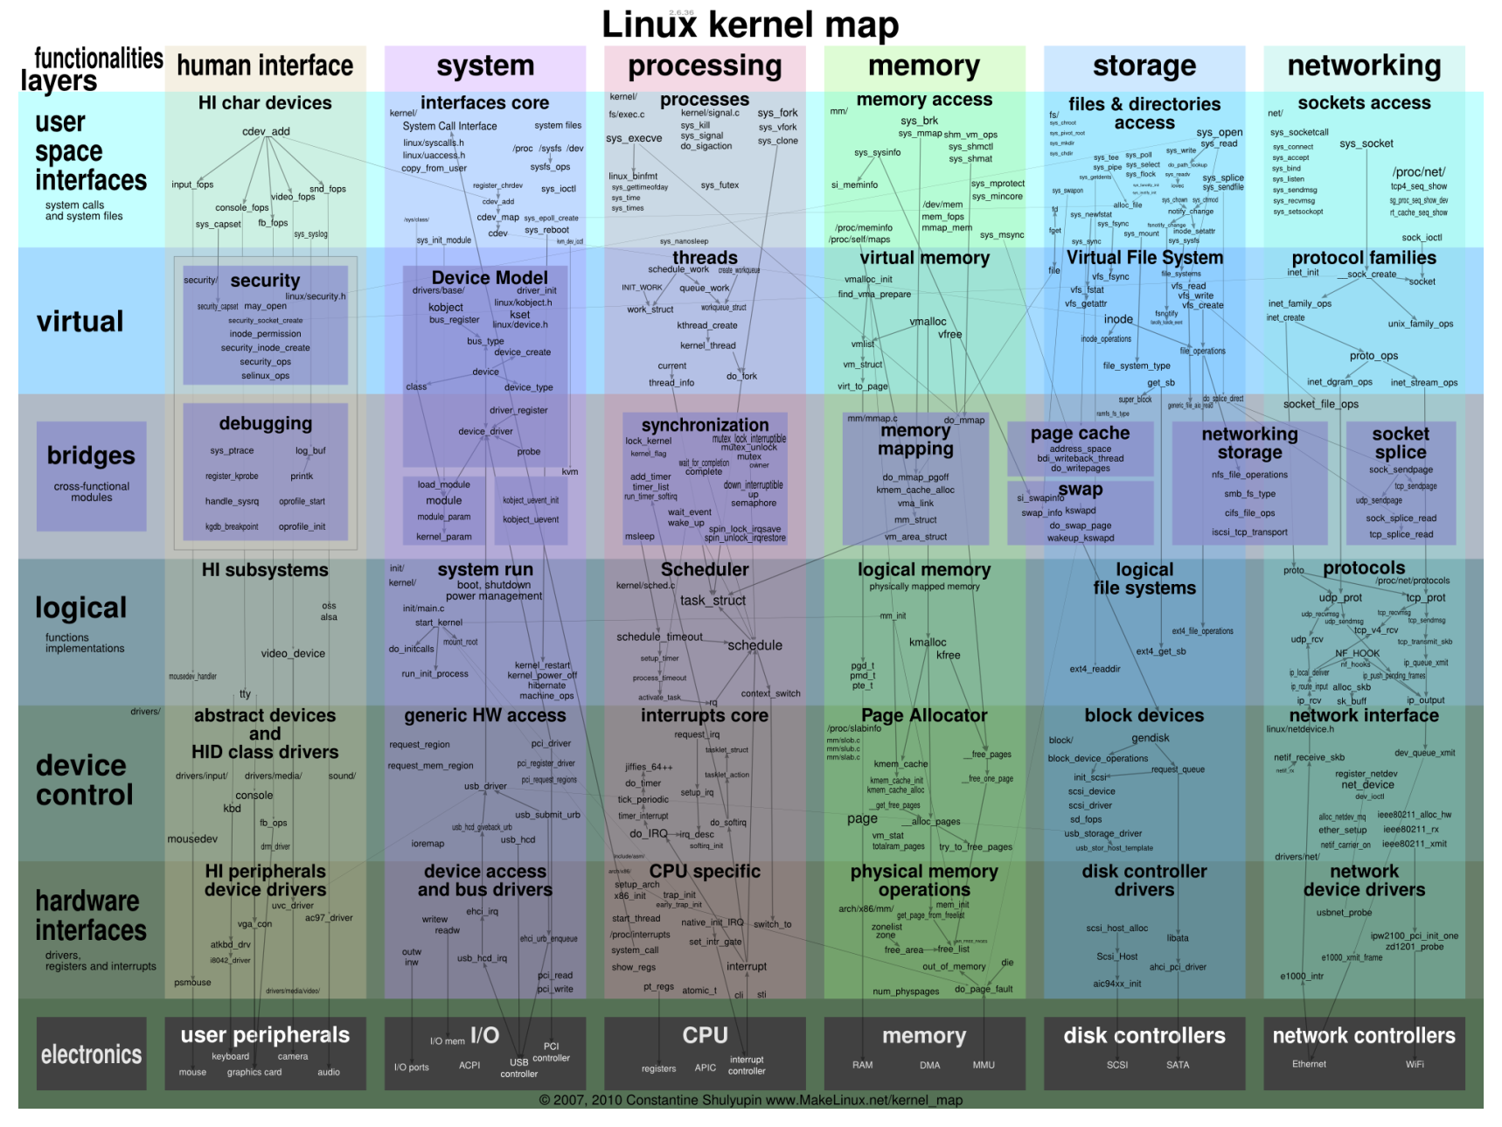
Examples – Linux
Source: http://www.makelinux.net/kernel_map

Slide 28
A Word About Synchronization
Concurrency handling is outside the scope of this lecture – see “Non-sequential programming”
Some pointers/methods/ideas
  In hardware:
    Atomic operations:
      ISA instructions that are guaranteed by design to run to completion
    Interrupts:
      Enable/disable interrupts via special ISA instructions
      Allows other interrupt handlers to run to completion
  In software:
    Spinlocks (busy waiting):
      Short-term synchronization mechanism
      Low overhead, avoid re-scheduling, wasteful on resources
    Semaphores (wait queues):
      Long-term synchronization mechanism
      Synchronize for events on special purpose data structures

Slide 29
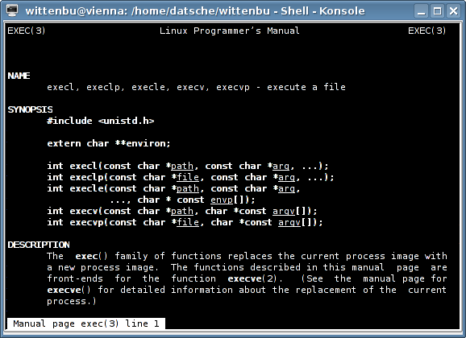
Manual Pages
UNIX-utility man
e.g. man exec

Slide 30
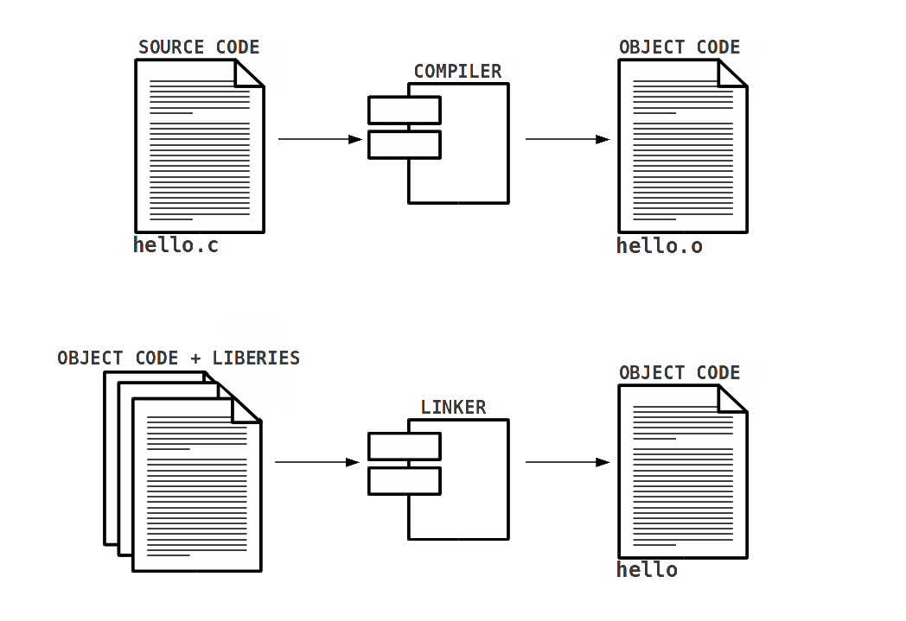
Program Building
Toolchain: set of programming tools that are used to build a product (executable)

Slide 31
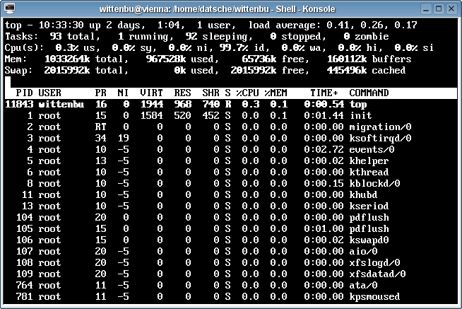
Process Monitor
UNIX utility top

Slide 32
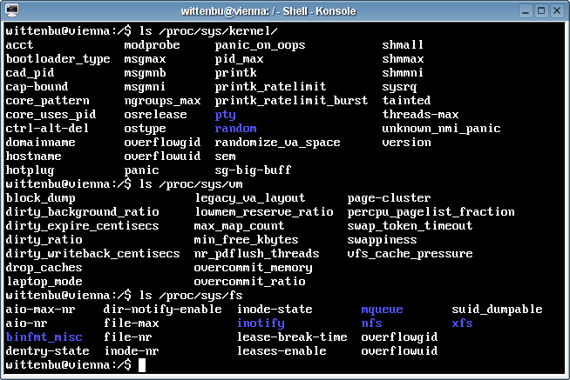
Kernel Parameters
Directories /proc and /sys
  virtual directories that reflect general kernel behaviors (“everything is a file”)

Slide 33
Content
Introduction and Motivation
Subsystems, Interrupts and System Calls
Processes
Memory
Scheduling
I/O and File System
Booting, Services, and Security

