Slide 1
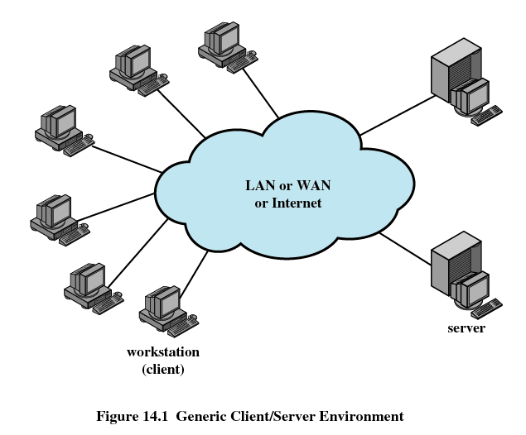
TI III: Operating Systems & Computer Networks Networked Computer & Internet
Prof. Dr.-Ing. Jochen Schiller
Computer Systems & Telematics
Freie Universität Berlin, Germany

Slide 2
Content (2)
Networked Computer & Internet
Sockets
Internet
Layers
Protocols
Host-to-Network
Physical Layer, Signals, Modems
Data Link Layer, Framing, Flow Control, Error Detection/Correction
Topologies, Medium Access
Local Area Networks, Ethernet
Internetworking
Switches, Routers
Routing
Internet Protocol
Addressing
Transport Layer
Protocol Mechanisms
TCP, UDP
Addressing, Ports
Applications
Domain Name System
Email
World Wide Web
Network Security
Basic Concepts & Terms
Cryptology
Firewalls, VPNs, IP Security, Email Security
Example
Under the Hood of Surfing the Web

Slide 3
Motivation – Networked Computers
Questions:
How can a user/process communicate over the network?
How can (possibly distant) computers exchange data?
How does a computer know which other computer it should be talking to?

Slide 4
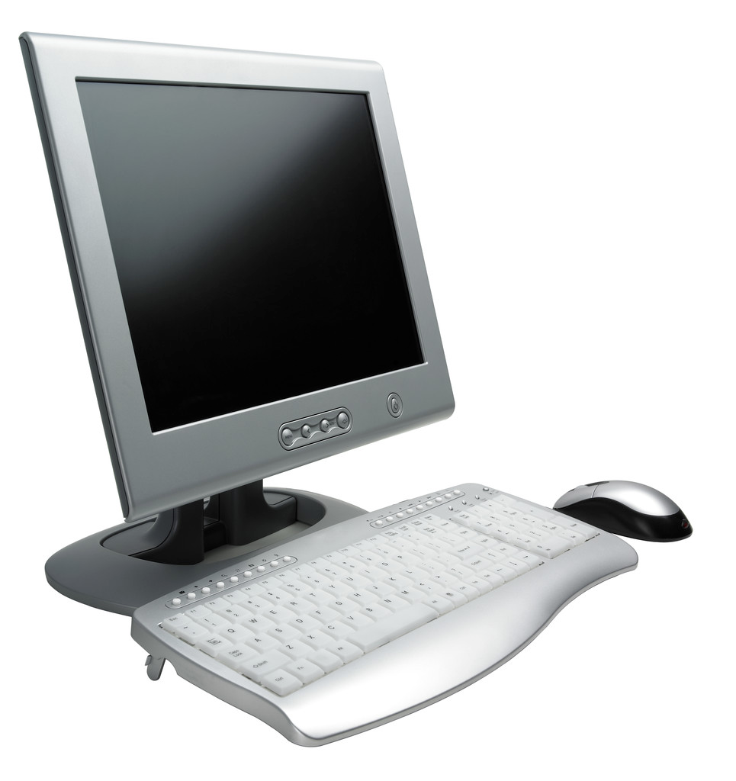
Motivation – Networked Computers
www.mi.fu-berlin.de
160.45.117.199
Socket
Enable communication between a client and server
Concatenation of a Port and an IP address form a socket, 160.45.117.199:80 (http://www.mi.fu-berlin.de)

Slide 5
OS Support for Networking
Types of Sockets (classical Internet)
Stream sockets
Use Transmission Control Protocol (TCP)
Reliable data transfer
Datagram sockets
Use User Datagram Protocol (UDP)
Delivery is not guaranteed
Processes may open sockets to transparently communicate with processes on remote computers

Slide 6
OS Support for Networking
Open Socket
Connect to Peer
Communication
Send Request
Receive Response
Close Socket
socket()
connect()
write(), send() read(), recv()
close()

Slide 7
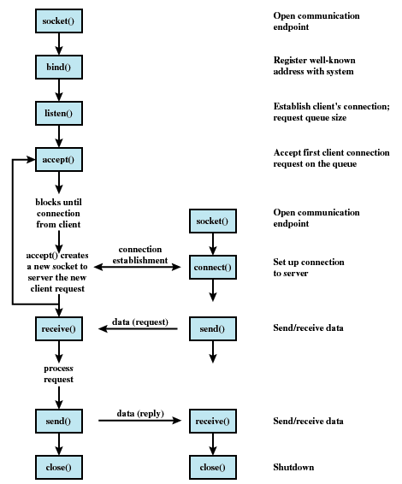
Socket Creation and Operation
Server
Client
System call
int socket(int domain, int type, int protocol)
Parameters
domain Protocol family
e.g. PF_INET for TCP/IP
type
Stream or datagram
protocol (optional)
e.g. TCP or UDP (for TCP/IP networking)

Slide 8
Datagram Communication
Simplest possible service: unreliable datagrams
Sender
int s = socket(…);
sendto(s, buffer, datasize, 0, to_addr, addr_length);
to_addr and addr_length specify destination
Receiver
int s = socket(…);
bind(s, local_addr, …);
recv(s, buffer, max_buff_length, 0);
Will wait until data is available on socket s and put the data into buffer

Slide 9
Byte Streams over Connection-Oriented Socket
For reliable byte streams, sockets have to be connected first
Receiver has to accept connection
Client
int s = socket(…);
connect(s, destination_addr, addr_length);
send(s,buffer, datasize, 0);
Arbitrary recv()/send()
close (s);
Connected sockets use a send without address information
Server
int s = socket(…);
bind(s, local_addr, …);
listen(s, …);
int newsock = accept(s, *remote_addr, …);
recv(newsock, buffer, max_buff_length, 0);
Arbitrary recv()/send()
close (newsock);
...
close(s);

Slide 10
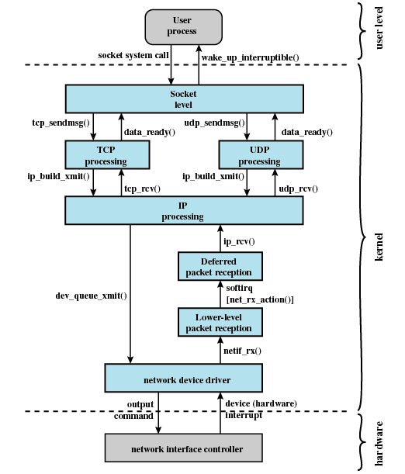
Kernel-level Socket Support
API to user space
TCP / UDP implementation
Internet Protocol (IP)
implementation
Device driver
(includes method to access
communication medium)
Layered communication
architecture

Slide 11
Questions & Tasks
What is the difference between connection oriented (streams) and connection-less (datagrams) services?
Which protocols support these services?
Where is the distance from sender to receiver (local, same city/country, global) reflected?
How to address a computer and a process?

Slide 12
The Internet

Slide 13
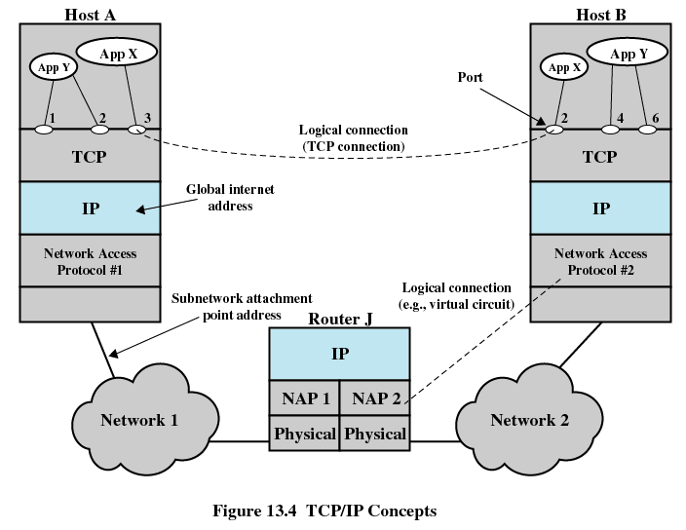
Internet / TCP/IP Network Stack

Slide 14
The Internet
The Internet consists of
many computers
using same network protocol family TCP/IP
IP on top of lower-level protocol (Ethernet, WLAN, Bluetooth, ...)
that are (directly or indirectly) connected to each other
that offer or use certain services
many users that have direct access to the services
many networks interconnected via gateways
Computer Science Dept.
FU Berlin
Germany
World
Notes:
Es gibt keine „saubere“ oder eindeutige Definition des Internets. Generell werden darunter einfach alle Computer verstanden, welche mit Hilfe der TCP/IP-Protokollfamilie (dazu später mehr) miteinander kommunizieren können. Manchmal wird zusätzlich die Forderung gestellt, dass diese Computer ständig erreichbar sein müssen. Damit würden alle Rechner mit Einwahlverbindung bzw. Firmenrechner hinter einer Firewall streng genommen nicht zu „dem“ Internet gehören, sehr wohl aber auf Dienste des Internets zugreifen können. Weiterhin gibt es heute mehrere „Internets“, welche teilweiße bewusst gegeneinander abgeschottet werden (Internet 2 etc.) bzw. nur wenige, stark überwachte Übergänge besitzen.

Slide 15
Structure of the Internet (Concept)
Backbone service providers
Consumer Internet Service Provider (ISP)
Peering Points – shortcuts between operators
Consumers
Direct backbone connectivity (companies) or ISP (private)
Large company
Consumer ISP 1
Backbone service provider 1
Backbone service provider 2
Peering point
Consumer ISP 2
Small company 2
Small company 1

Slide 16
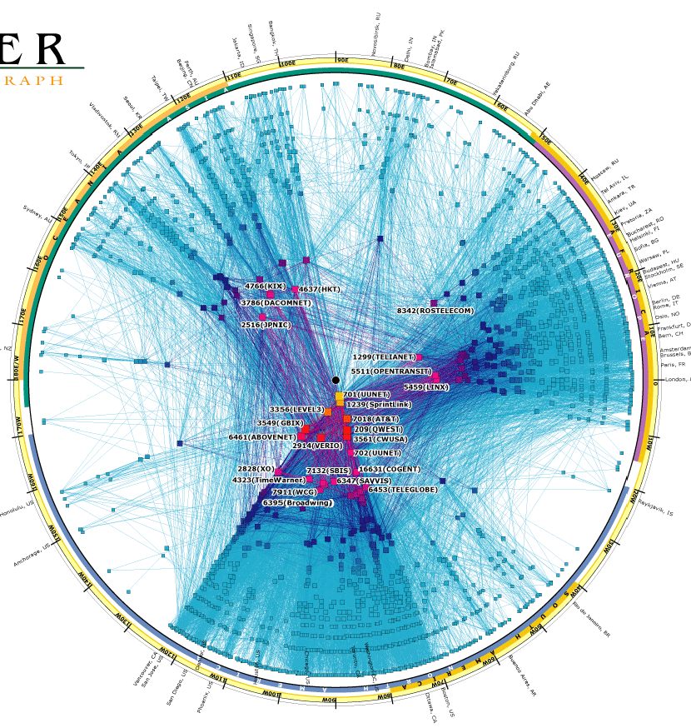
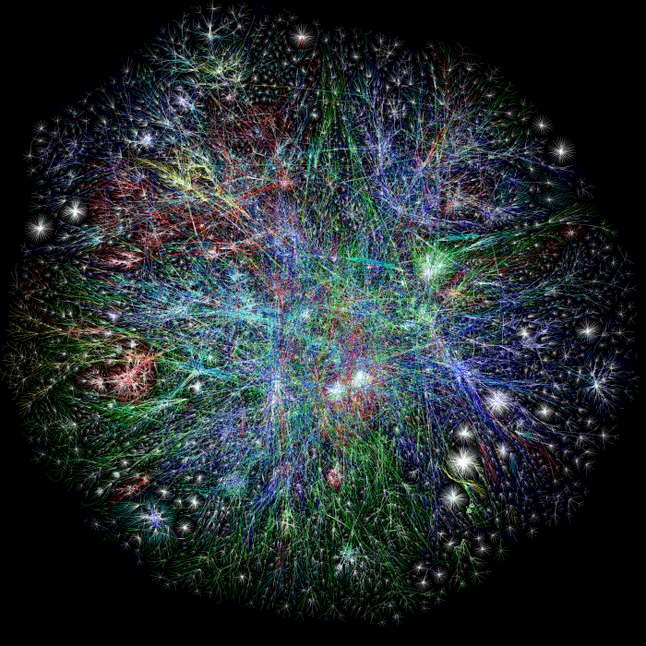
Structure of the Internet (“Reality”)
Source: www.caida.org
Notes:
Mehr zu solchen Darstellungen unter http://www.caida.org/.

Slide 17
Exemplary Services in the Internet
World Wide Web (WWW)
World-wide interlinked resources
Based on “Hypertext Transfer Protocol” (HTTP)
Electronic mail (email)
Exchange of digital multimedia messages
Based on “Simple Mail Transfer Protocol” (SMTP)
File transfer
Exchange of files
Based on “File Transfer Protocol” (FTP)
Network management
Monitoring and control of networked systems
Based on “Simple Network Management Protocol” (SNMP)
P2P, VoIP, IPTV, CDN, ...
Many company-specific services: Skype, Gaming, ...
Notes:
Wie bereits angesprochen, ist eine Grundvoraussetzung im Internet die Verwendung gemeinsamer Kommunikationsprotokolle, konkret der TCP/IP-Protokollfamilie. Auf deren Basis werden dann unterschiedliche Dienste realisiert.
Der bekannteste Dienst ist das World Wide Web (WWW), das im Verlauf der Vorlesung noch öfter als Beispiel herangezogen wird. Ebenfalls sehr gebräuchlich sind Dienste zur Übermittlung von elektronischer Post oder zum Transferieren von Dateien. Schließlich sei noch darauf hingewiesen, dass gerade in einem derart komplexen Netz wie dem Internet die Möglichkeit der entfernten computergestützten Verwaltung gegeben sein muss.

Slide 18
Classical Internet Design Principles
Minimalism and autonomy
Independent operation of the network, no internal changes necessary if connected to other networks
“Best-Effort” services
Network tries as best as possible to transmit data end-to-end
Reliable communication is feasible through retransmission
Today several extensions towards quality-of-service (QoS) support exist
Stateless intermediate systems
No intermediate system (routers) should keep state related to any end-to-end communication
Big difference to classical telephone networks (circuit vs. packet switched)
Alternatives necessary for quality-of-service support
Decentralized control
No global, centralized control of all interconnected networks
Do we still have this situation today with >60% traffic handled by Google, Amazon, Facebook, Apple …?
Notes:
Diese Entwurfsprinzipien waren und sind stets Streitpunkte innerhalb der Forschergemeinde. Auf der einen Seite trugen sie sehr stark zur Verbreitung des Internets bei: das Internet garantiert nichts und ist mit praktisch jedem Transportmedium zufrieden. Alle Netzkomponenten können sehr einfach gestaltet werden, niemand hat die Kontrolle über das ganze Netz (wobei allerdings weite Strukturen von wenigen kontrolliert werden…). Auf der anderen Seite benötigen gerade viele Multimedia-Anwendungen gewisse Dienstgütegarantien, welche das Internet so nicht bieten kann. Gerade die Zustandslosigkeit, im Prinzip einer der großen Vorteile, steht einer Dienstgüteunterstützung entgegen.

Slide 19
Some (Historical) IP Design Principles
RFC 1958, based on papers from mid-80s
Make sure it works – before writing the standard
Keep it simple
Make clear choices
Exploit modularity
Expect heterogeneity
Avoid static options and parameters
Look for a good design; it need not be perfect
80-20 rule: 80% of effects comes from 20% of causes
Be strict when sending and tolerant when receiving
Think about scalability (with regard to nodes and traffic)
Consider performance and cost
Looking back, some choices are not optimal anymore.

Slide 20
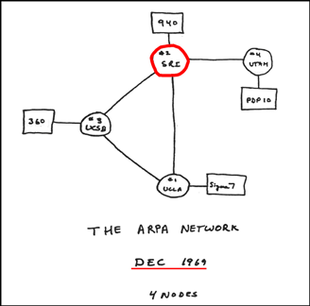
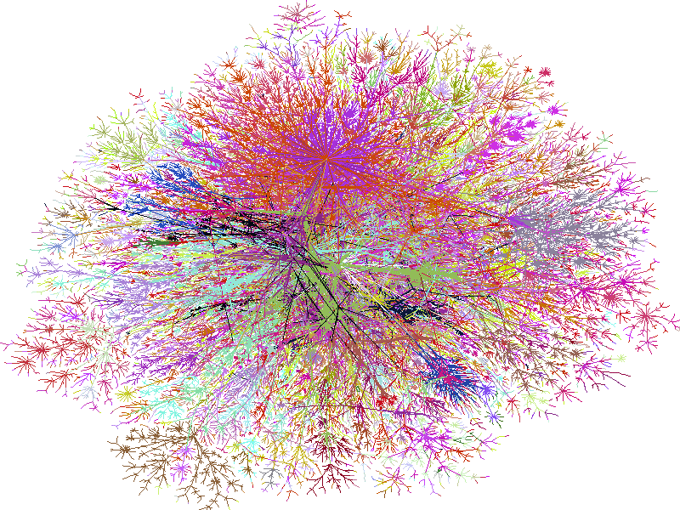
Development of the Internet
1962 DoD (Department of Defense): “Defense depends on communication.”
1967 ARPA (Advanced Research Project Agency) of the DoD: Project reliable packet network at SRI
1969 First “Internet” (4 hosts)
1971 Start of ARPAnet, the first Internet backbone
1974 New protocol suite: TCP/IP (Transmission Control Protocol/Internet Protocol)
1980 Integration of TCP/IP protocols into UNIX (BSD)
1988 IP connection to the Internet from Germany via EUnet - IRB Dortmund and XLink Karlsruhe
1991 EBONE: European backbone
1995 Internet becomes visible due to WWW
1996 University Corporation for Advanced Internet Development - Internet2
1999 Second Internet2-Backbone: Abilene
~2000 Rise and fall of dotcoms
2006 VoIP, Web 2.0 hype (and history repeats…)
2009 Clouds, more clouds
2010+ Everything is mobile (> 4.5bn subscribers), apps rule…
20xy Internet of Things with > 30bn devices, IPv6 finally everywhere
Scan of ARPANET logic map, circa 1969, © SRI International
1969
…
2020
© Steve Jurvetson / CC BY 2.0

Slide 21
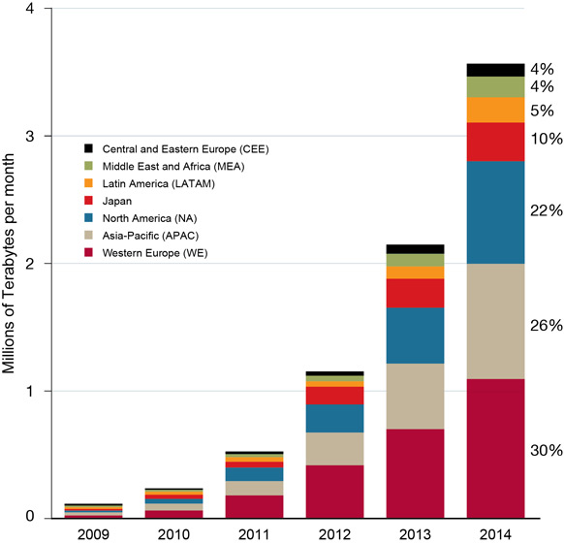
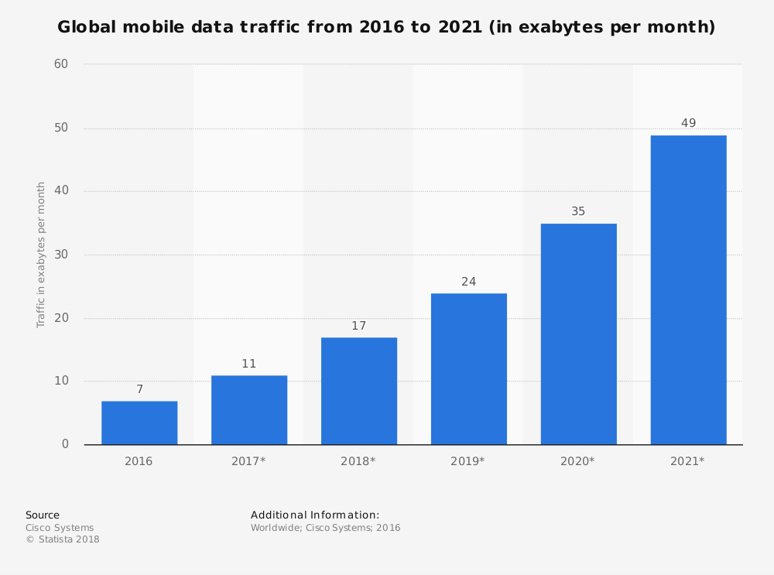
Global Mobile Data Traffic Forecast by Region
Source: Cisco and MIT Technology Review
More than 50% is video!
Notes:
Exponential growth: doubling every year
Asia (+ Japan) = 40%
EU = 25% only!!

Slide 22
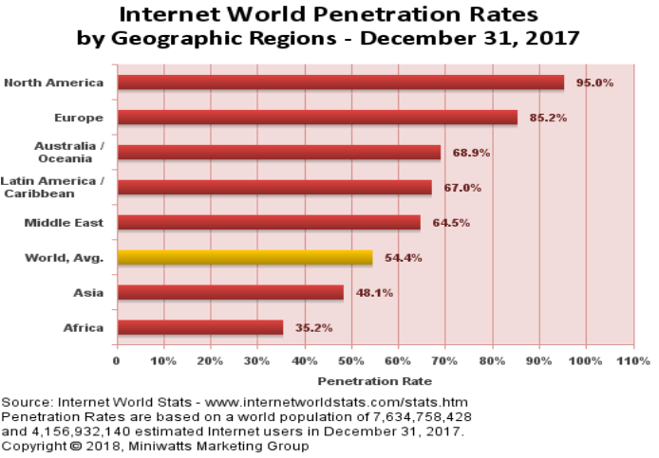
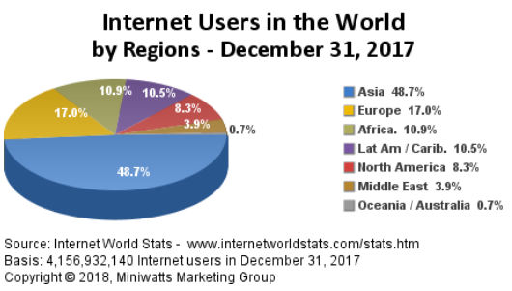
Internet Users World-Wide

Slide 23
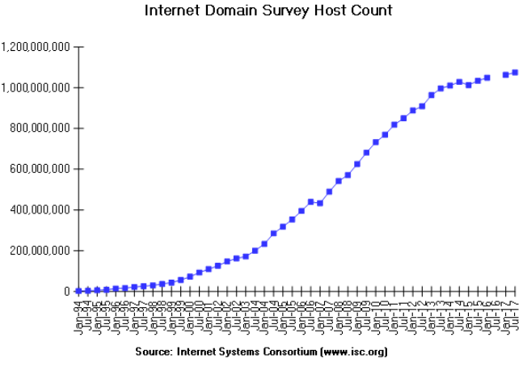
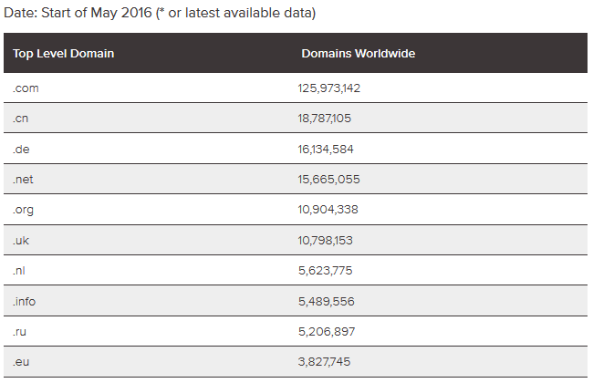
Hosts and Internet Domains
15 million .de – domains
> 1 billion hosts world-wide (but > 7 billion mobile devices, > 30 billion IoT predicted…)
Sources: DENIC (www.denic.de), Internet Systems Consortium, Inc. (http://www.isc.org/)

Slide 24
Questions & Tasks
Check the latest numbers regarding domains, hosts, users, penetration!
What is the job of a router (from a high-level perspective)?
What do applications see from the network stack?
Who owns the Internet?
Why having peering points?
What do many services in the Internet have in common?
Compare the classical Internet design principles with today’s applications and their requirements. What challenges do arise?

Slide 25
Protocols

Slide 26
The Classical Internet Protocol Suite
TCP (Transmission Control Protocol)
Reliable, connection oriented transport protocol over unreliable IP (Internet Protocol)
UDP (User Datagram Protocol)
Connectionless transport protocol, offers application interface to IP plus multiplexing
Examples for application oriented protocols
HTTP: HyperText Transfer Protocol
FTP: File Transfer Protocol
Telnet: Simple terminal protocol
Application
oriented
Application
oriented
TCP
UDP
Internet
TCP
UDP
Host A
IP
IP
Host-to- network
Host-to- network
Host B

Slide 27
Protocols
Protocols are a set of rules
Describe how two (or more) remote parts of a layer cooperate to implement the service of the given layer
Behavior, packet formats
These remote parts are called peer protocol entities or simply peers
Use the service of underlying layer to exchange data with peer
Use
Use
SAP n+1
SAP n+1
Protocol
Layer n+1
Layer n+1
Use
Use
SAP n
SAP n
Layer n
Layer n

Slide 28
Protocol Stacks
Typically, several layers and thus several protocols in real system
Layers/protocols are arranged as (protocol) stack
One atop the other, only using services from directly beneath (so-called strict layering)
L4 protocol
Layer 4
Layer 4
L3 protocol
Layer 3
Layer 3
L2 protocol
Layer 2
Layer 2
L1 protocol
Layer 1
Layer 1
Physical medium (layer 0)

Slide 29
Layers Do Not Care About Distributed Lower Layers
A given layer n+1 does not care about the fact that its lower layer is actually distributed …
Layer n+1 imagines layer n as something that “just works”, has service access points where they are necessary
In reality, layer n of course is distributed in turn, relying on yet lower layers
At the end, the physical medium (layer 0) is transporting signals (as physical representation of data)
Ln+1 protocol
Layer n+1
Layer n+1
SAP n
SAP n
Ln protocol
Layer n
Layer n
SAP n-1
Ln-1 protocol
SAP n-1
Layer n-1
Layer n-1

Slide 30
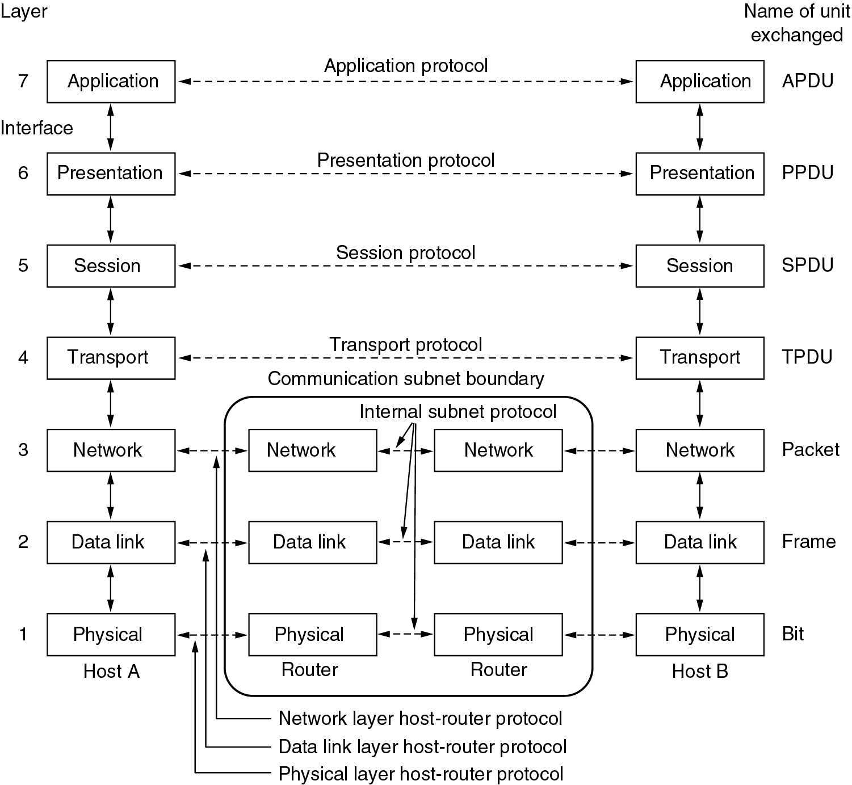
ISO/OSI 7-layer Reference Model
PDU: Protocol
Data Unit
Network protocol
Data link protocol
Physical layer protocol

Slide 31
Seven Layers (in brief)
Physical layer: Transmit raw bits over a physical medium
Data Link layer: Provide a (more or less) error-free transmission service for data frames over a shared medium
Network layer: Solve the forwarding and routing problem for a network
Transport layer: Provide (possibly reliable, in order) end-to-end communication, overload protection, fragmentation
Session layer: Group communication into sessions which can be synchronized, checkpointed, …
Presentation layer: Ensure that syntax and semantic of data is uniform between all types of terminals
Application layer: Actual application, e.g., protocols to transport web pages

Slide 32
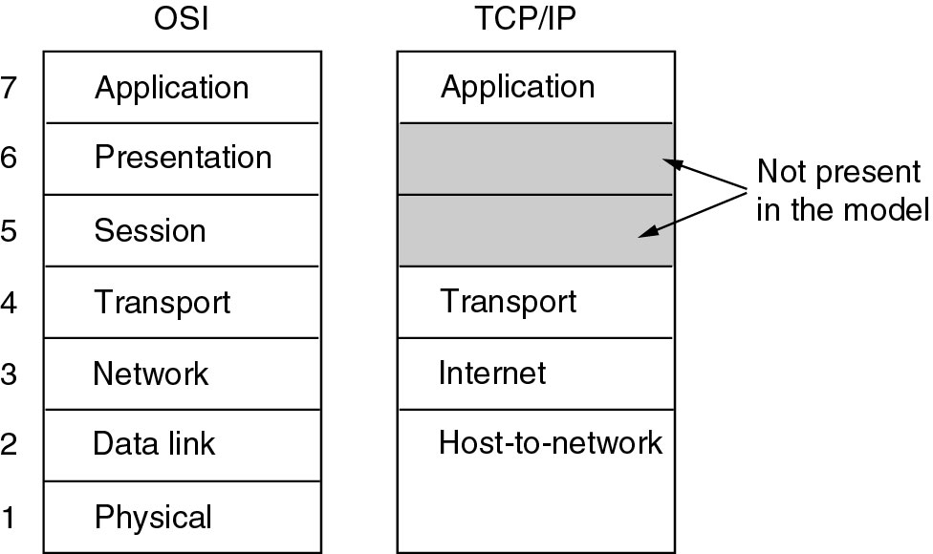
TCP/IP Protocol Stack
Nothing stated by TCP/IP model

Slide 33
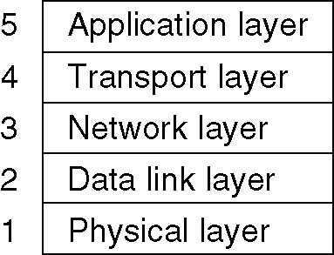
ISO/OSI versus TCP/IP
ISO/OSI: Very useful model, almost non-existing protocols
TCP/IP: Non-existing model, very useful protocols
Use simplified ISO/OSI model, but treat TCP/IP protocol stack in context of this model
With suitable add-ons especially for the lower layers

Slide 34
7 Layers with Intermediate System
End
system
End
system
Network
Layer 7
Application layer
Layer 7
Layer 6
Presentation layer
Layer 6
Layer 5
Session layer
Layer 5
Layer 4
Transport layer
Layer 4
Layer 3
Network layer
Layer 3
Layer 3
Network layer
Layer 3
Layer 2
Data link layer
Layer 2
Layer 2
Data link layer
Layer 2
Layer 1
Physical layer
Layer 1
Layer 1
Physical layer
Layer 1

Slide 35
Protocols and Messages
When using lower-layer services to communicate with remote peer, administrative data is usually included in those messages
Typical example:
Protocol receivers data from higher layer
Adds own administrative data (header/trailer)
Passes the extended message down to the lower layer
Receiver will receive original message plus administrative data
Packet arriving at Layer n+1’s SAP
Layer n+1
Layer n+1
Delivered by layer n
Extended packet passed to layer n
Layer n

Slide 36
Encapsulation of Data
AH Application Header
PH Presentation Header
SH Session Header
TH Transport Header
NH Network Header
DLH Data Link Header
DLT Data Link Trailer
User data
Application layer
AH
data
Application layer
sending
Presentation
layer
PH
data
receiving
Presentation
layer
Session layer
SH
data
Session layer
Transport
layer
TH
data
Transport
layer
Network
layer
NH
data
Network
layer
Data link layer
DLH
data
DLT
Data link layer
Physical layer
bits
Physical layer

Slide 37
Questions & Tasks
Layering – again! Where do you already know this from?
What is a protocol? What is a peer?
What is the idea of strict layering? Advantages/disadvantages?
What are the differences between TCP and UDP? Advantages/disadvantages?
Which layers just virtually transport data, which one does this in real?
Encapsulation comes with the layering – what are advantages and disadvantages?
Do you know encapsulation from systems outside computer networks?

Slide 38
Content
Networked Computer & Internet
Host-to-Network
Internetworking
Transport Layer
Applications
Network Security
Example

